Slide 1


Slide 2
Welcome to the NNA Investigators Meeting
Kelly Falkner
Director, NSF Office of Polar Programs
Robert B. Stone
Division Director, NSF Civil, Mechanical and Manufacturing Innovation Division
Kellina M. Craig-Henderson
Deputy Assistant Director, NSF Social, Behavioral, and Economic Sciences Directorate

Slide 3
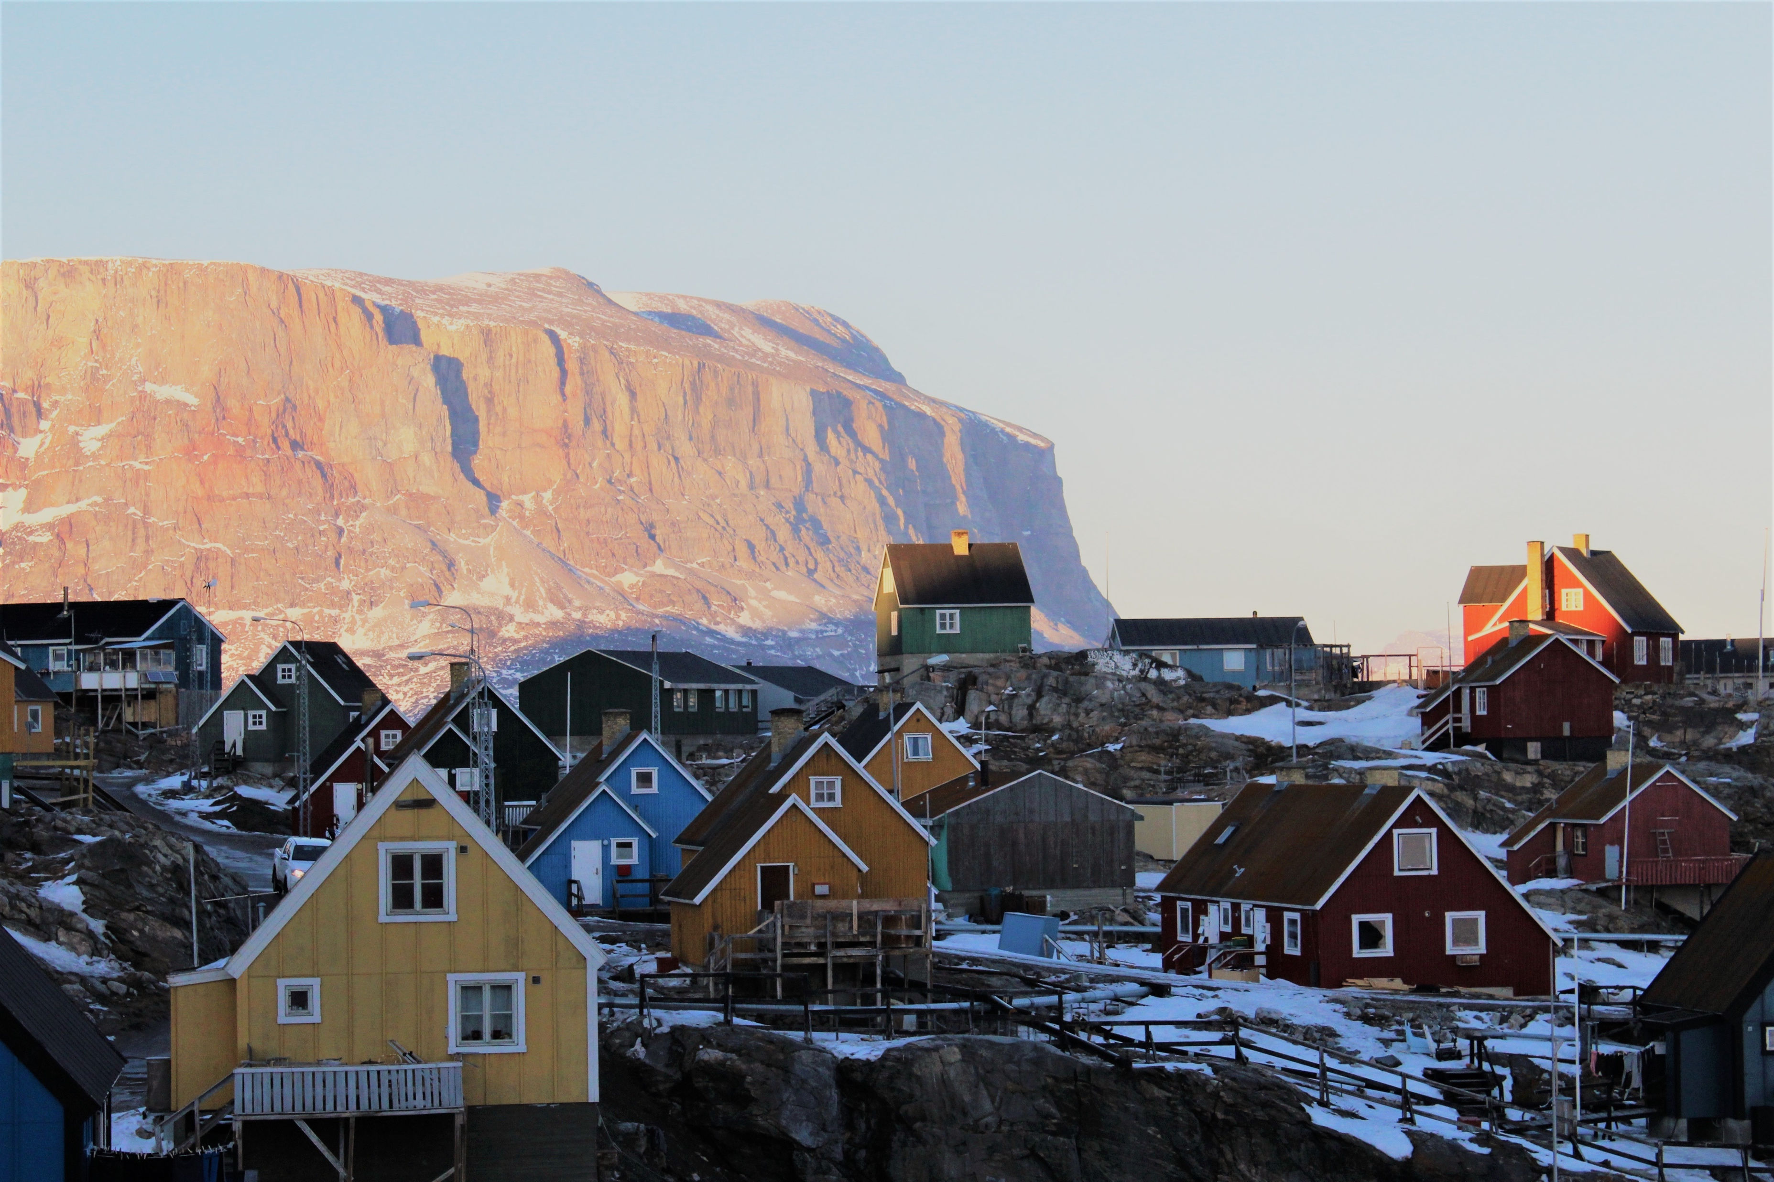

Navigating the New Arctic
Roberto Delgado and Kendra McLauchlan
Program Directors
National Science Foundation
Photo: Sarah Cooley/Brown University
Notes:
View of Uummannaq, Greenland (https://en.wikipedia.org/wiki/Uummannaq) (photo courtesy of Jonathan Ryan, Brown University)
Uummannaq is a town in central-western Greenland. Population around 1300. Hunting, fishing, canning, and marble quarry are important economic drivers. Heliport and seaport for access.

Slide 4
Introducing the NNA Working Group
Jesus Maurosa | Engineer, ENG/CMMI
Gregory Anderson | Program Director, GEO/OPP
Bradley Barker | Program Director, EHR/DRL
Roberto Delgado | Program Director, GEO/OPP
Irina Dolinskaya | Program Director, ENG/CMMI
Claire Hemingway | Program Manager, OD/OISE
Mark Hurwitz | Program Director, SBE/SES
Katia Kontar | AAAS S&TP Fellow, GEO/OPP
Kendra Mclauchlan | Program Director, BIO/DEB
Madeline Midyette | Program Assistant, GEO/OAD
Karl Rockne | Program Director, ENG/CBET
Kate Ruck | Contractor, GEO/OPP
John Schade | Program Director, BIO/DEB
Colleen Strawhacker | Program Director, GEO/OPP
Jielun Sun | Program Director, GEO/AGS
Kevin Thompson | Program Director, CISE/OAC
Jacqueline Vadjunec | Program Director, SBE/BCS
Kevin Webster | Program Support Manager, ENG/CMMI
Jonathan Wynn | Program Director, GEO/EAR
Margarida Yuan | Staff Associate, GEO/OAD

Slide 5
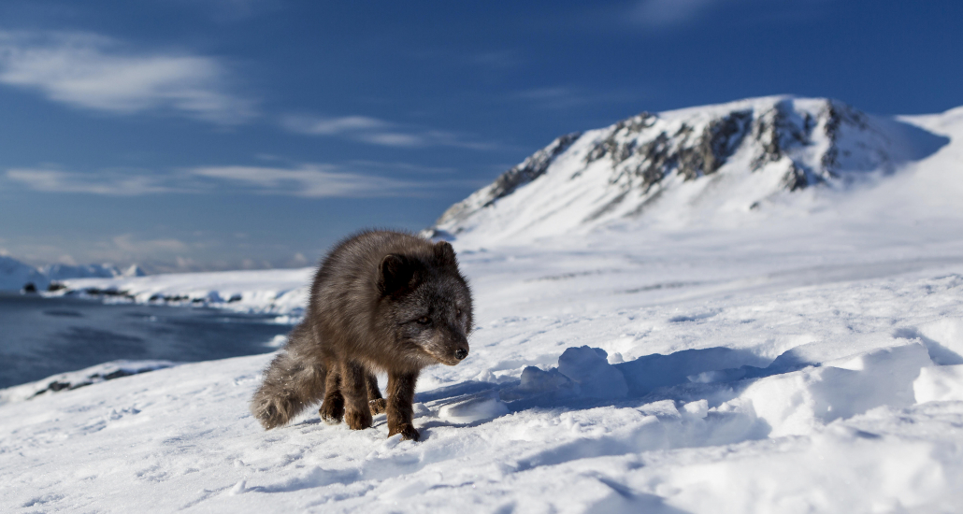
Opportunities
A sizeable increase in research funding available for Arctic science
New research communities are developing innovative ideas
Challenges
How do we connect diverse research communities for truly convergent research?
How do we ensure the influx of new science is not disruptive to Arctic residents? Or even better, that this new science is useful to Arctic communities?
Photo: Jon Leithe/Norwegian Polar Institute

Slide 6
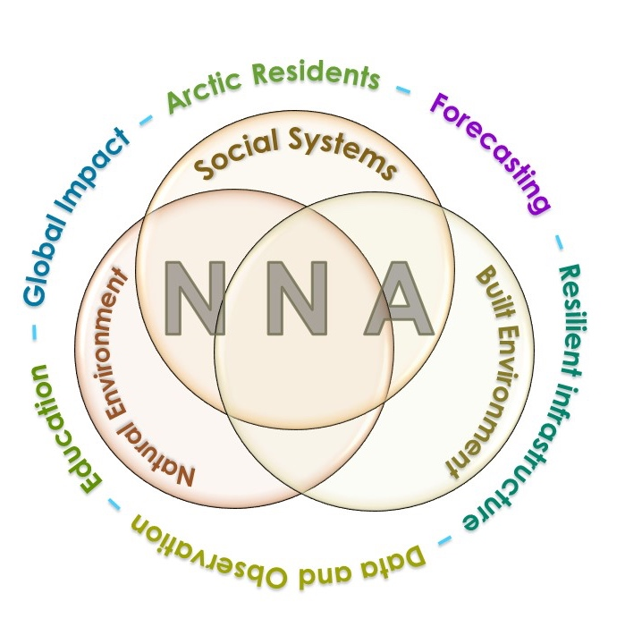
NNA FY20 Major Goals and Key Components
Improved understanding of Arctic change and its local and global effects
New and enhanced research communities that are diverse, integrative, and well-positioned to carry out NNA-relevant research
Research outcomes that inform U.S. national security, economic development, and societal well-being, and enable resilient, sustainable Arctic communities.
Enhanced efforts in formal and informal education focused on the multi-scale impacts of Arctic change and that broadly disseminate NNA research outcomes.

Slide 7
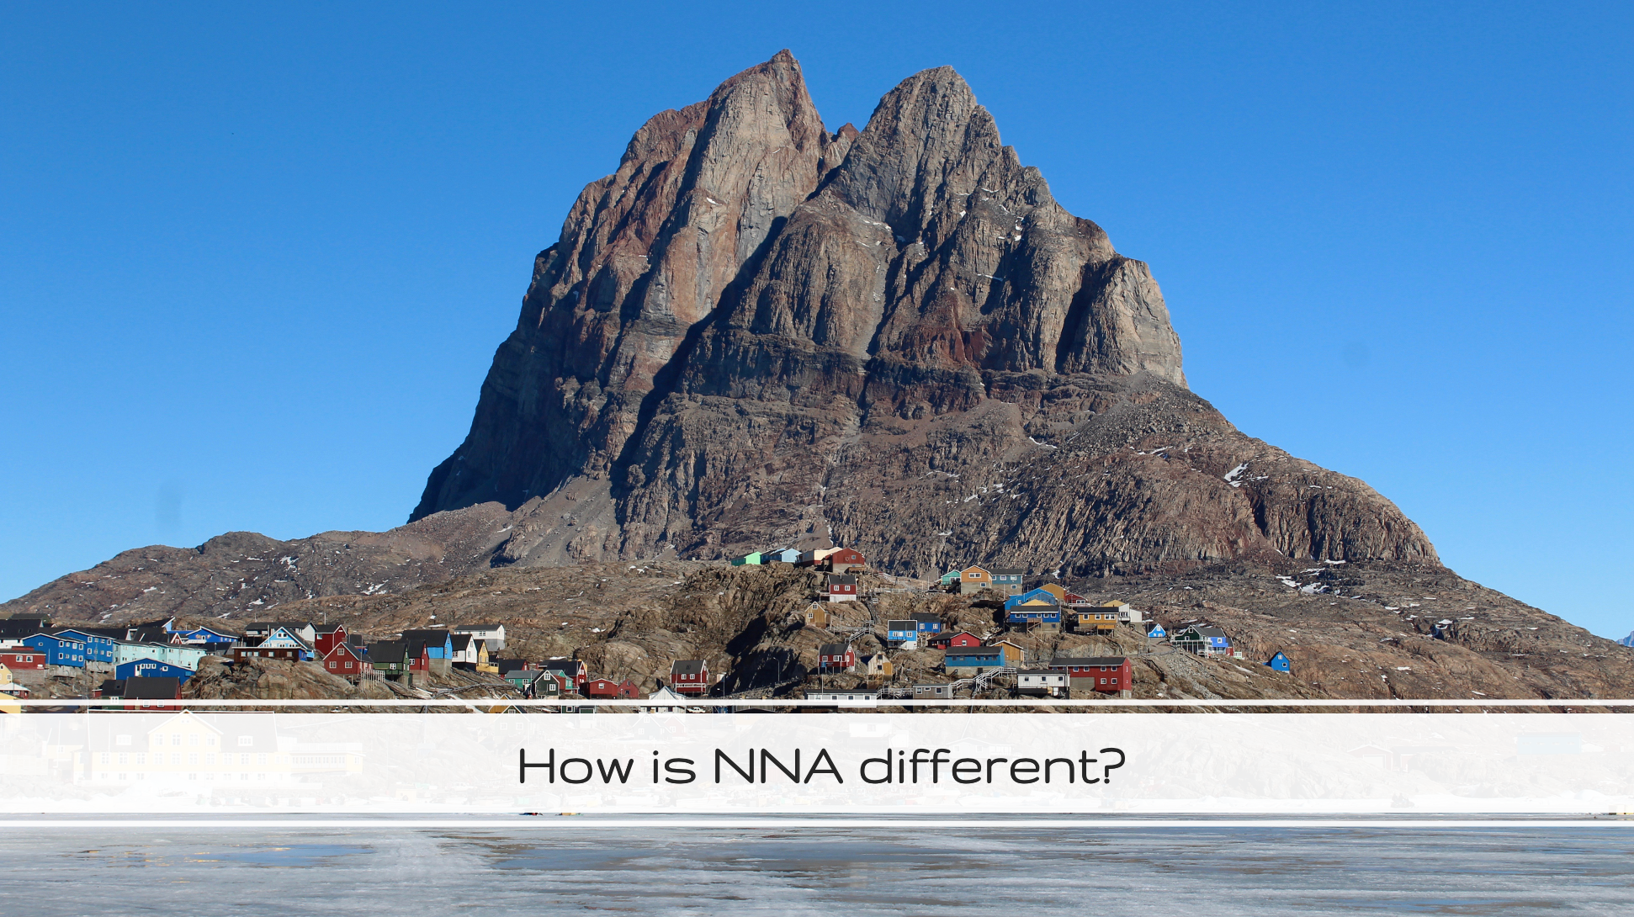
Photo: Sarah Cooley/Brown University
Notes:
===
View of Uummannaq, Greenland (https://en.wikipedia.org/wiki/Uummannaq) (photo courtesy of Jonathan Ryan, Brown University)

Slide 8
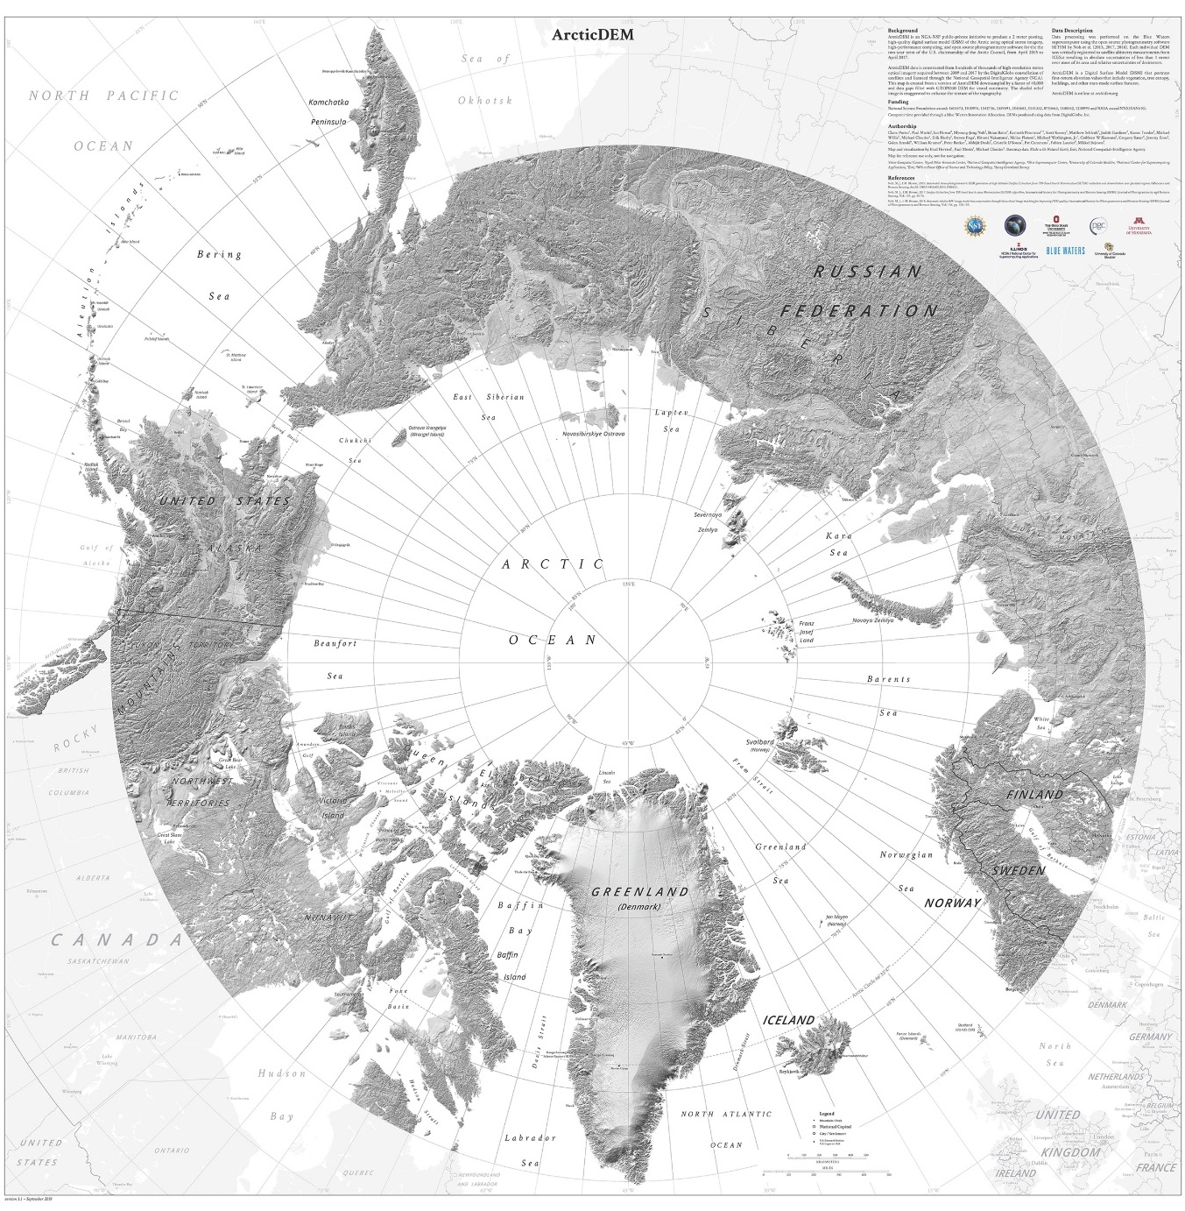
Crossing Boundaries
social system
built
environment
natural environment
Notes:
NNA crosses boundaries – geography, agency, intellectual
NNA involves nearly every research Directorate at NSF, OISE, and OIA.
NNA projects must focus on a question or questions in the overlap space between at least two circles of the Venn diagram

Slide 9

Meeting Goals
To accelerate the rate of dissemination of ideas among researchers
To build an intellectual research core to address NNA challenges
To enable enhanced research collaborations

Slide 10
NNA Investigators Meeting Overview
Day 1 Focus: Introductions and Peer Support
Introductions across our NNA Community
Opportunities for peer support and collaboration
Deepen understanding of Community and Convergence
Establish collaborative relationships
Day 2 Focus: Future Planning
Address current challenges
Learn from each other
Moving forward on data-sharing and the NNA Community Office
Q&A with community members

Slide 11

Meeting Housekeeping
Your Program Workbook
Time
Breakout Sessions
- Brief introductions: name, role & NNA project title
- Facilitator role
- Note-taker role
- Rapporteur role
- Opportunity to learn from each other
- Contributing
        open and constructive approach
        be willing to speak up
        share the ‘air-time’ – be focused and succinct
Report outs – 3 minutes per group

Slide 12
Day 1 Agenda
12:30-1:30pm ET – Session 1.1. Peer Support
1:30-2:00pm ET – BREAK
2:00-3:30pm ET – Session 1.2 Enhancing Collaboration Capacity
3:30-4:00pm ET – BREAK
4:00-5:30pm ET – Session 1.3 Report Outs & Plenary Discussion
5:45-6:45pm ET – Office Hours with Arctic Community Collaboration & Research Co-Production Advisors (Optional)
5:30-7:00pm ET – Virtual Happy Hour (Optional)

Slide 13

Peer Support Small Group Discussions
Desired Outcomes:
  Participants connect with other investigators and learn about their projects
  Investigators learn about NNA community challenges and explore how they can support one other in overcoming them.
  Individuals document common themes among their discussions that they can introduce in other meeting break-out discussions.
Notes:
  See the Session 1.1. Break-Out Session Guidance in your program book (pg 23)
  You will need to accept the invite to join the break-out room
  You will need to pick someone from your group to serve in the timekeeping role.
  The meeting host will send time reminders & bring you back to the main meeting room automatically at 1:25pm ET
  Click “Ask For Help” to request that the meeting host join you in the breakout room if you are having a problem
  Zoom chat will only send messages to other participants in your breakout room.

Slide 14

NNA Peer Support Activity: Process Steps
13 mins per individual peer challenge
Peer group members take turns asking questions to clarify their understanding
Step 3
Peer Group members take turns making suggestions/ recommendations to help the owner successfully address the challenge
Owner of Challenge spends 2 minutes succinctly explaining current challenge
Step 1
Step 2
2 mins
3 mins
8 mins
Move to next
Peer Challenge
and repeat process
Tips for success:
Keep information sharing, questions, responses and recommendations brief and succinct
Follow time guidelines
Record insights in personal Program Workbook
Save deeper discussion with peers on specific recommendations as a follow-on from NNA meeting
Breakout Group Facilitator/Timekeeper Role:
Monitor Time and Process
Notify group when it’s time to move to next step and next peer challenge.
Marion Smith – Elemental Consulting

Slide 15
BREAK-OUT IN PROGRESS:
Peer Support Activity
  See the Session 1.1 Break-Out Session Guidance in your Program Book (Pg 23)

Slide 16
Peer Support Small Group Discussions
Desired Outcomes:
  Participants connect with other investigators and learn about their projects
  Investigators learn about NNA community challenges and explore how they can support one other in overcoming them.
  Individuals document common themes among their discussions that they can introduce in other meeting break-out discussions.
BREAK-OUT SESSION WRAP-UP

Slide 17
The Navigating the New Arctic (NNA)
Investigators Meeting will be taking a break from 1:30-2:00pm ET
We will reconvene at 10am AK/ 11am PT/ 12pm MT/1pm CT/ 2pm ET

Slide 18
Session 1.2: Enhancing Collaboration Capacity

Slide 19
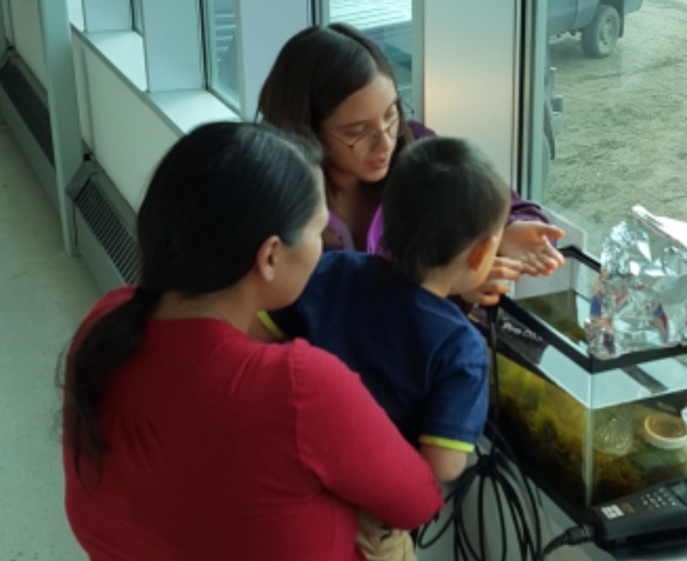
TWO THEMES:
Community = Working with Arctic Communities & Research Co-Production
Convergence = Overcoming Barriers to Convergent Arctic Research
Notes:
CONVERGENCE DEFINITION REMINDER:
NSF identifies Convergence Research as having two primary characteristics:
Research driven by a specific and compelling problem. Convergence Research is generally inspired by the need to address a specific challenge or opportunity, whether it arises from deep scientific questions or pressing societal needs.
Deep integration across disciplines. As experts from different disciplines pursue common research challenges, their knowledge, theories, methods, data, research communities and languages become increasingly intermingled or integrated. New frameworks, paradigms or even disciplines can form sustained interactions across multiple communities.
The convergence paradigm intentionally brings together intellectually-diverse researchers to develop effective ways of communicating across disciplines by adopting common frameworks and a new scientific language, which may, in turn, afford solving the problem that engendered the collaboration, developing novel ways of framing research questions, and opening new research vistas.
NOTE – THESE TWO THEMES DEFINITLY OVERLAP… HOWEVER, WE IMAGINE THAT INDIVIDUALS WHO CHOOSE TO TAKE PART IN THE CONVERGENCE BREAKOUT THEME MAY WISH TO EXPLORE A WIDER RANGE OF CHALLENGES TO NNA RESEARCH COLLABORATION (i.e. barriers to working across NNA project teams/ institution/diverse research programs/scientific disciplines/international borders, etc).

Slide 20
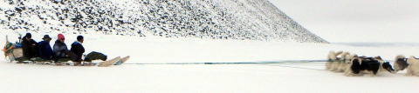
Session 1.2: Enhancing Collaboration Capacity
Community Focus Questions:
Convergence Focus Questions
What does co-production of knowledge mean to you &/or the other investigators on your NNA project team?
How can you apply the concept of reciprocity in the context of research?
What kinds of resources and support do you need (and/or does the NNA community/larger Arctic research community need) to engage in collaborative and co-productive research with Arctic communities?
What challenges do the NNA projects face with regard to working effectively across scientific disciplines to achieve the goal of research convergence?
What tools, techniques, or resources have been helpful in promoting successful research collaborations and how might they be applied to enhancing convergence outcomes across the NNA projects?
How can the NNA community work together to overcome the existing barriers to convergence research and/or broader collaboration?
What support could be provided to help investigators successfully initiate, engage in, and foster convergence research?
Notes:
Speaker: Marion
Note – there are some old questions in the session guidance. Use the agenda questions instead.

Slide 21
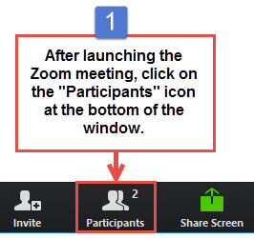
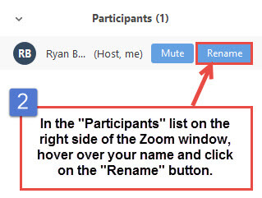
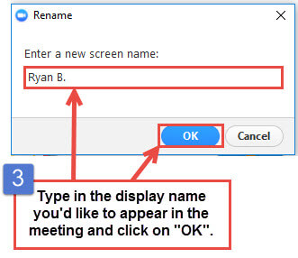
Please Assign Yourself to A Break-Out Theme By Changing Your Zoom Name
  To Join A “Community” Focused Break-Out, Add a 1 Before Your Name
  To Join A “Convergence” Focused Break-Out, Add a 2 Before Your Name
  If you are a Facilitator for this Session, Add a 3 Before Your Name
  If you are a phone-in only participant, please stay on the line & we will assist you
Background photo by Ute Kaden

Slide 22
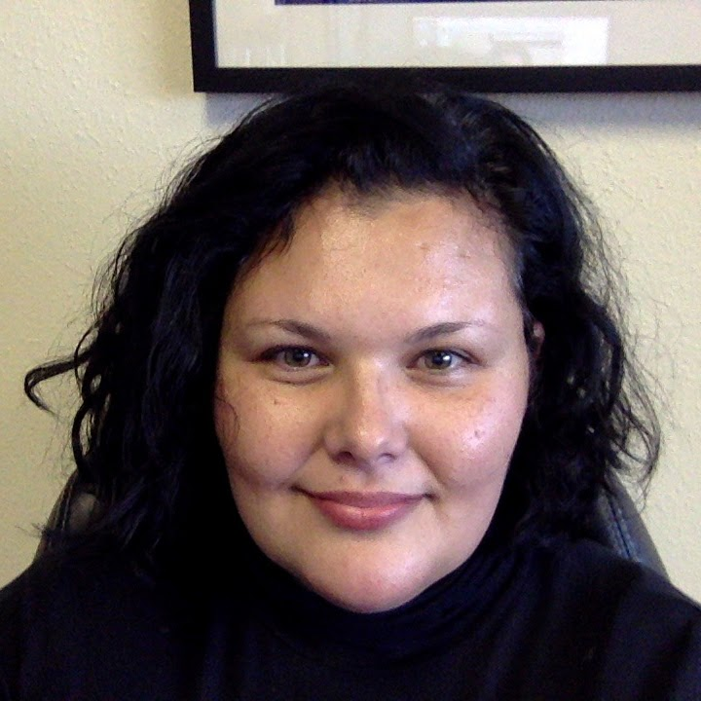
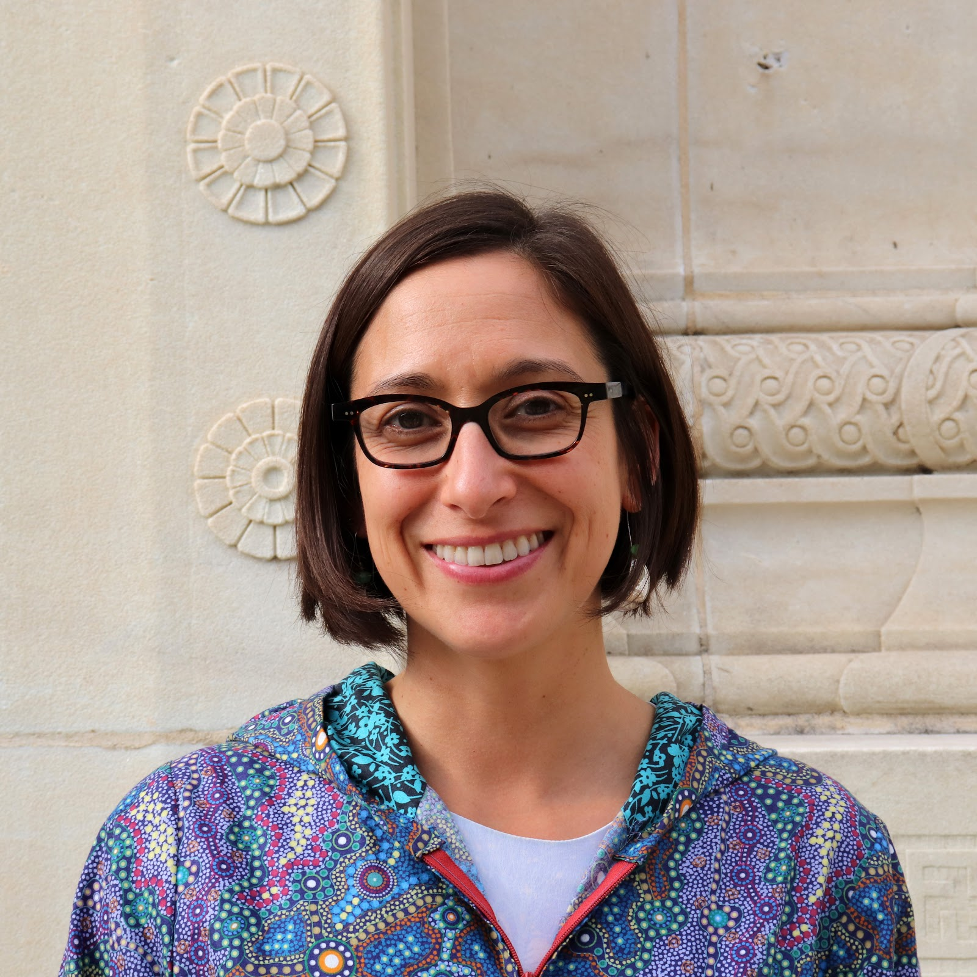
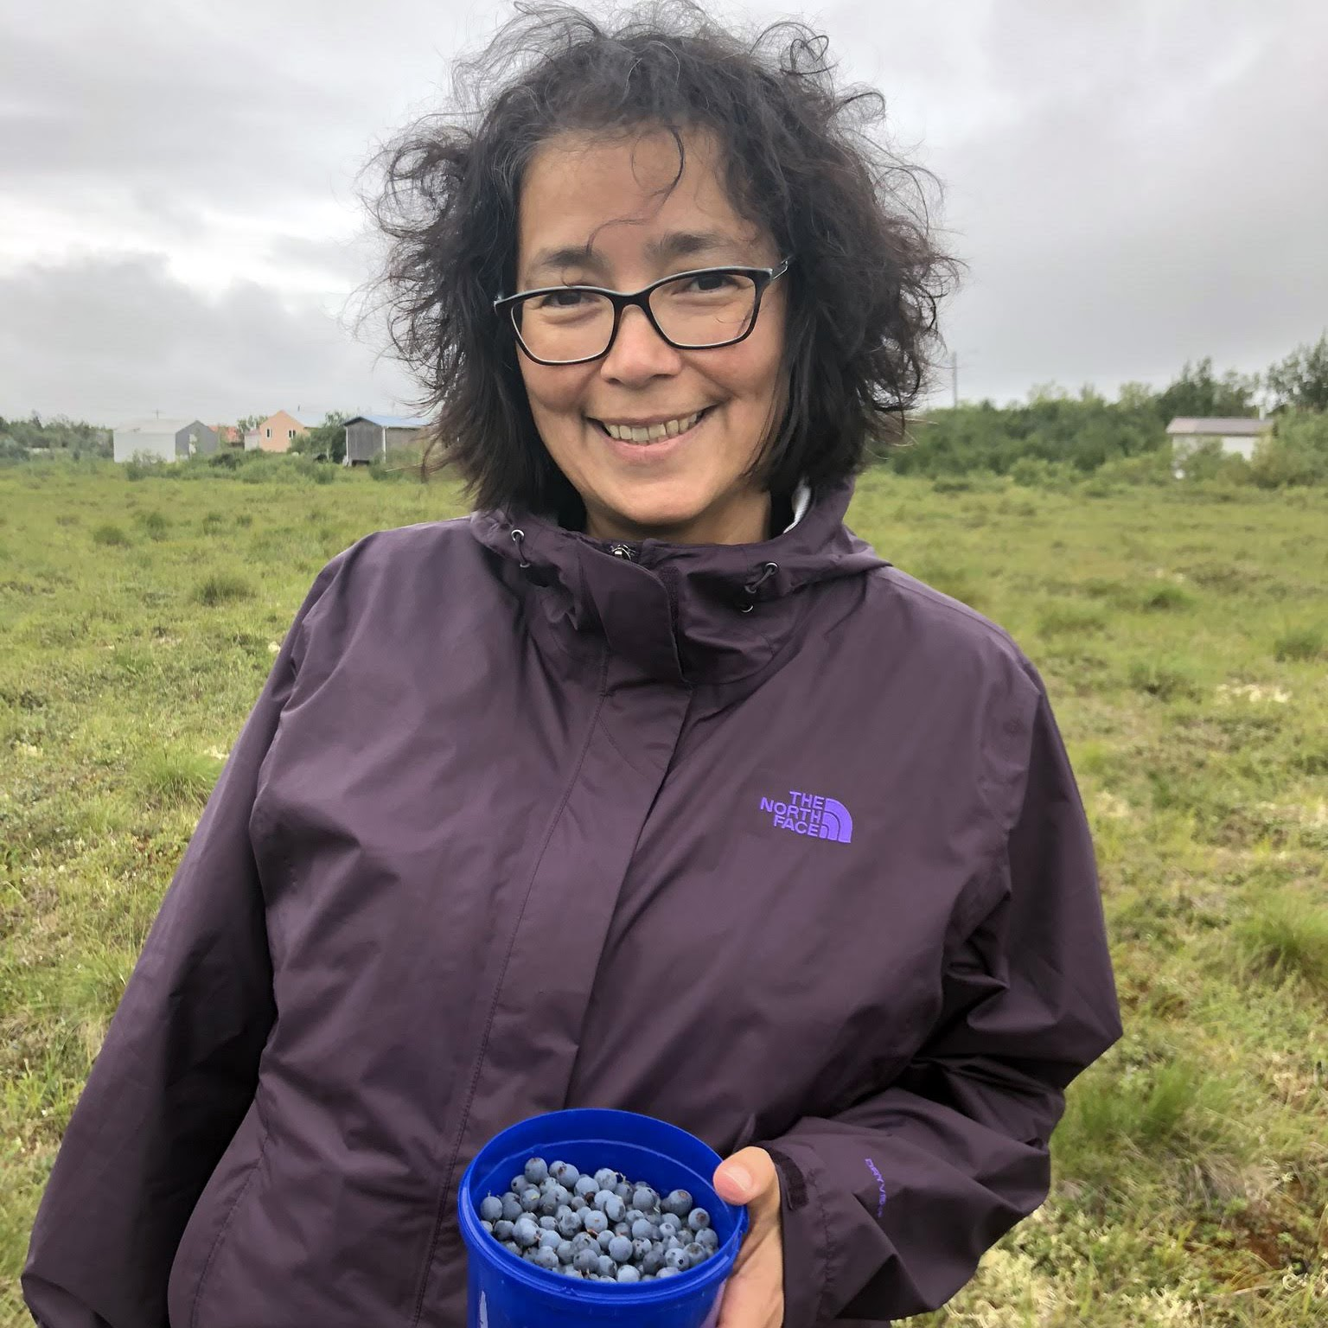
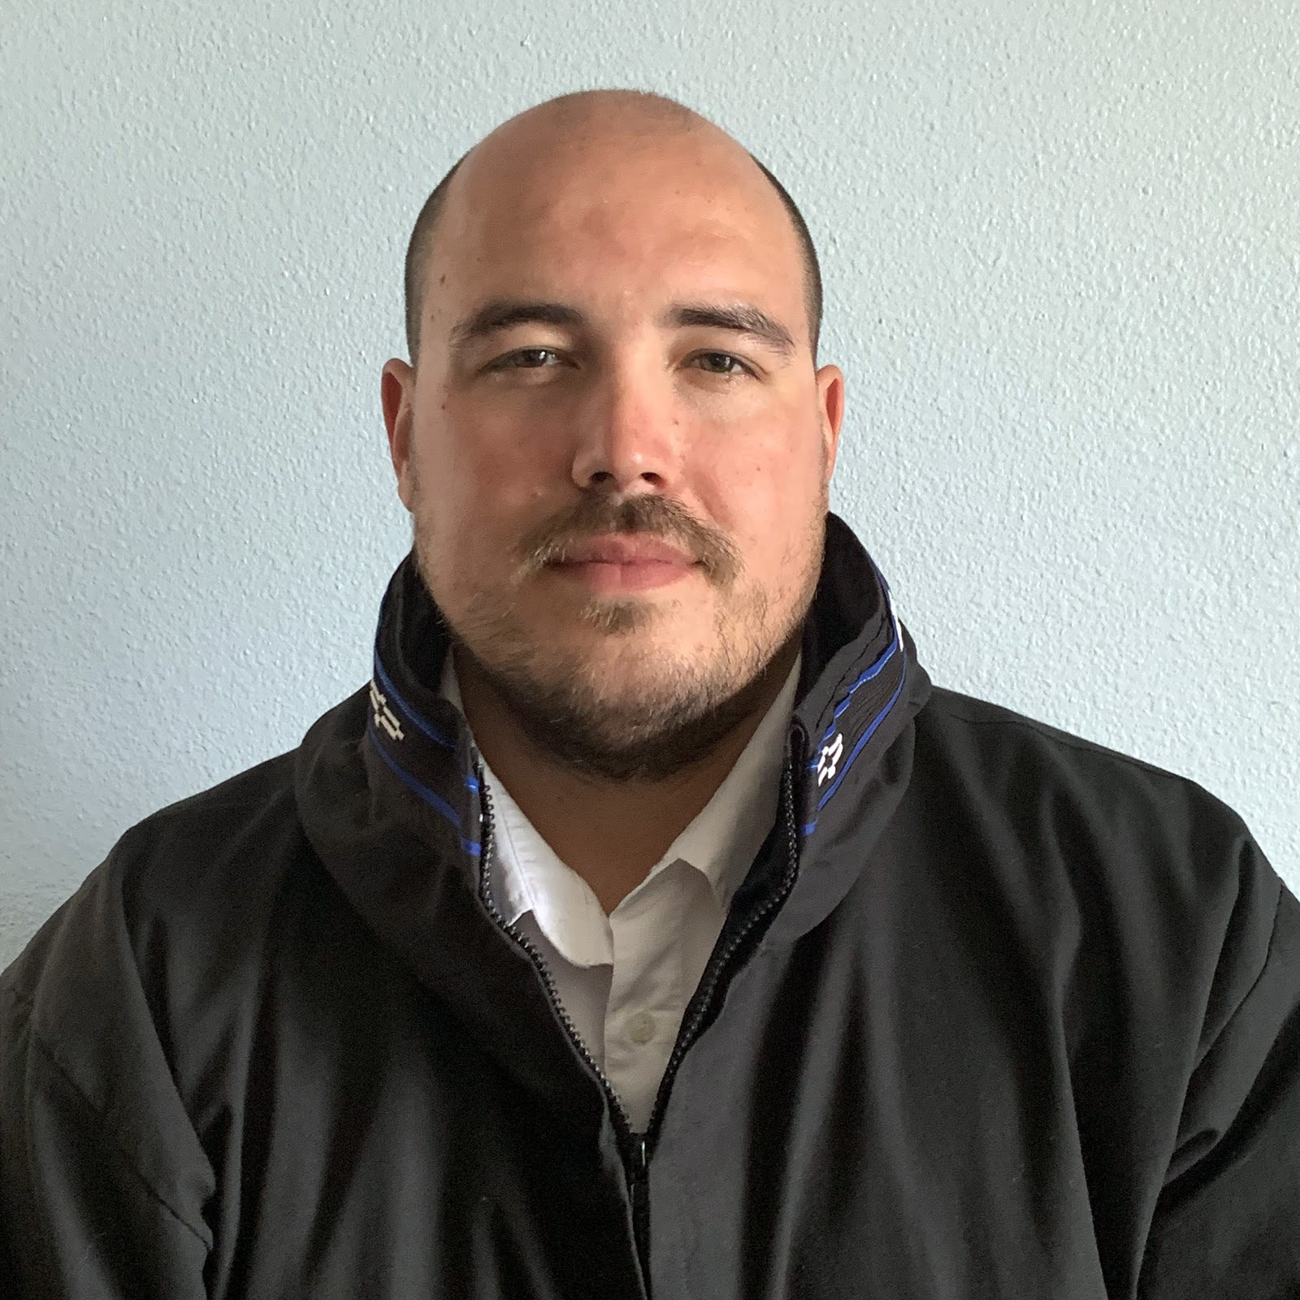
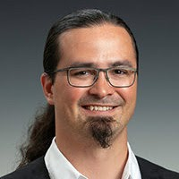
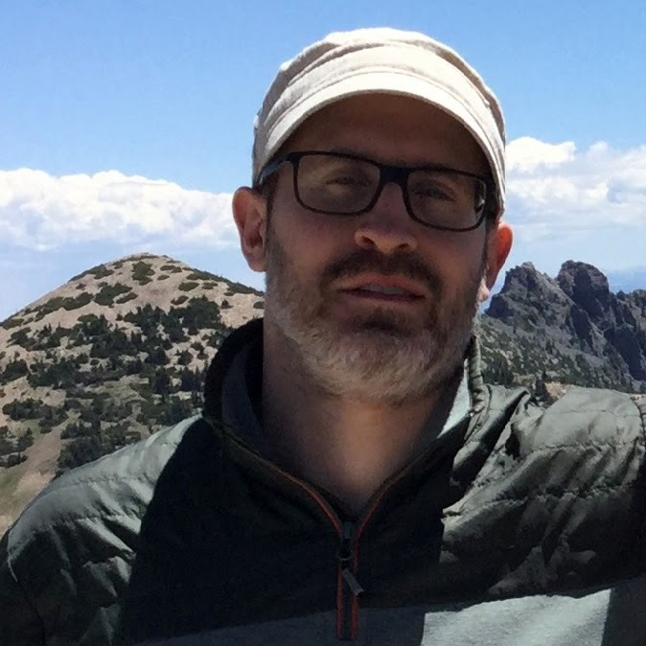
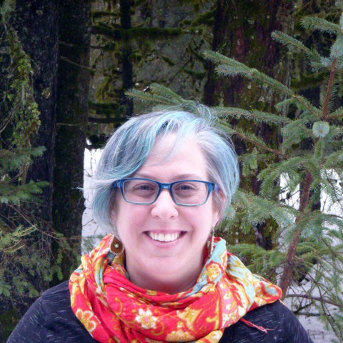
Arctic Community Collaboration &
Research Co-Production Advisors
Carolina Behe
Inuit Circumpolar Council Alaska
Nikoosh Carlo
CNC North Consulting
Raychelle Daniel
Pew Charitable Trusts
Kaare Sikuaq Erickson
UIC Science
Nagruk Harcharek
UIC Science
Brenden Raymond-Yakoubian
Sandhill.Culture.Craft
Julie Raymond-Yakoubian
Kawerak, Inc.

Slide 23
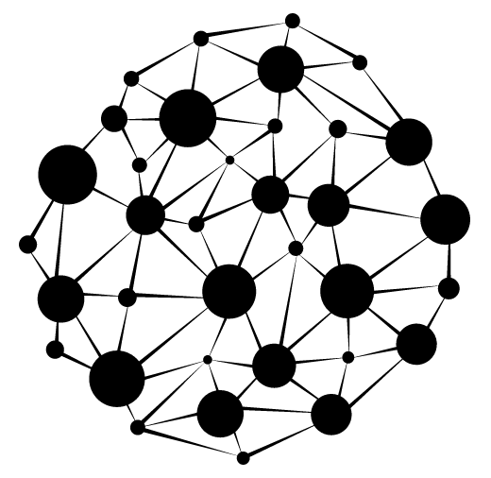
Session 1.2: Enhancing Collaboration Capacity
Desired Outcomes:
  Key discussion points from each break-out are captured by the group facilitator or a designated note-taker in a shared Google doc.
  Discussion highlights are synthesized by the break-out group rapporteur and shared during 3-minute presentations during the Session 1.3 plenary.
Notes:
  See the Session 1.2 Break-Out Session Guidance in your program book (pg 25)
  A facilitator has been assigned to assist you in this discussion
  Group rapporteurs will be responsible for a 3-minute report outs during the Session 1.3 plenary
  The host will send time reminders & bring you back to the main meeting room automatically at 3:25pm ET

Slide 24
BREAK-OUT IN PROGRESS: Enhancing Collaboration Capacity
  See the Session 1.2 Break-Out Session Guidance in your Program Book (Pg 25)

Slide 25
Session 1.2: Enhancing Collaboration Capacity
Desired Outcomes:
  Key discussion points from each break-out are captured by the group facilitator or a designated note-taker in a shared Google doc.
  Discussion highlights are synthesized by the break-out group rapporteur and shared during 3-minute presentations during the Session 1.3 plenary.
BREAK-OUT SESSION WRAP-UP

Slide 26
The Navigating the New Arctic (NNA)
Investigators Meeting will be taking a break from 3:30-4:00pm ET
We will reconvene at 12pm AK/ 1pm PT/ 2pm MT/3pm CT/ 4pm ET

Slide 27
Session 1.3: Report Outs & Plenary Discussion

Slide 28
Session 1.3: Report Outs and Plenary Discussion
Desired Outcome:
  Breakout group rapporteurs share 3-minute presentations of key insights from their discussions.
Report Out Process:
  Facilitator will invite each rapporteur to take 3 minutes to share key insights
  Rapporteurs should switch on their video and unmute their mic
  when their breakout room number is named
  Rapporteurs from the ‘Community’ group discussions in order of their breakout group number will be invited to share
  Rapporteurs from the ‘Convergence’ group discussions in order of their breakout group number will be invited to share

Slide 29
Break-Out Discussion Reports
Community Rapporteurs:
Convergence Rapporteurs
Group # 1: Ming Xiao
Group # 5: Julie Brigham-Grette
Group #11: Andy Mahoney
Group #12: Jana Peirce
Group #14: Melissa Chipman
Group #16: Don Anderson
Group #17: Courtney Carothers
Group #2: Mark Serreze
Group #3: Andrey Petrov
Group #6: Xueke Li
Group #7: Ruth Varner
Group #15: Anne Garland
Group #18: Natalie Boelman

Slide 30


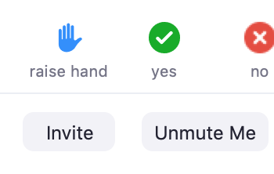
Q & A / Discussion
To participate in this Q & A/Discussion period, you may either type your questions in the chat box or click the “Raise Hand” icon.
The host will select and read questions typed into the chat box.
When raising your hand, the host will call on you and you may unmute yourself and ask your question.
If you are calling-in, please unmute by dialing *6
Please identify yourself & who you are directing your question to.
Click the Participants icon
Click the “Raise Hand” icon on the Participant window
Click “Unmute Me” when the host calls on you

Slide 31
Break-Out Discussion Reports
Community Rapporteurs:
Convergence Rapporteurs
Group # 1: Ming Xiao
Group # 5: Julie Brigham-Grette
Group #11: Andy Mahoney
Group #12: Jana Peirce
Group #14: Melissa Chipman
Group #16: Don Anderson
Group #17: Courtney Carothers
Group #2: Mark Serreze
Group #3: Andrey Petrov
Group #6: Xueke Li
Group #7: Ruth Varner
Group #15: Anne Garland
Group #18: Natalie Boelman

Slide 32
Q & A / Discussion
To participate in this Q & A/Discussion period, you may either type your questions in the chat box or click the “Raise Hand” icon.
The host will select and read questions typed into the chat box.
When raising your hand, the host will call on you and you may unmute yourself and ask your question.
If you are calling-in, please unmute by dialing *6
Please identify yourself & who you are directing your question to.
Click the Participants icon
Click the “Raise Hand” icon on the Participant window
Click “Unmute Me” when the host calls on you

Slide 33
Session 1.3: Report Outs & Plenary Discussion
Desired Outcome:
  Breakout group rapporteurs share 3-minute presentations of key insights from their discussions.
BREAK-OUT SESSION WRAP-UP

Slide 34
Office Hours with Arctic Community Collaboration
& Research Co-Production Advisors
Raychelle Daniel
Pew Charitable Trusts
Kaare Sikuaq Erickson
UIC Science
Julie Raymond-Yakoubian
Kawerak, Inc.
When
Today: 5:45-6:45pm ET
Tomorrow: 10:45am-11:45am ET
Where
Zoom url: https://zoom.us/j/9074501600 (Program Book Pg. 20)
(NOTE: this is a different Zoom url that we are using for the NNA meeting)

Slide 35
NNA Virtual Meeting
Happy Hour Hangout
We will keep this Zoom space open until 7pm ET if anyone would like to stay a little longer (or come back after a break) to socialize informally!
Notes:
\

Slide 36
This Concludes Day 1 of the Navigating the New Arctic (NNA) Investigators Meeting
We will reconvene tomorrow at 8am AK/9am PT/10am MT/11am CT/12pm ET

Slide 37
NNA Virtual Meeting
Happy Hour Hangout
We will keep this Zoom space open until 7pm ET if anyone would like to stay a little longer (or come back after a break) to socialize informally!

Slide 39
Day 2: Future Planning
Address current challenges
Learn from each other
Moving forward on data-sharing and the NNA Community Office
Q&A with community members

Slide 40
Day 2 Agenda
12:00-1:30pm ET – Session 2.1 Addressing Current Challenges
1:30-2:00pm ET – BREAK
2:00-3:30pm ET – Session 2.2 Break-Out Group Reports & Plenary
3:30-4:00pm ET – BREAK
4:00-5:30pm ET – Session 2.3 Data Sharing & NNA Community Office

Slide 41
Meeting Housekeeping
Your Program Workbook
Time
Breakout Sessions
- Brief introductions: name, role & NNA project title
- Facilitator role
- Note-taker role
- Rapporteur role
- Opportunity to learn from each other
- Contributing
        open and constructive approach
        be willing to speak up
        share the ‘air-time’ – be focused and succinct
Report outs – 3 minutes per group

Slide 42
NNA Investigators Meeting
Reflections and Insights from Day 1
Community Theme
Engagement & Co-Production along a Continuum:
Drivers, Principles, & Goals
Convergence Theme
Diverse Perspectives; Beyond Academia;
Methods & Data; Evaluation
Shared Attributes of Enhancing Collaborative Capacity
Notes:
Speaker: Roberto
To be developed the evening of Thursday, 16 April or morning of Friday, 17 April. Marion will present in lieu of Katia. Summary of the key takeaways and lessons learned from the Enhancing Collaboration Capacity Session

Slide 43
Focus on Future Planning
COVID-19
Data Management
November Meeting Goals

Slide 44
Session 2.1: Addressing Current Challenges

Slide 45

Session 2.1: Addressing Current Challenges
Focus Questions:
How has COVID-19 disrupted your project or field research plans? How are you finding ways to adapt that could be relevant to others in the NNA community?
Do COVID-19 disruptions present any opportunities for the NNA community to do things differently or to strengthen collaborations?
How can you apply what you know/are learning about co-production and collaboration to this COVID19 situation? (i.e. in terms of relationship building, on the ground collaborations with communities when field work is cancelled or uncertain, using this as an opportunity to create longer-term modifications to how research is done, etc.)
What could the NNA community achieve together over the next six months to a year given the current challenges and circumstances?
How can these activities/actions serve as a stepping stone to what the NNA community might achieve together over the next 5+ years?

Slide 46
Session 2.1: Addressing Current Challenges
Desired Outcomes:
Key discussion points from each break-out are captured by the group facilitator or a designated note-taker in a shared Google Doc.
Discussion highlights are synthesized by the break-out group rapporteur so they can be shared during 3-minute presentations during the Session 2.2 plenary.
Notes:
  See the Session 2.1 Break-Out Session Guidance in your program book (pg 27)
  A facilitator has been assigned to assist you in this discussion
  Group rapporteurs will be responsible for a 3-minute report outs during the Session 2.2 plenary
  The host will send time reminders & bring you back to the main meeting room automatically at 1:25pm ET

Slide 47
BREAK-OUT IN PROGRESS: Addressing Current Challenges
  See the Session 2.1 Break-Out Session Guidance in your Program Book (Pg 27)

Slide 48
Session 2.1: Addressing Current Challenges
Desired Outcomes:
Key discussion points from each break-out are captured by the group facilitator or a designated note-taker in a shared Google Doc.
Discussion highlights are synthesized by the break-out group rapporteur so they can be shared during 3-minute presentations during the Session 2.2 plenary.
BREAK-OUT SESSION WRAP-UP

Slide 49
The Navigating the New Arctic (NNA)
Investigators Meeting will be taking a break from 1:30-2:00pm ET
We will reconvene at 10am AK/ 11am PT/ 12pm MT/1pm CT/ 2pm ET

Slide 50
Session 2.2: Report Outs & Plenary Discussion

Slide 51
Session 2.2: Report Outs & Plenary Discussion
Desired Outcomes:
  Breakout group rapporteurs share 3-minute presentations of key insights from their discussions on Addressing Current Challenges
Report Out Process:
  Facilitator will invite each rapporteur to take 3 minutes to share key insights
  Rapporteurs should switch on their video and unmute their mic
  when their breakout room number is named
  Rapporteurs will be invited to share in order of their breakout group number
Notes:
Speaker: Marion

Slide 52
Break-Out Discussion Reports
Rapporteurs:
Rapporteurs
Group #1: Peter De Carlo
Group #2: Dima Streletskiy
Group #3: Mary Albert
Group #4: Aaron Poe
Group #5: Ann Tickamyer
Group #6: Johnny Ryan
Group #7: Bruce Vaughn
Group #8: David Emerson
Group #11: Kirsty Tinto
Group #12: Evie Fachon
Group #13: Ted Maksym
Group #14: Thomas Ravens
Group #15: Mark Serreze
Group #16: Matt Druckenmiller
Group #17: Kaare Erickson
Group #18: Tom Sharkey

Slide 53
Q & A / Discussion
To participate in this Q & A/Discussion period, you may either type your questions in the chat box or click the “Raise Hand” icon.
The host will select and read questions typed into the chat box.
When raising your hand, the host will call on you and you may unmute yourself and ask your question.
If you are calling-in, please unmute by dialing *6
Please identify yourself & who you are directing your question to.
Click the Participants icon
Click the “Raise Hand” icon on the Participant window
Click “Unmute Me” when the host calls on you

Slide 54
Break-Out Discussion Reports
Rapporteurs:
Rapporteurs
Group #1: Peter De Carlo
Group #2: Dima Streletskiy
Group #3: Mary Albert
Group #4: Aaron Poe
Group #5: Ann Tickamyer
Group #6: Johnny Ryan
Group #7: Bruce Vaughn
Group #8: David Emerson
Group #11: Kirsty Tinto
Group #12: Evie Fachon
Group #13: Ted Maksym
Group #14: Thomas Ravens
Group #15: Mark Serreze
Group #16: Matt Druckenmiller
Group #17: Kaare Erickson
Group #18: Tom Sharkey

Slide 55
Q & A / Discussion
To participate in this Q & A/Discussion period, you may either type your questions in the chat box or click the “Raise Hand” icon.
The host will select and read questions typed into the chat box.
When raising your hand, the host will call on you and you may unmute yourself and ask your question.
If you are calling-in, please unmute by dialing *6
Please identify yourself & who you are directing your question to.
Click the Participants icon
Click the “Raise Hand” icon on the Participant window
Click “Unmute Me” when the host calls on you

Slide 56
Session 2.2: Report Outs & Plenary Discussion
Desired Outcomes:
  Breakout group rapporteurs share 3-minute presentations of key insights from their discussions on Addressing Current Challenges
PLENARY SESSION WRAP-UP

Slide 57
The Navigating the New Arctic (NNA)
Investigators Meeting will be taking a break from 3:30-4:00pm ET
We will reconvene at 12pm AK/ 1pm PT/ 2pm MT/3pm CT/ 4pm ET

Slide 58
Session 2.3: Data Sharing &
NNA Community Office

Slide 59

Session 2.3: Data Sharing
& NNA Community Office
Focus Questions:
What strategies for data sharing across the project teams are needed?
What kinds of data/information do projects currently need to move their work forward?
What additional data/information would be useful to help the NNA community produce new knowledge together?
What other tools, activities, support services, etc. would the NNA Investigator community like to see implemented by the new NNA coordination office?
How can the community stay connected and continue working together before the NNA coordination office is in place?
What would you like to see happen at the next NNA community meeting being planned for the fall.

Slide 60
Session 2.3: Data Sharing
& NNA Community Office
Desired Outcomes:
Key discussion points from each break-out are captured by the group facilitator or a designated note-taker in a shared Google Doc.
Break-out group rapporteurs share top take-away from their discussion with all meeting participants via Zoom chat.
Notes:
  See the Session 2.3 Break-Out Session Guidance in your program book (pg 28)
  A facilitator has been assigned to assist you in this discussion
  The host will send time reminders & bring you back to the main meeting room automatically at 5:05pm ET

Slide 61
BREAK-OUT IN PROGRESS:
Data Sharing & NNA Community Office
  See the Session 2.3 Break-Out Session Guidance in your Program Book (Pg 28)

Slide 62
Session 2.3: Data Sharing
& NNA Community Office
Desired Outcomes:
Key discussion points from each break-out are captured by the group facilitator or a designated note-taker in a shared Google Doc.
Break-out group rapporteurs share top take-away from their discussion with all meeting participants via Zoom chat.
BREAK-OUT SESSION WRAP-UP

Slide 63
RESPONSE TO KEY TAKE-AWAY POINTS

Slide 64

What’s Next for the NNA Ecosystem?
ARCUS
  Meeting evaluation next week
  Virtual meeting report shared with all NNA Investigators
  Virtual meeting plenary recordings shared with all NNA Investigators
  New hub of webpages for the NNA projects to be developed
NSF
  New 2020 NNA awards announced
  Community Office selected
  Develop plans for the NNA Program
  Continue outreach
NNA Investigators
  Continue progress on projects
  Keep training and mentoring
  NNA Slack workspace to remain open & active
Community Members
NNA Investigator meeting in November

Slide 65
THANK YOU!!

