Slide 1
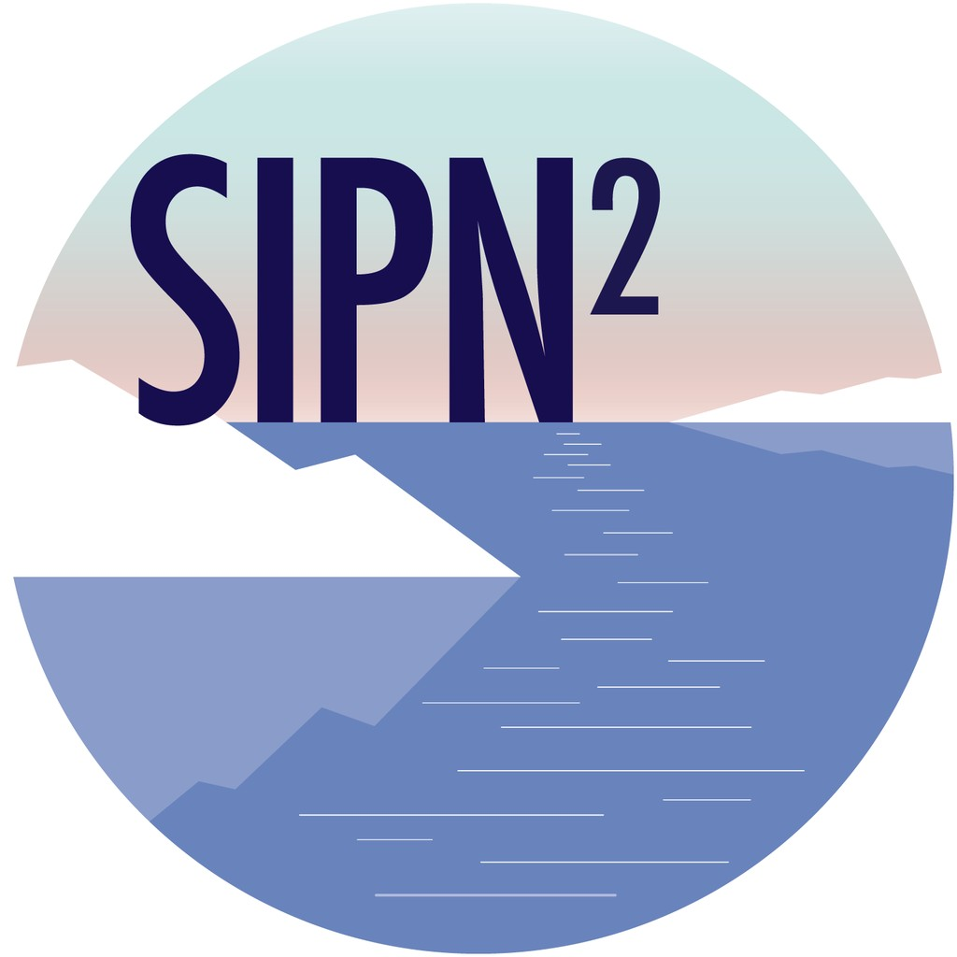
SIPN2 AGU Meeting 2018: Community Round-Robin
    Order of Presentations
    NSIDC-CDR data Ge Peng
    Sea ice melt/freeze Angela Bliss
    Statistical Modeling Dmitri Kondrashov
    GFDL Models Mitch Bushuk
    NASA0 GMAO Andrea Molod
    Melt-pond Randy Scharien
    UW SiPN2 portal Nic Wayand
    THINICE Cecilia Bitz
    AWI APPLICATE Luisa Cristini
    PMEL/UW Saildrons Calvin Mordy

Slide 2
SIPN2 AGU Meeting 2018: Community Round-Robin
Scientific Stewardship of NOAA/NSIDC Sea Ice Concentration CDR
    The effort is on improving usability of the dataset by providing evaluation and validation results, and spatial and temporal characterizations (e.g., Meier et al. 2014, Polar Research; Peng and Meier 2017, Annals of Glaciology).
    Key highlight: NOAA NCEI (National Centers for Environmental Information) has included 16 sub-Arctic regions in its monthly sea ice monitoring services.
    Seeking collaboration: Times series of monthly sea ice extent computed from climate model simulations and projections (e.g., Stroeve et al. 2012, Geophys. Res. Lett.) for statisticians to utilize machine learning techniques, building on Peng et al. 2018, Remote Sensing.
    Contact info: Ge Peng; NC State University/NCEI; Ge.Peng@noaa.gov; +1 (828) 257–3009 (o)
(Peng et al. 2016, D-Lib Magazine)

Slide 3
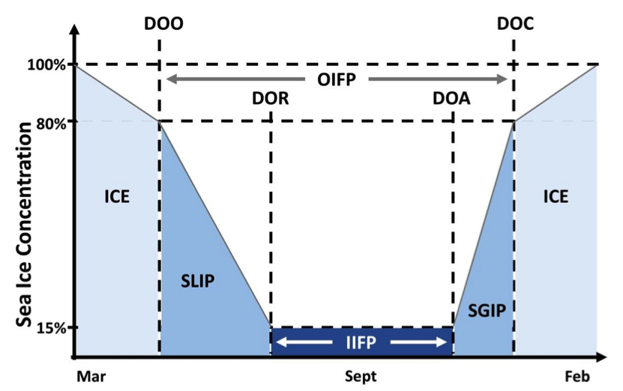
SIPN2 AGU Meeting 2018: Community Round-Robin
Arctic sea ice seasonal change and melt/freeze
climate indicators from satellite data
  The evolution of the annual Arctic sea ice seasonal cycle is summarized for stakeholders
    Dates of sea ice opening, retreat, advance, and closing from sea ice concentrations
    Melt and freeze onset dates from brightness temperatures
    1979 - 2016
  Dataset coming soon to NSIDC
      Steele et al. (2018); doi: 10.5067/KINANQKEZI4T
  Find out more at posters on Friday AM
    C51D-1101: Pan-Arctic Analysis (Peng)
    C51D-1096: Regional Analysis (Mike)
Mike Steele, Angela Bliss*, Ge Peng, Walt Meier, & Suzanne Dickinson
[Peng et al., 2018]
*Contact: blissan@oregonstate.edu
Notes:
Peng, G., M. Steele, A. C. Bliss, W. N. Meier, S. Dickinson (2018), Temporal Means and Variability of Arctic Sea Ice Melt and Freeze Season Climate Indicators Using a Satellite Climate Data Record, Remote Sensing, 10(1328). https://doi.org/10.3390/rs10091328

Slide 4
1-slide, 1-minute summary
SIPN2 AGU Meeting 2018: Community Round-Robin
Data-driven Modeling and Prediction of Arctic Sea Ice
    Dmitri Kondrashov, dkondras@atmos.ucla.edu
    http://research.atmos.ucla.edu/tcd//dkondras/Arctic_Sea_Ice.html
    Using advanced statistical modeling techniques and observations to predict sea ice extent over large Arctic regions on subseasonal-to-seasonal time scales.
    The average of real-time summertime (June, July, August) Sea Ice Outlooks was within 0.2M km2 of the observed September pan-Arctic Sea Ice Extent for three years in a row, 2016—2018.
    Seek partners in/for a project to extend this effort to finer temporal and spatial scales by including relevant atmospheric and oceanic datasets, as well as other sea ice variables.
    Kondrashov, D., M. D. Chekroun, and M. Ghil, 2018: Data-adaptive harmonic decomposition and prediction of Arctic sea ice extent, Dynamics and Statistics of the Climate System, 3(1), 1, doi:10.1093/climsys/dzy001.

Slide 5
1-slide, 1-minute summary
SIPN2 AGU Meeting 2018: Community Round-Robin
Seasonal Sea Ice Prediction Efforts at the NOAA Geophysical Fluid Dynamics Laboratory (GFDL)
    Producing quasi-operational seasonal sea-ice predictions on the first of each month with GFDL-FLOR and GFDL-CM2.1. Submitting predictions each month to the SIPN2 portal as well as the September Sea Ice Outlook.
    Current research focus on:
      Regional Arctic sea ice: Inherent predictability and operational prediction skill
      Ocean and sea ice data assimilation, observing system experiments (Talk: Wed 11:05-11:20am, Salon G, 399457)
    Currently developing next generation seasonal prediction system based on GFDL-CM4 model components
    We are interested in doing detailed comparisons with other prediction systems! E-mail: mitchell.bushuk@noaa.gov
Target Month: September; Lead: 2
2018 Observed
ACC = 0.90
Detrended ACC = 0.63

Slide 6


1-slide, 1-minute summary
SIPN2 AGU Meeting 2018: Community Round-Robin
NASA Global Modeling and Assimilation Office (GMAO)
    The GMAO uses coupled Earth-System models and data assimilation techniques to study and predict phenomena that evolve on seasonal to decadal timescales, and to enhance NASA's program of Earth Observations.
    A new version of the GEOS system has been developed that includes 2-moment cloud microphysics, a new shallow-convective cloud scheme, a new ocean-atmosphere interface layer, improved bathymetry, sea surface salinity assimilation, and enhanced ensemble generation.
    We seek to identify new data sources for forecast initialization, and a characterization of uncertainty in current data sources.
    Our website, https://gmao.gsfc.nasa.gov/seasonal/, Andrea.Molod@nasa.gov, Richard.Cullather@nasa.gov, Bin.Zhao@nasa.gov

Slide 7
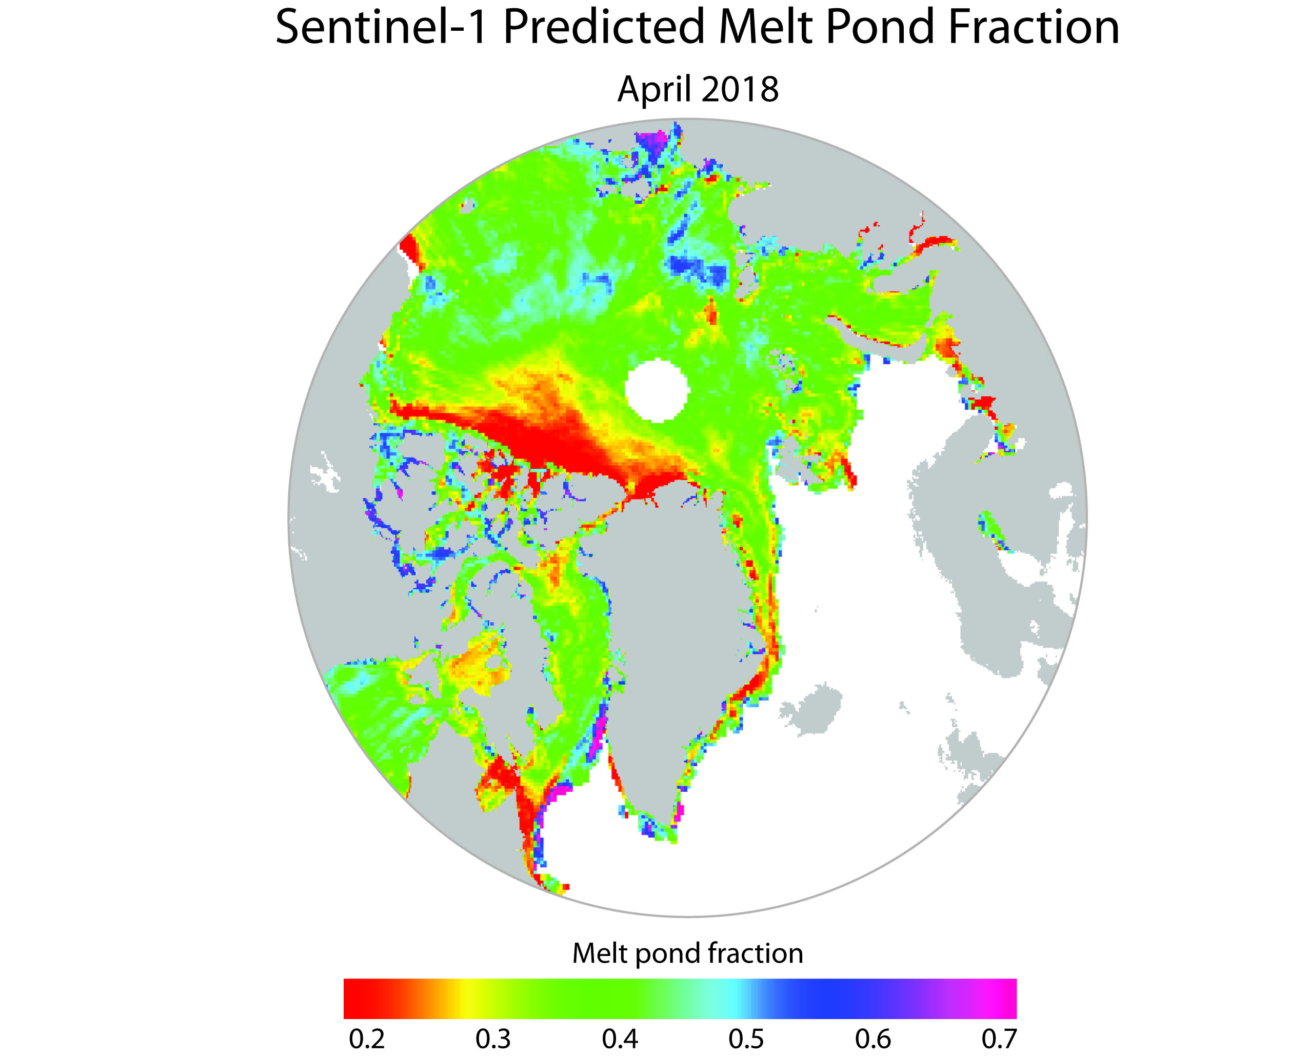
1-slide, 1-minute summary
SIPN2 AGU Meeting 2018: Community Round-Robin
Arctic sea ice melt pond fraction prediction
    Sea ice melt pond fraction is predicted in the late winter period (~April) using satellite synthetic aperture radar (SAR).
    Strong correlation between predicted pond fraction and detrended summer sea ice area in the Canadian Arctic Archipelago (2009-2017) when 2013 is left out (R=-0.74). Improvement over spring SAT.
    Feedback and opportunities for testing welcomed, e.g. comparisons to a melt pond model, regional studies, etc.
    Contact Randy Scharien (randy@uvic.ca); poster on Wednesday, 13:40 - 18:00, Session C33F: Integrating Observations and Models to Better Understand a Changing Arctic System Posters

Slide 8
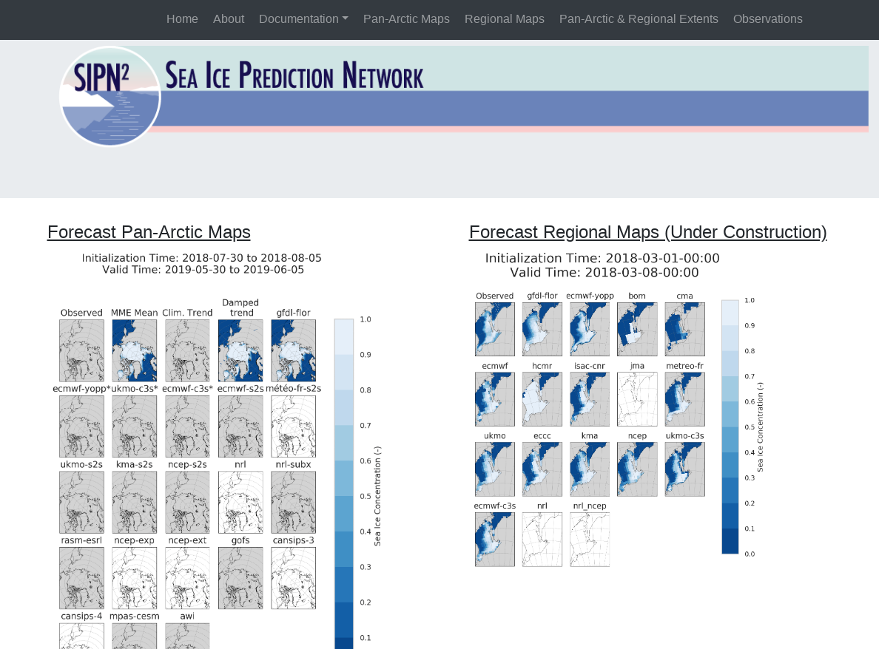
SIPN2 AGU Meeting 2018: Community Round-Robin
atmos.uw.edu/sipn
Public Sea Ice Forecast Database
15 Dynamical models
4 Statistical models
Updated daily
SIC and SIT
Available through
Polar Pangeo...

Slide 9

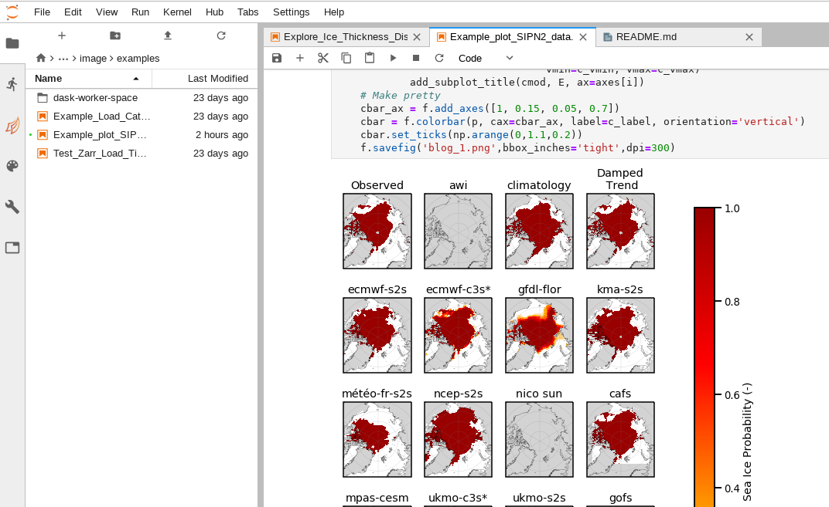

SIPN2 AGU Meeting 2018: Community Round-Robin
Polar.Pangeo.io
What is Pangeo?
Cloud computing simplified
What does it provide?
Jupyter Python Browser access to cloud computing
What is Polar Pangeo?
Growing Community of Polar researchers, sharing Polar data and cloud support

Slide 10
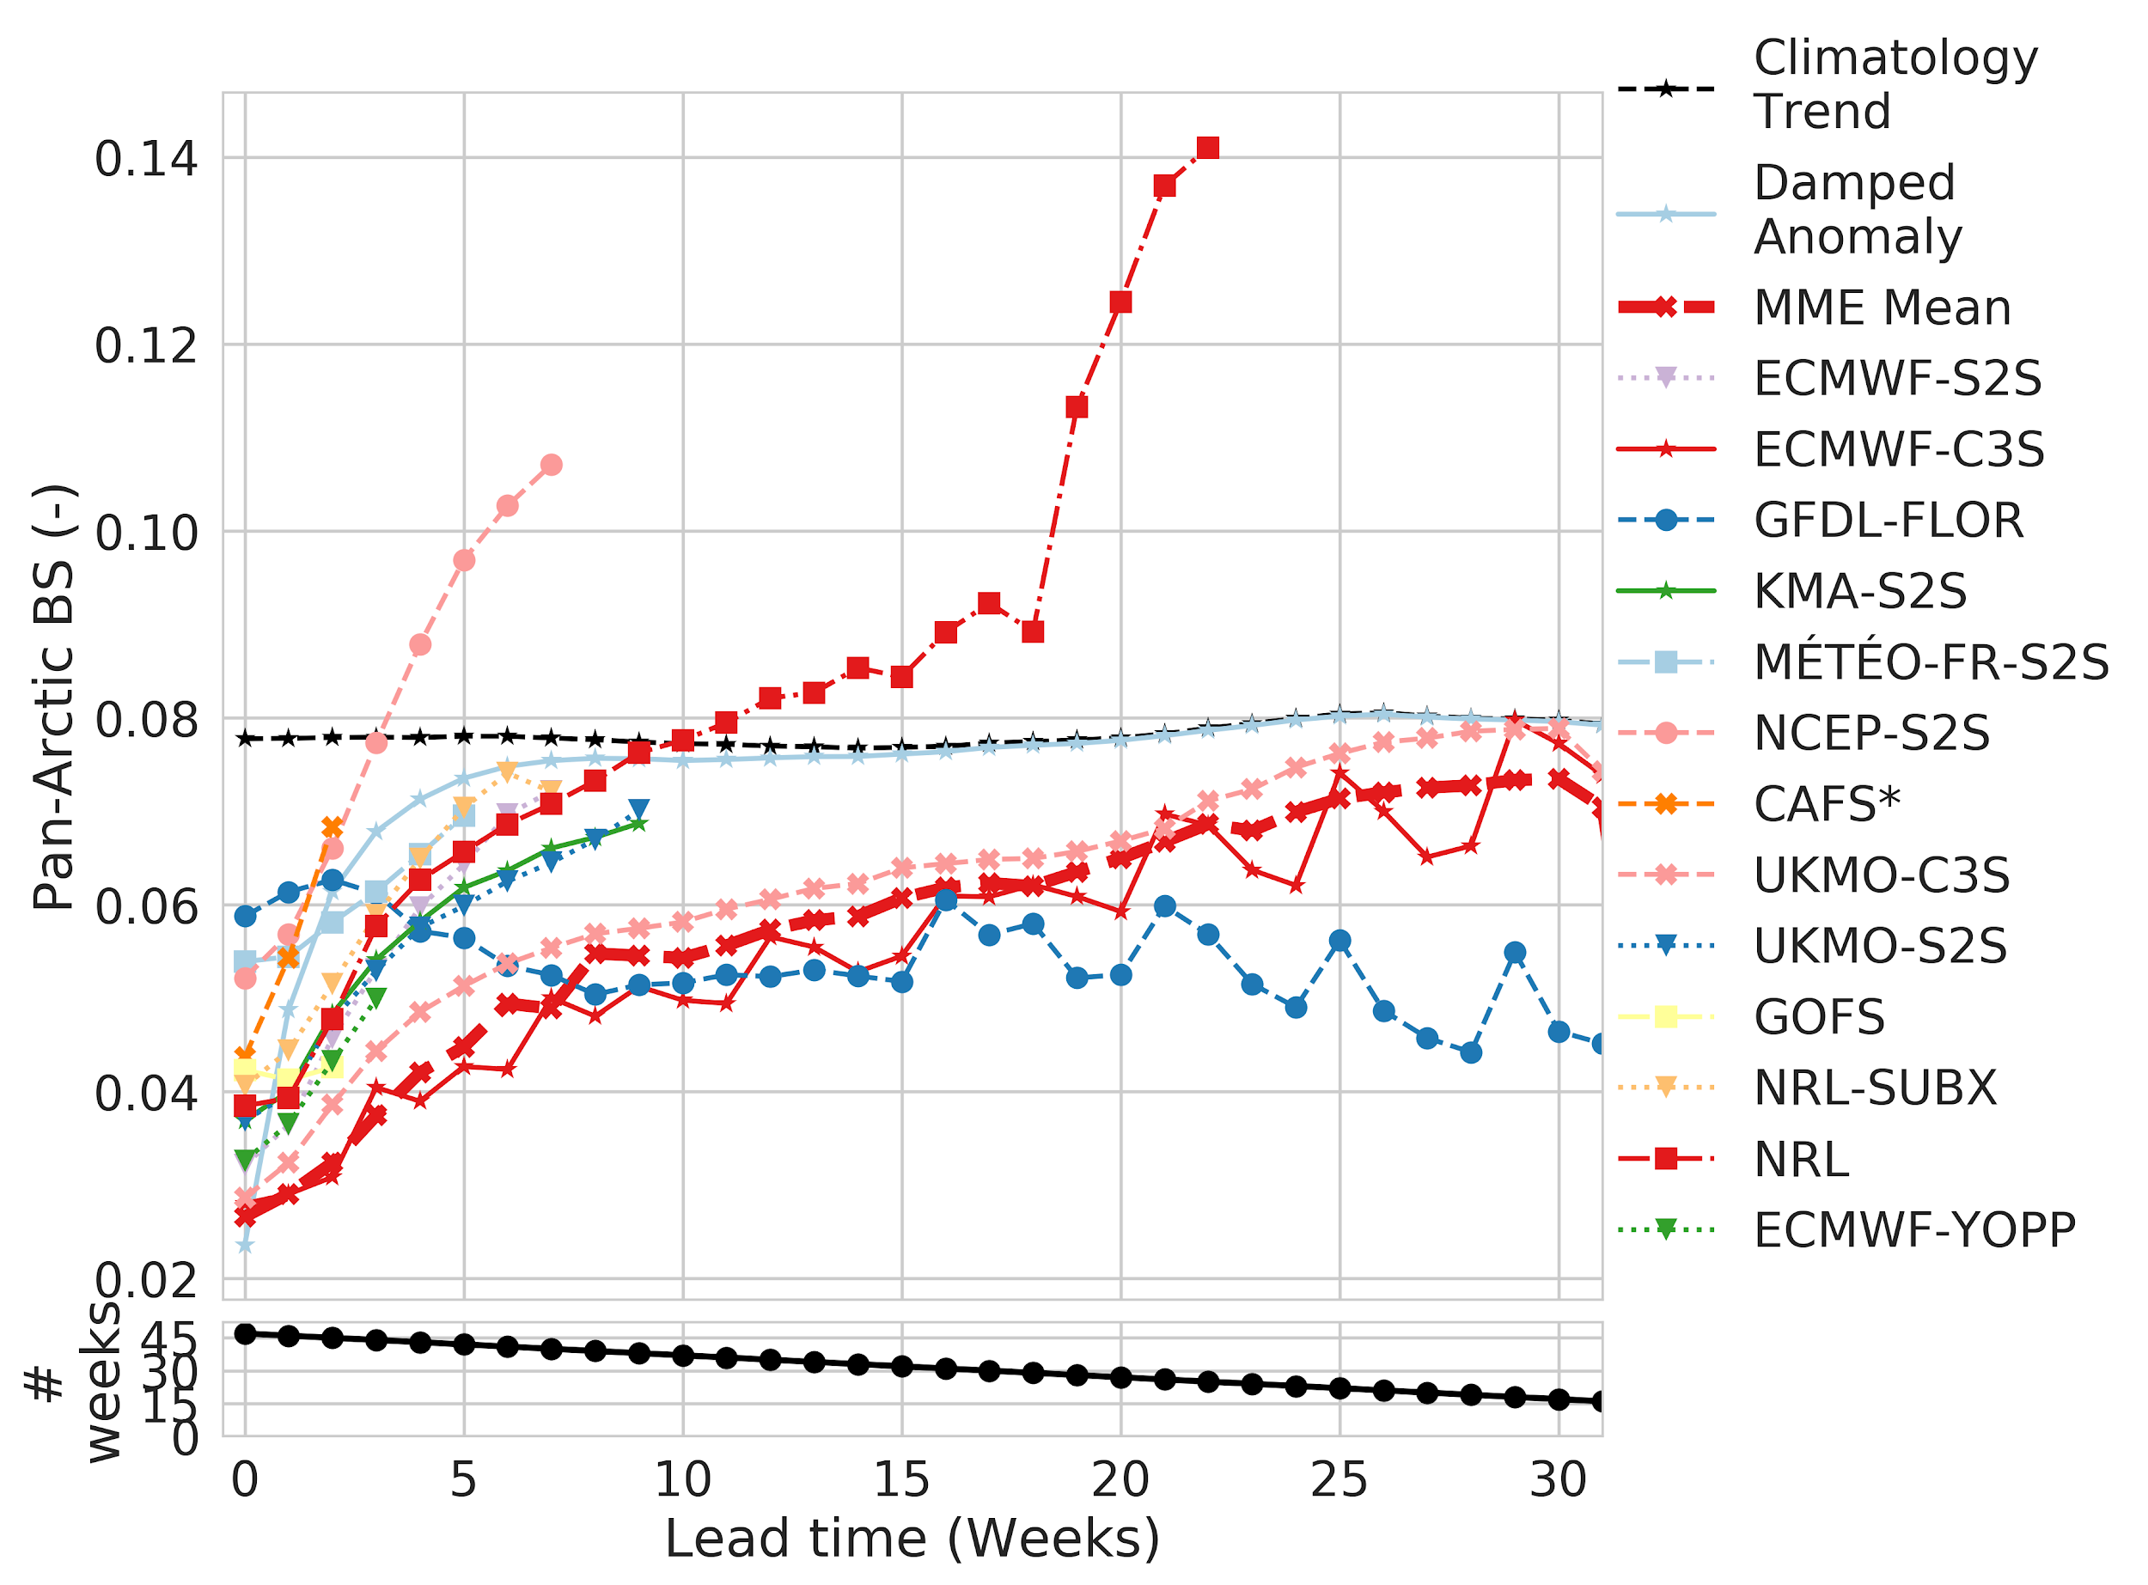
SIPN2 AGU Meeting 2018: Community Round-Robin
Example:
Forecast Skill
vs. Lead time
(WORSE)
Large range in Initialized Skill
MME Skillful out to 21 weeks
MME not always the best
Brier Score
(BETTER)
(January - November 2018)
Wayand et al. (submitted)

Slide 11
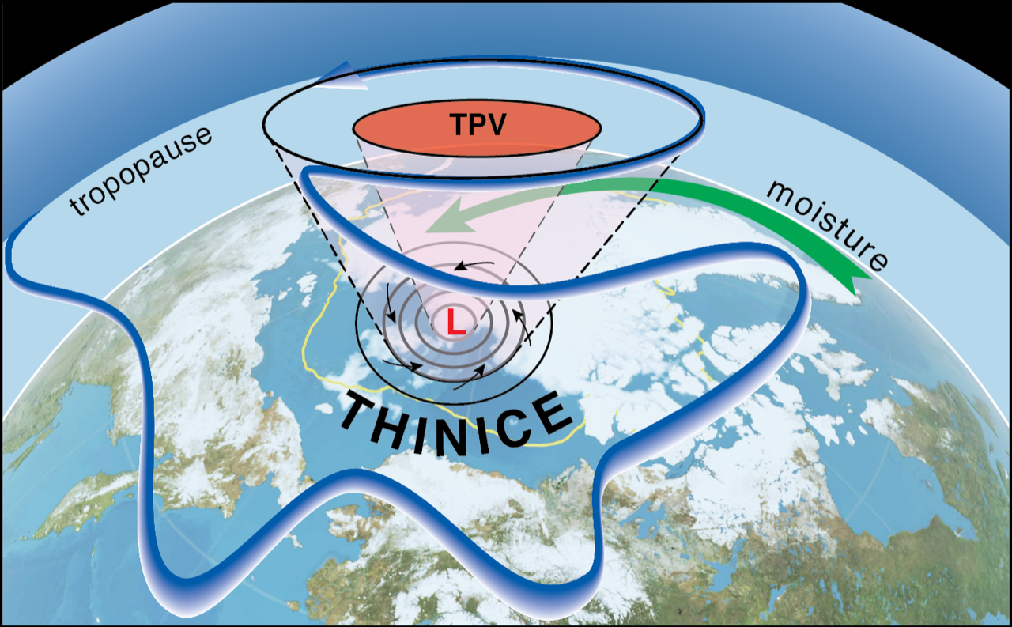
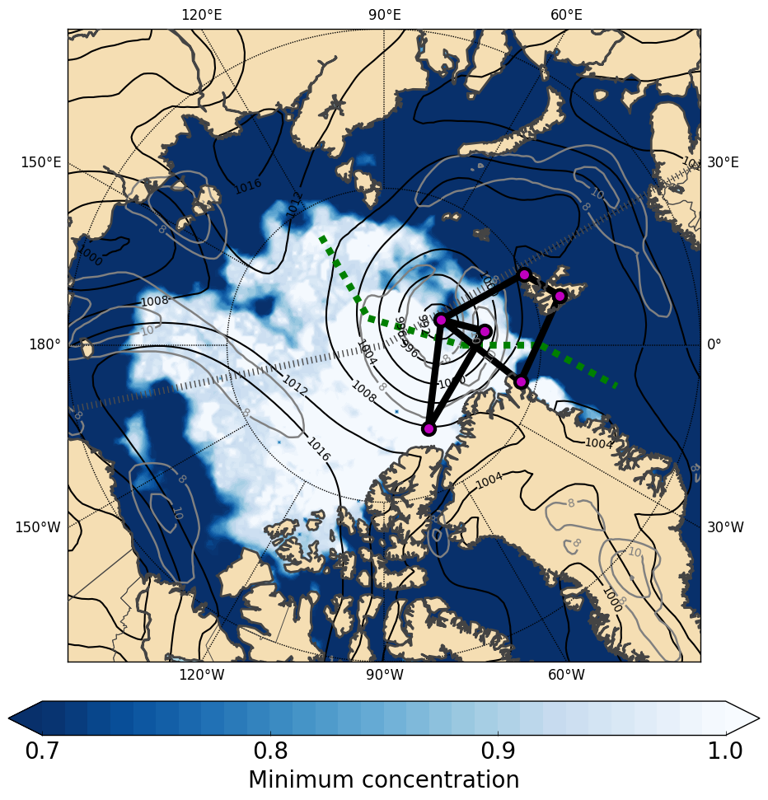
THINICE is a proposal in preparation for a field program to study Arctic cyclone – sea ice interactions
What are the basic dynamics and energetics driving Arctic cyclone evolution?
How are tropopause polar vortices (TPVs) related to Arctic cyclones?
Are Very Rapid Ice-Loss Events (vRILEs) primarily caused by Arctic cyclones through ocean waves, ocean upwelling, and atmospheric stresses exerted on relatively thin ice?
Sea level pressure during a vRILE in 2006

Slide 12

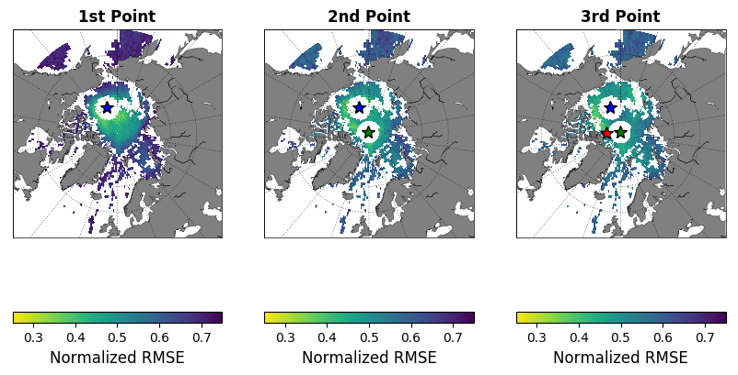
SIPN2 AGU Meeting 2018: Community Round-Robin
The overarching goal of APPLICATE is to develop enhanced predictive capacity for weather and climate in the Arctic and beyond, and to determine the influence of Arctic climate change on Northern Hemisphere mid-latitudes, for the benefit of policy makers, businesses and society.
Empirical statistical models for predicting Sea Ice Volume and Area anomalies
  Does the model resolution affect the SIV and SIA predictability?
  Can we use the empirical models to determine optimal sampling locations?
Taking advantage of the length scales Ponsoni et al. 2018, The Cryosphere (under discussion)
Notes:
Figure: 3 common optimal locations for all Models
SIA - Sea Ice Area
SIV - Sea Ice Volume

Slide 13

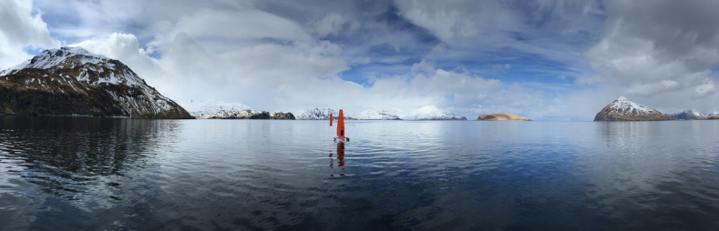
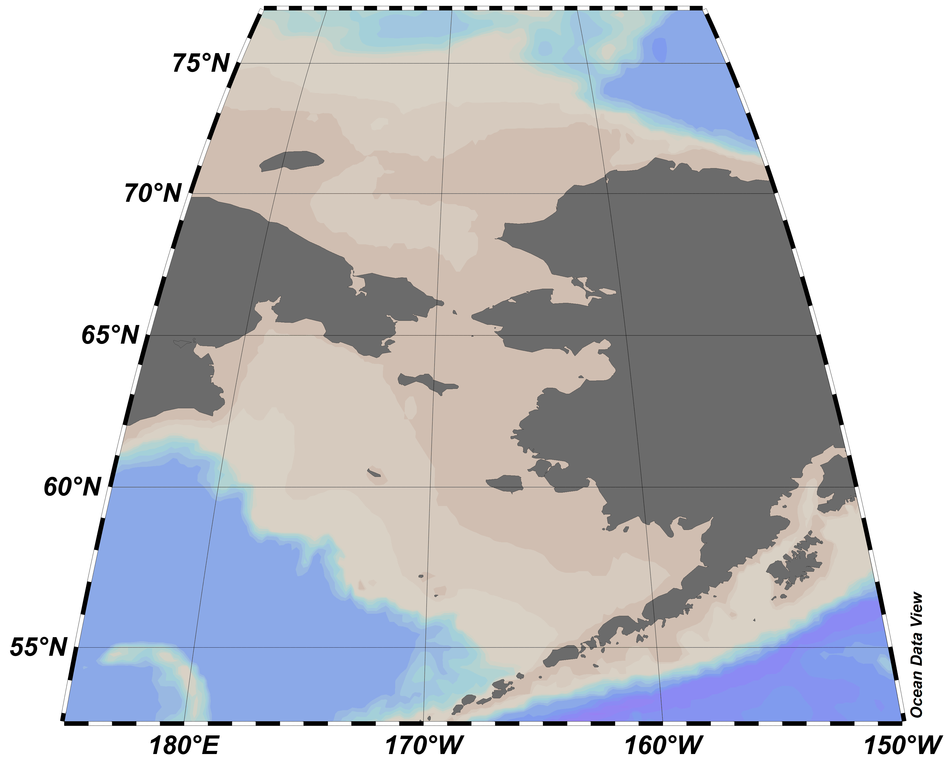

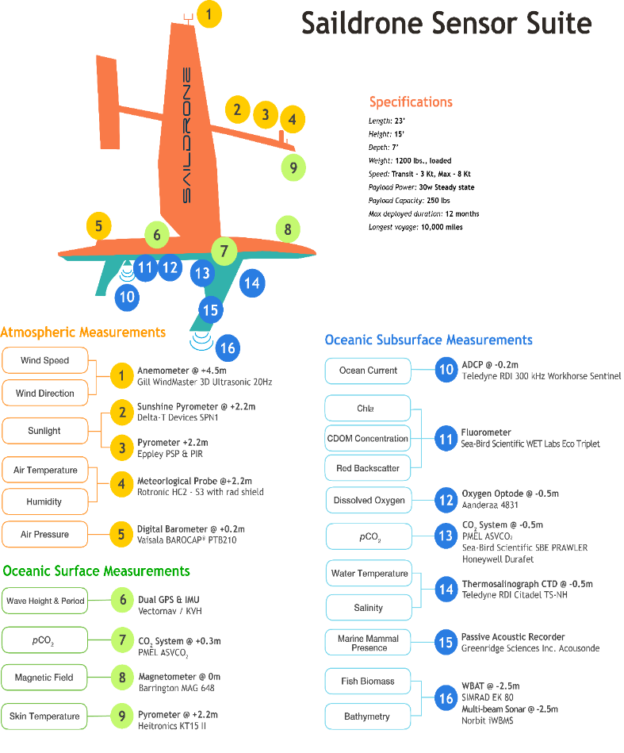





2019 ARCTIC SAILDRONE PROGRAM
ANTICIPATED RESEARCH MISSIONS
Saildrone Sensor Suite
A Public Private Partnership
ARCTIC SURVEY
A Cross-line Office Integrated Survey
ARCTIC MIZ-HF PILOT STUDY
A Marginal Ice-Edge Zone Heat Flux Pilot Study
USV2
DBO Survey
DBO5
DBO4
PT. HOPE
DBO3
100 km
NOME
USV1
Acoustic Survey
ALASKA
30 km
50 x 50 km grid
Measure biogeochemical properties and the air-sea flux near the retreating ice edge using multiple SD USVs
PI: C. Zhang, OAR/PMEL
DUTCH HARBOR
April-May: 3-5 Saildrone USVs depart Dutch Harbor, AK.
Upon reaching the ice, USVs begin MIZ-HF pilot study.
USV1 breaks-off to conduct an acoustic fish survey.
Aug: USV2 breaks-off to conduct a CO₂ survey the Distributed Biological Observatory (DBO; regions 1, 2 and 6 not shown).
New Mission Objectives
Continuous measurements in the two 50 x 50 km grid points that are nearest the retreating ice.
Measure gradients normal to the MIZ during ice retreat, ice advance, and when the ice-edge is stable.
Deploy ALAMO floats and other technologies in the MIZ-HF study domain.
December 3, 2018 FUNDING FOR THE FY19 NOAA ARCTIC SAILDRONE MISSIONS IS PROVIDED BY NOAA PROGRAMS at OMAO, OAR, & FISHERIES Contact: Calvin Mordy, mordy@uw.edu

