Slide 1

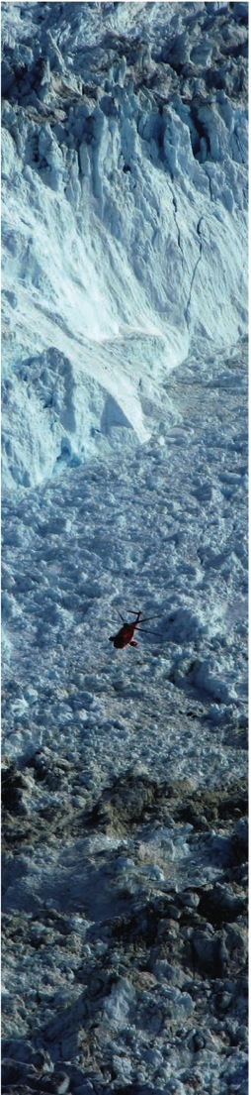
Understanding and Predicting
Arctic Land-ice Loss and its impacts
Fiamma Straneo (WHOI), Ted Scambos (NSIDC)
Greenland Ice Sheet
(6.5 m SLR)
Arctic Ice Caps/Glaciers
(0.35 m SLR)
Current discharge
1200 Gt/yr
(+30% 1960-1990)
Current discharge
226 Gt/yr
(+50% 1960-1990)
Bamber et al 2012; Enderlin et al 2014; Dyurgerov et al 2010; Gardner et al 2013

Slide 2
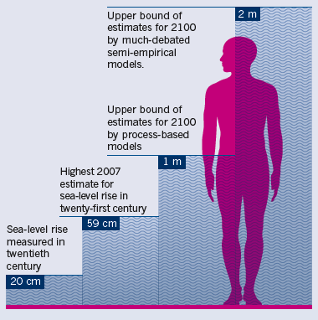
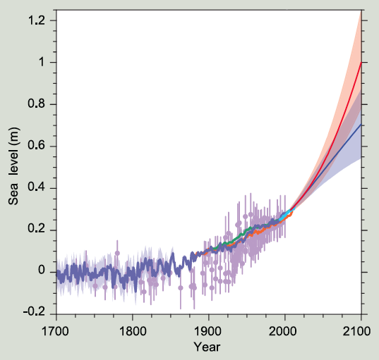
Consequences:
#1 Sea Level Rise
Greenland ~1/4 SLR
Shepherd et al. 2012; IPCC 2013; Scientific American, 2013

Slide 3
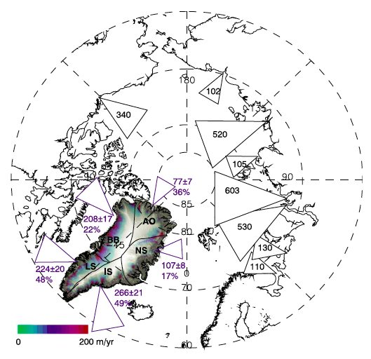
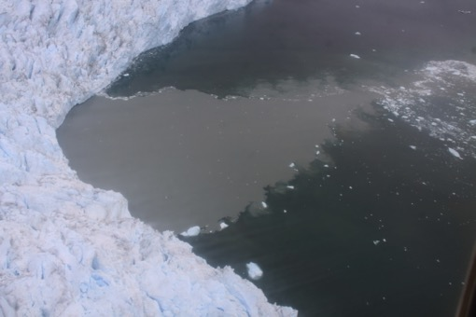
Consequences #2 Increased discharge
Freshwater discharge
into the North Atlantic
Material properties – iron, organic carbon …
Impact on dense water formation, AMOC, sea-ice
Ecosystems – stratification, nutrients
Bamber et al. 2012; Juul-Pedersen, 2015; Bhatia et al. 2013; Hood et al. 2015

Slide 4
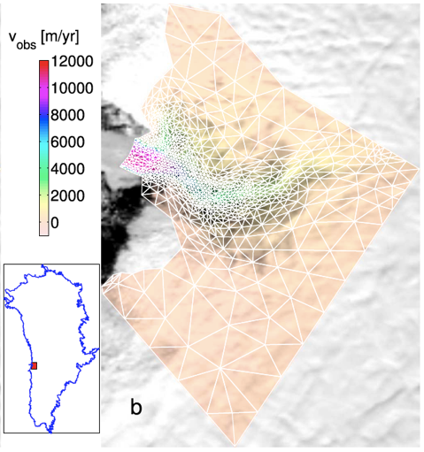
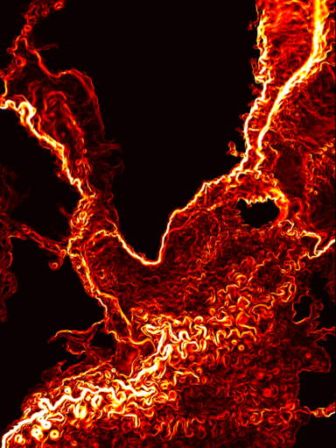
How do we predict future ice sheet changes and
their impact on the ocean ?
Wire ice sheet and ocean models
The challenges:
Limited understanding of glacier/ocean interaction
No data to inform understanding and models
Complex, multidisciplinary problem (oceanography, glaciology, climatology, paleo, atmospheric science, observationalists and modelers).

Slide 5
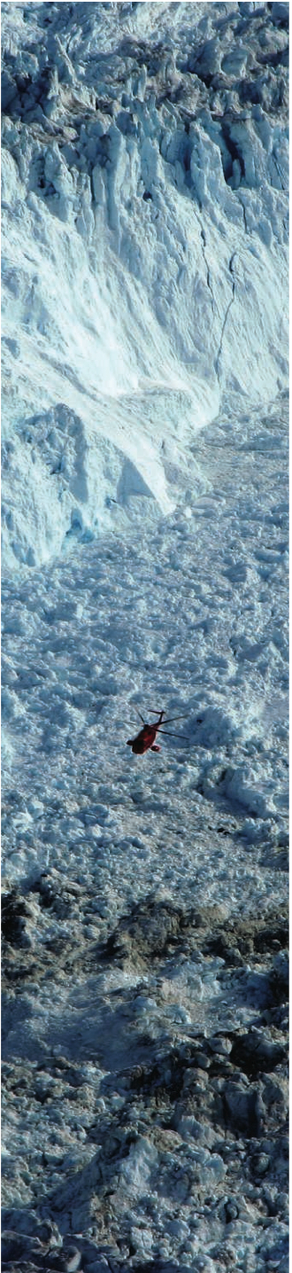

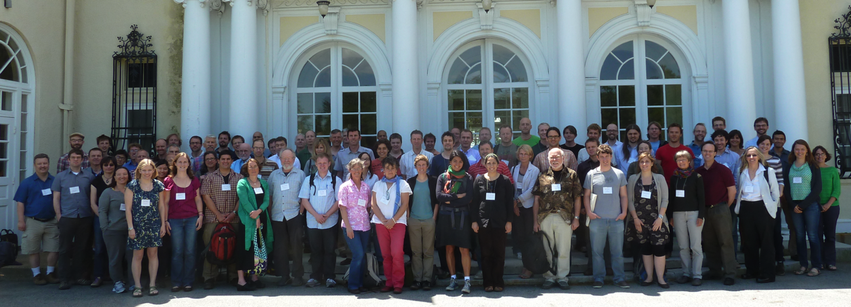
2011-2014 WORKING GROUP on
Greenland Ice Sheet/Ocean Interactions
1. Summarized the State of knowledge (integrating community feedback)
US CLIVAR Report 2012-2; BAMS Article 2013
2. A open, international workshop, June 2013
Brought together the communities, identified the scientific priorities (100 participants, 11 nations, 1/3 early career)

Slide 6
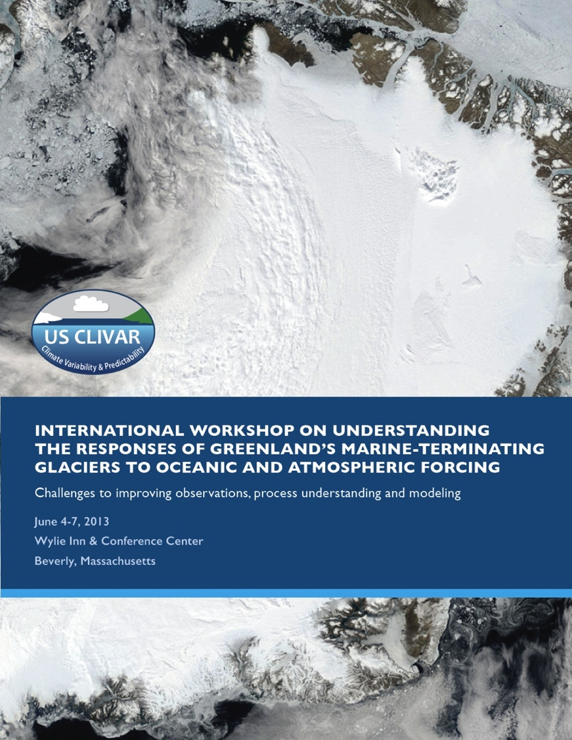
Heimbach et al. 2014
3. Scientific priorities from workshop
Greenland Ice Ocean Observing System (GrIOOS)
Data Compilation and Sharing (including bathymetry)
Targeted process studies
Megasites experiment

Slide 7
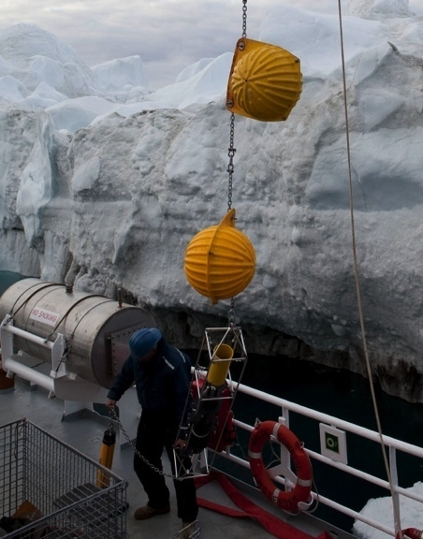
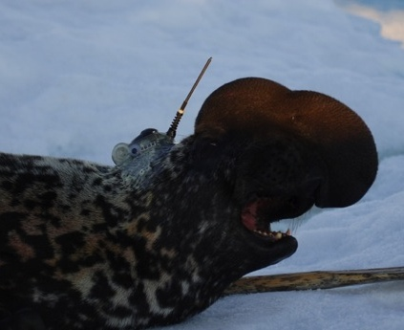
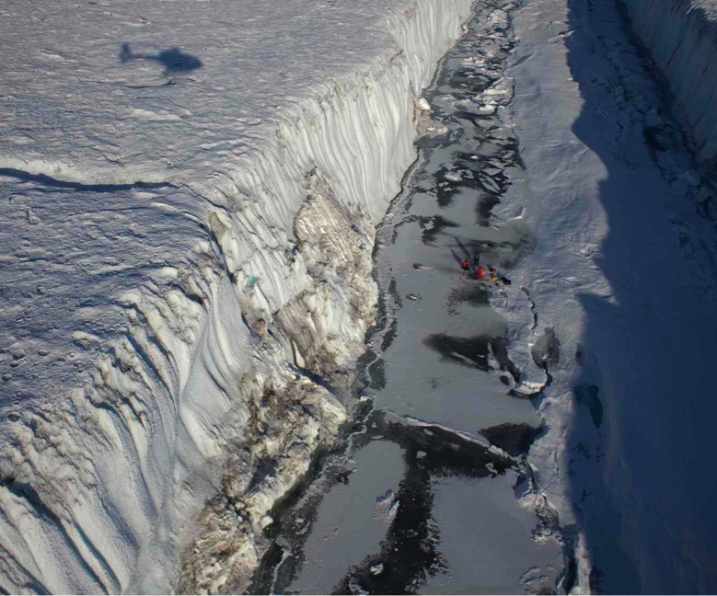
Primary SEARCH Land Ice Action Team Activity years 1,2
Greenland Ice/Ocean Observing System (GrIOOS)
Long-term glaciological, oceanographic, and atmospheric measurements at key sites around Greenland.
Understand time-evolving relationships between the ocean/glacier/atmosphere
Provide data to validate and force models.

Slide 8
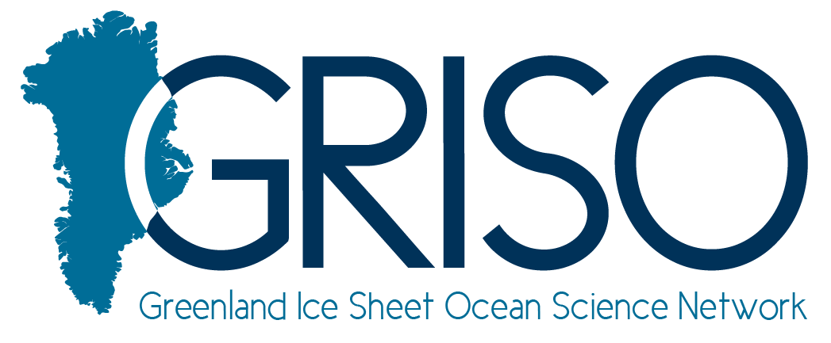
Why SEARCH ?
Improved predictions required a coordinated effort that is beyond what a single individual, group, nation can achieve.
GrIOOS requires an effort that spans across
International boundaries
Disciplines
Methodology (from field to climate models)

Slide 9



GrIOOS – Workshop Dec 12-13th San Francisco
Define the design and implementation plan for GrIOOS including description of key measurements, identification of sites and instrumentation; integration with existing networks.
ACTION TEAM/Steering Committee
J. Abermann (Asiaq, Greenland),
A. Ahlstrøm (GEUS, DK),
G. Hamilton (U Maine, USA),
P. Heimbach (UT Austin & MIT, USA),
R. Mottram (DMI, DK),
S. Nowicki (NASA Goddard, USA),
T. Scambos (NSIDC, USA),
F. Straneo (WHOI, USA),
D. Sutherland (U Oregon, USA),
M. Truffer (U Alaska, USA)
Bob Bindschadler – SEARCH SSC

Slide 10
GrIOOS Workshop Dec 12-13th San Francisco
Solicited Expression of Interest;
50 attendees from 7 countries, including oceanographers, glaciologists, climate modelers, ice sheet modelers, marine biologists, spanning different career stages and balanced gender representation;
Invited 7 program managers from US and Danish funding agencies;
Invited members of Greenland’s government;
Co-organized with Ice Sheet Modeling Intercomparison Project

Slide 11
SEARCH Activities to date (beyond GrIOOS)
Scientific Coordination – SEARCH Presentations
Townhall organized at the AGU Fall Meeting, Dec 2014
Webinar to IARPC Glacier/Fjord group, Jan 2015
CliC Steering Committee Meeting in Boulder, Feb 2015
Ilulissat Climate Days Meeting, Ilulissat, Greenland 2015
Engaging Stakeholders – SEARCH Presentations
Predicting a changing Arctic – Consortium for Ocean Leadership Forum, Washington DC, March 2015
Warming Arctic Conference – ‘Leadership, Diplomacy and Science: Resolving the Arctic Paradox’, Fletcher School of Business, Tufts University, April 2015 – attended by representatives of the Arctic Council Nations

Slide 12
Planned Activities Year 2
Workshop and Workshop Report
Drafted in early winter, circulated for community feedback and publication ~ Spring 2016
2. Follow up on report
National/International Funding Agencies
Coordination with existing networks
CliC Steering Meeting (February 2016)
3. Arctic Stakeholders
Greenlandic fisheries
Arctic Encounters meeting, January 2016

Slide 13
