Slide 1
The PolarSEEDS project: communicating Greenland melting through visualization and sonification
M. Tedesco, J. Perl, I. Saltz, E. Ham
V. Golosiy, P. Alexander, T. Datta
Radovsky, F. Quiroz, G. Lewkowicz
The City College of New York, CUNY, New York
www.polarseeds.org
cryocity@gmail.com

Slide 2
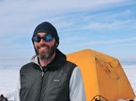
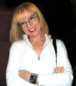
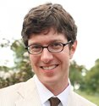
Who and what ?
Infographics
Photography
Gamification
Videos
Sounscapes and sonifications
???
Ina Saltz
Jon Perl
Ethan Ham
Earth and Atm. Dept.
Art Dept.
Music Dept.
Art Dept.

Slide 3
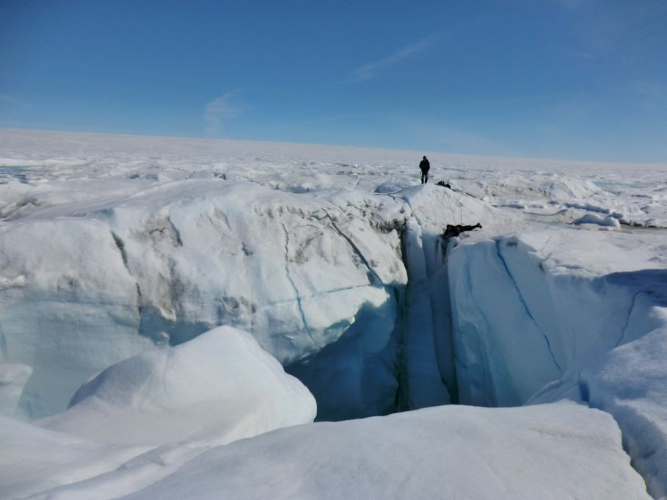
Photography

Slide 9
The Exhibit

Slide 10
The Polar Game

Slide 11
Albedo experiment

Slide 12
Sonifications and soundscapes
the use of non-speech audio to convey information or perceptualize data

Slide 13
Sonifications and soundscapes

Slide 14
www.polarseeds.org
Thank you

