Slide 1
Approaches to anticipate futures
Forecasting: Quantitative prediction of outcomes based on conceptual or mathematical models
Stationarity
Simplified (analytical or complex) system models
Analogs (paleo, historical, geographical)
Numerical system models (climate models, earth system models)
Foresight: Systematic, mostly qualitative exploration of full range of plausible future outcomes
Scenarios and foresight – expert assessments (narratives, refined analyses such as consistency/plausibility or geospatial analysis)
Notes:
Contrast between forecasting and scenarios

Slide 2
AMSA
Brigham
Notes:
-broader question: Arctic of 2050
-AMSA assumes sea ice goes the way models say
-scenarios for different stakeholders

Slide 3
Steps in scenario identification
Co-develop defining question
Summarize current knowledge & trends
Identify important drivers (factors, forces)
Identify key uncertainties (from key drivers)
Develop scenarios as plausible futures for bundles of key drivers & uncertainties
Identify indicator variables
Integrate scenarios into planning process by tracking indicators & developing strategies cognizant of scenarios
1
2
4
3
2
1
4
3

Slide 4
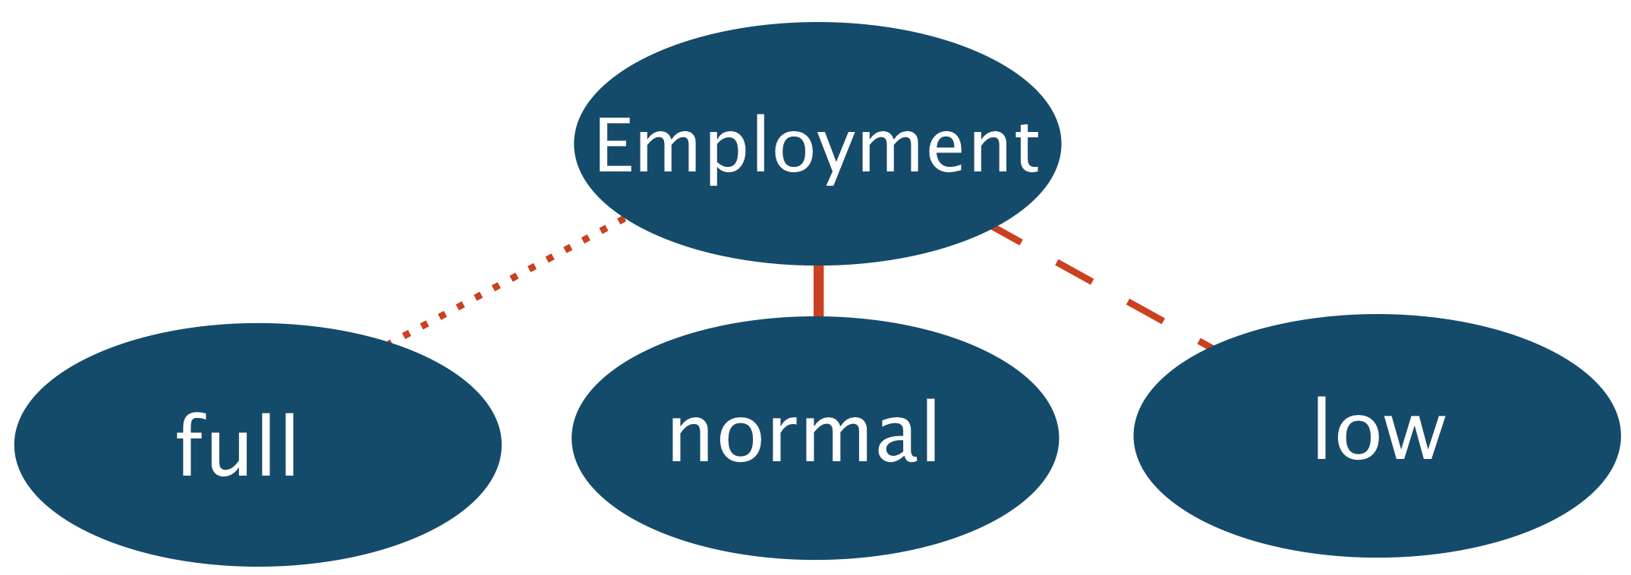
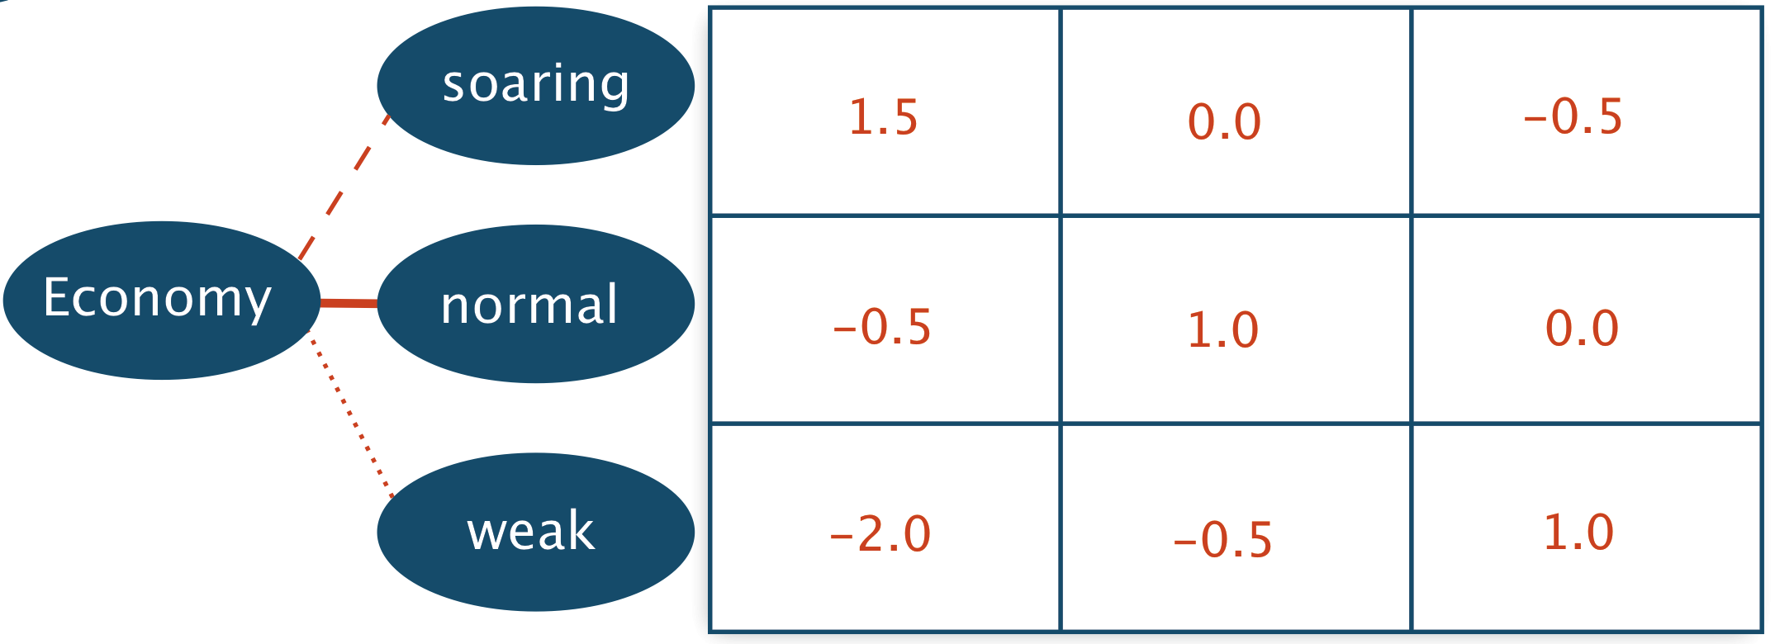
Plausibility & Consistency
Robustness Ro
Projection bundles with high plausibility and consistency values and no/few partial inconsistencies

Slide 5
Further in-depth analysis of projection bundles
Mueller-Stoffels et al., 2010

Slide 6
NSSI Scenarios Project
Project initiative by North Slope Science Initiative (NSSI)
Funded by broad partnership and administered through BLM to develop Energy and Resource Development Scenarios
Scenarios process to help NSSI member agencies and their partners refine research and monitoring investments
What is the future of energy development, resource extraction, and associated support activities on the North Slope and adjacent seas through 2040?

Slide 7
Drivers of change
Economic and regulatory
Price of oil and gas products
Demand for energy/ mineral resources
Regulatory environment
Development of infrastructure (onshore/ coastal)
Price of other commodities (coal, minerals)
Oil/ gas production tax code
Oil and gas development outside Alaska
Technology and information
New technology (efficiency, discovery, clean-up)
Demographics, Politics and Education
Global political stability
Natural systems
Extent of seasonal sea ice
Climate change (temperature, precipitation)
Erosion (coastal/ riverine)
Permafrost degradation
Endangered species listings & critical habitat designations
Human-caused environmental disasters (e.g. oil spills)
Community dynamics
Community stance on development
Local (village/borough) economy
Community health and food security

Slide 8
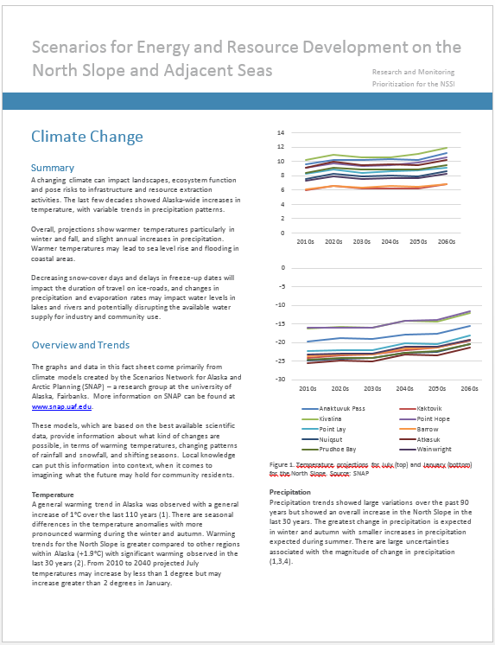
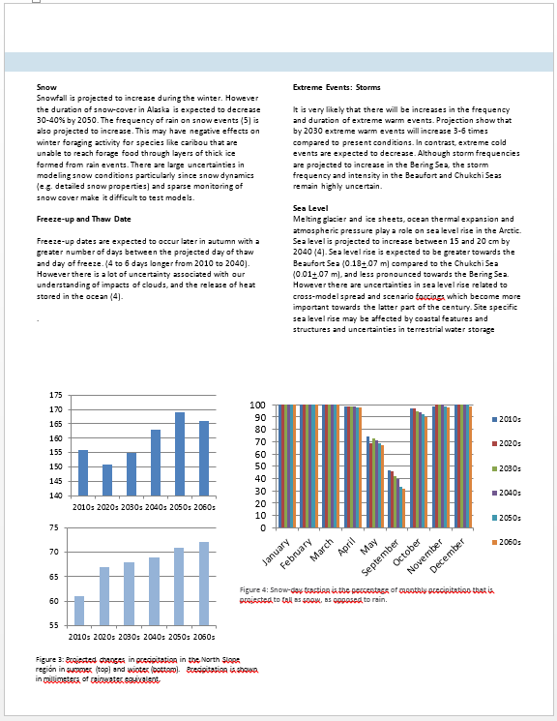
Fact sheets on key drivers
Expert-reviewed
Synthesizes knowledge on trends and uncertainties
Helps inform workshop discussions

Slide 9
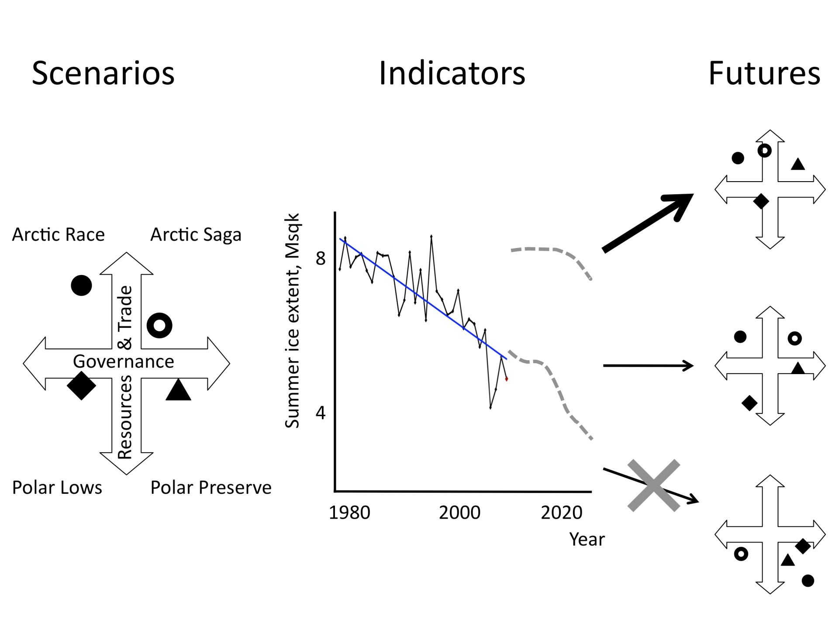
Decision-making in a changing Arctic
GCM output
Observations
Stroeve et al., 2010
Eicken & Lovecraft, Ch. 9, Nx2020, 2011
Notes:
Scenarios vary for different stakeholders because stakeholders also want to shape the future
The question: how to get from scenario to future? Right now more decision making (or at least thinking) based on GCM output than anything else (certainly that is what scientific community focuses on)
Need to fill in that gap, and some progress made: Stroeve et al. showed that sea ice summer ice extent decline at lower end of model envelope
use to exclude physically impossible scenarios

Slide 10
?
Present
?
?
?
?

Slide 11
Scenarios: Challenges and Opportunities
Importance of partnerships to support process
Stakeholder buy-in important
Commitment to follow-through with scenario outcomes
Opportunities to share information and expertise among stakeholders
Ongoing outreach
Understand scenarios use and limitations
Rationale for prioritizing drivers and uncertainties
Provide products that can be shared with stakeholders
Scenarios without a specific “end-point” – revisit process and reassess priorities

Slide 12
Questions & Discussion
SEARCH Arctic Futures 2050

