Slide 1
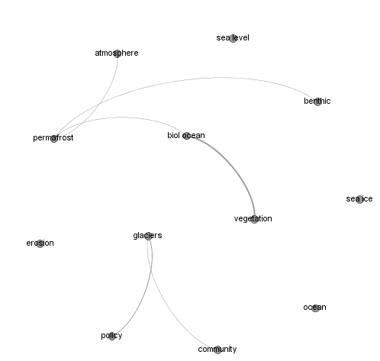
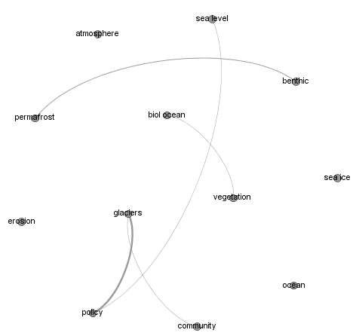
SEARCH-wide interdisciplinary linkages
A: Network of important GAPS in disciplines
B: What linkages could be made over the next 5 years?
Graphical network representation (free software: Gephi)
A: SEARCH researchers report linkages needed based on gaps in knowledge (include supporting products/ papers). Network represents linkages needed, not linkages that already exist.
B: Network represents what linkages might be made over the next 5 years. Can be evaluated at a later time to determine progress in achieving linkages.
Metrics: Number of nodes, thickness of lines between nodes (indicating number of times link was reported as an important linkage needed), quantitative metrics on overall network connectedness, average distances between nodes
*Note, this method does not track NUMBER of new papers/ proposals/ products generated, but that can be reported as a separate metric

Slide 2
Specific product evaluation
Supporting local networks and cross-scale linking
This is an example from evaluating the ACCAP webinar series
Individual/Organization
Participants
& speakers
National
NCA (speaker)
Networking Activity
Link
Participant
NPS
Regional/State
Intra-agency satellite site
Participants
& speakers
ACCAP
Alaska LCC
Discuss findings from NCA
NPS
NPS
Connect tribes & state/federal agencies
Native Govts.
KBRR
Non-webinar participants
Participants
& speakers
Local
Consultant (participant)
Share information
Community
(non-participants)
Local
satellite site
Participant
Local
Local
Interviews/ surveys to identify who are using SEARCH products (e.g. evaluation of Sea Ice Prediction Network products)
Identify role of SEARCH in providing useful information to local-regional-national stakeholders

Slide 3
Needed from workshop participants
Report important gaps in knowledge:
  – each paired node only appears once, order is not important
Name | Discipline 1 | Discipline 2 | Can this linkage be made within 5 years? (Y/N) | Optional
Olivia Lee | Sea ice | Policy | Y | Supporting papers/ products
Olivia Lee | Sea ice | Marine ecology | N | Supporting papers/ products

