Slide 1

SEARCH Observing Change Panel:
Activities, Outputs & Future Direction
Review OCP charge
Highlights of OCP activities
Proposed OCP roles within the new SEARCH structure

Slide 2
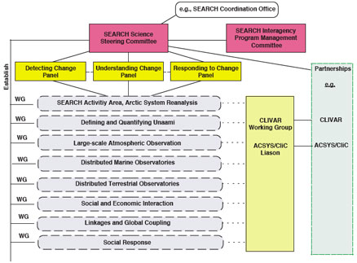
OCP within former SEARCH Structure

Slide 3
Observing Change Panel Charge (2008)
Work with the SEARCH Science Steering Committee to guide the development of the observation component of SEARCH, including:
Work with the broader scientific community to develop and, at opportune intervals, update SEARCH Observing System plans.
Facilitate ongoing compilation of relevant information on funded observing system components (including the Arctic Observing Network [AON] projects).
Assess the current observing components in relation to SEARCH priorities and identify key gaps in the observation network.
Facilitate cooperative relationships between the SEARCH observing system components and other ongoing and planned national and international observation programs relevant to the SEARCH observing effort.
Work with the Understanding Change and the Responding to Change Panels to ensure that modeling of and responding to arctic change priorities are integrated with observation efforts.
Provide feedback and advice as sought by the SEARCH Science Steering Committee (SSC), panels, and working groups on relevant aspects of the science and methodology of observing change in the Arctic.
Provide a communication link between the SEARCH observational programs and the broader scientific community to ensure flow of information and promote scientific exchange.

Slide 4
OCP Key Activities and Outputs
• 2005 – SEARCH Implementation Workshop Report
• 2008 – SEARCH/DAMOCLES Arctic Observation Integration Workshops & Report
• 2009 – SEARCH State of the Arctic Observing Network (AON) Workshop & Report
2009 – AON Design & Implementation Workshop
• 2010 – Interagency AON Working Group Meeting
• 2012 – AON Design & Implementation Task Force Report
• 2012 – US Arctic Observing Coordination Workshop & Report
2012, 2013 – EU-CA-US, US-UK Coordination Workshops
2013 – Arctic Observing Summit
2014 – Arctic Observing Summit
2015 – AON Open Science Meeting
Notes:
Mission specifics: stakeholders; creating a forum for communication (reflected in specific activities such as Arctic Observing Coord meeting; AOS, sea ice outlook etc.)

Slide 5

AON 2009 Status Report and Recommendations
Selected Recommendations
Balance flagship sites & distributed observing.
Improve interagency coordination to support sustained, climate-scale observing.
Develop community-based mechanism for system evaluation and identification of new priorities in response to changes in environment and/or understanding.
Coordination and standardization of measurements across the network.
Autonomous Sensors for biological and chemical oceanographic sampling.
Integration of human dimensions into network design.
Promote and aid northward expansion of established observing systems.
Encourage and undertake bottom-up and top-down system design efforts.
Broaden partnerships – industry, local, state, federal agencies.
Improve international coordination through multi-lateral science agreements, data sharing/exchange, shared programs (e.g. international ice station).

Slide 6

2012 AON Coordination Workshop
Interagency meeting to develop a shared vision for the AON and a plan for advancing that vision.
‘Showcase’ projects to demonstrate successful approaches for interagency coordination, balance between basic research and stakeholder needs, generation and uptake of data and products.
From Observations to Management: Science to Inform Decisions Regarding Offshore Oil and Gas Activities in the Chukchi Sea
A Distributed Environmental Observatory for Terrestrial Change Detection
The Distributed Biological Observatory
Multidisciplinary Drifting Observatory for the Study of Arctic Climate – MOSAiC
Ocean Observations to Improve Sea Ice Forecasting
Data Management
Provide an inventory of data archives and access points
Activate an interagency data collaboration team or forum to discuss an improved process for sharing arctic data
Implement metadata exchange standards and protocols across the various archives
Identify the most used or highest priority AON datasets and the science or management questions answered with those data

Slide 7
ADI Task Force: Conclusions & Recommendations
1. Design & optimization hierarchy
2. Key science questions
3. Space and time scales
4. Prioritization
5. Design and optimization approaches
6. Metrics
7. Management structure

Slide 8
ADI Task Force Community Survey
Agency responses placed more importance on:
Balancing observations across regions
Applying rigorous approaches to observing system design
Academic responses placed more importance on:
Sustaining long-term observations
Agencies more strongly agree:
Observing systems need input from data users
Arctic observation system must meet needs of stakeholders outside scientific community
Academics more strongly agree:
Observing system design best done by those carrying out observations

Slide 9
ADI Task Force Selected Conclusions & Recommendations
Key science questions must be laid out in an actionable form
Pan-Arctic space scale and seasonal to decadal time scales
Questions of societal relevance will often require AON observing activities at the local or regional scales
Higher priority assigned to those approaches that can help address multiple science questions
Methodologies and implementation strategies for network design vary widely between disciplines, both in approach and maturity
Observing system design and optimization need to be considered in a hierarchy of approaches
An important aspect of its design is the ability of the network to remain agile and able to adapt to a rapidly changing Arctic
Metrics should be relevant to the present and possible future states of the Arctic as opposed to the Arctic of the past
Allowable uncertainties will depend on the science question asked
AON Scientific Steering Group (AON-SSG) is recommended to provide a management structure

Slide 10


International Arctic Observing Summit Goals
To provide community-driven, science-based guidance for the design, implementation, coordination and sustained long-term (decades) operation of an International Network of Arctic Observing systems that serves a wide spectrum of needs
To create a forum for coordination and exchange between researchers, stakeholders, and funding agencies involved in long-term observing activities.

Slide 11
Objectives, Products & Audience
Recurring, biennial forum to coordinate and optimize resource allocation for an International Network of Arctic Observing Systems.
Engage academia, government agencies and other Arctic stakeholders (e.g. local communities, industry, non-governmental organizations).
Assess the science basis for the Arctic observing activities.
Provide guidance and recommendations for Arctic observing
Synthesize Arctic science, network design options and observing priorities into recommendations for decision makers.
Identify network issues that require SAON attention.

Slide 12
AOS 2013 & 2014 Themes
2013
Status of the Current Observing System
Observing System Design and Coordination
Stakeholder Perspectives on Observing System Design and Integration
Mechanisms for Coordination of Support, Implementation and Operation of a Sustained Arctic Observing System.
2014
Stakeholders and Arctic Observations Science Coordination for Improved Arctic Observing
Technology and Innovation
Remote Sensing Solutions
Data Management

Slide 13

What Are We Aiming For?
Data and sound data management are integral parts of arctic observing network (National Academy of Sciences 2006, Lichota & Wilson 2010, National Research Council 2014)
Multidisciplinary, quick open access, easy to use, reliable, full documentation
Long-term data preservation
“Single view" providing discovery and access multiple data resources and centers
A system that serves its users (users must be involved in design)
National Academy of Sciences. (2006). Toward an Integrated Arctic Observing Network (p. 128). Washington D.C.: National Academies Press. Retrieved from http://www.nap.edu/catalog/11607.html
National Research Council. (2014). The Arctic in the Anthropocene: Emerging Research Questions (p. 220). Washington D.C.: National Academies Press. Retrieved from http://www.nap.edu/catalog.php?record_id=18726
Lichota, G. B., & Wilson, S. (2010). SAON Data Management Workshop report: Developing a Strategic Approach. (p. 15).

Slide 14
Where are We?
Many centers managing and providing data (e.g. Arcticobservingviewer.org, NCAR, NSIDC, UCAR, international etc.)
Aggregation and integration hubs established (e.g. ACADIS, ELOKA in U.S.)
Coordination bodies are emerging (e.g. Alaska Data Integration Working Group ; Arctic Antarctic Data Coordination Network ; IARPC Data Access group; emerging National Data Service etc. in the U.S. ; Arctic Data Coordination Network through IASC, SAON data committees, GEO/GEOSS Cold Regions, GCW and others on the international scene)
Community is at the outset of developing broad standards - central topic at IASC/SAON meeting November 2014; SciDataCon 2014 (i.e. SAON / SCAR-SCADM Polar Data Profile)
Single view (e.g. Arctic Data Explorer)
Community aiming for dedicated resources (e.g. submission of Belmont Forum proposal to develop data management - six countries including Russia, China)

Slide 15
Priorities and Way Forward?
Establish appropriate level of community informed and negotiated standardization (e.g. metadata, formats, structure, semantics)
  Identify existing community standards and specifications and build on them
  Use standards to support data as an online service
Develop high value applications (mediators) using data services
  Establish manageable, short cycle development targets
  Work closely with observing sub-communities
Establish multi-scale governance model
  Avoid “central management” – harness diversity of community
  Facilitate development of virtual community of practice that promotes communication across projects, programs, agencies, governments. Focus on connecting major hubs.

Slide 16
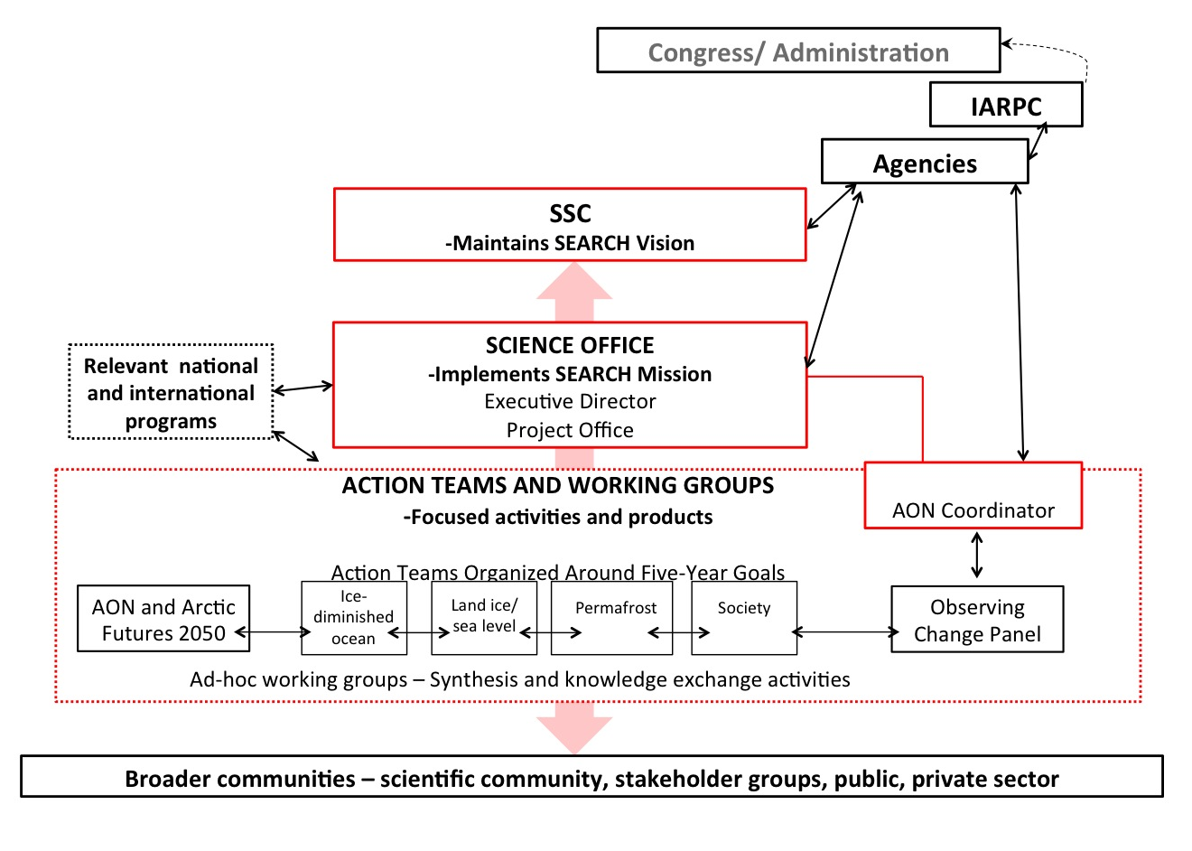
OCP within the New SEARCH Framework
AOS Coordinator

Slide 17
OCP Future Tasking and Directions
There remains a need for a community-based entity (OCP or other) to provide long-term guidance and coordination for the sustained, climate scale observing network.
Maintain broad scope – interagency Arctic Observing System
Focus on long-term, sustained observing activities.
Provide ‘corporate memory’ for climate-scale system.
Explicit role as an advisory body for the NSF AON- community coordination, regular assessment of science goals, network performance and stakeholder requirements, …
Similar relationship to IARPC Observing Team, interagency AOS?
OCP interaction with the Action Teams
  Provide community support from broad AOS network
  Transition Action Team outputs, activities to AOS
Other…?

Slide 18
OCP Questions & Issues
Revise terms of reference
Membership
  Broaden representation
  Adjust terms to ensure constant renewal while also retaining institutional memory.
Support needed for future activity
  Biennial AON Open Science Meeting
  Smaller community-driven meetings
  Annual OCP meetings, perhaps in conjunction with SSC

