Slide 1
Knowledge to Action
Bob Bindschadler & Susan Crate

Slide 2
Framing
Contemporary change is causing problems in the Arctic
Many of those problems can be alleviated by actions, at local, regional, national or even international scales
  Such actions should be informed by knowledge to ensure both feasibility and effectiveness
  Research can be a means to acquire both of those forms of knowledge
The unprecedented pace of arctic change demands immediate actions, so
  Effective research must be identified and implemented
  Knowledge gained from that research must be acquired quickly
  That knowledge must be usable in defining necessary actions

Slide 3
(Traditional) Scientific Research Approach
Plan
  Often hypothesis-driven
  Sometimes scientists’ agenda driven
Observe
Analyze
Test/Validate
Communicate
How well is this working for dealing with Arctic change?

Slide 4

SEARCH
Responding
Observing
Understanding

Slide 5
SEARCH
Responding
Observing
Understanding

Slide 6
Knowledge to Action (K2A)
Science still advances without it, but society does not benefit.
K2A requires a “completeness” that generally has not been achieved (not just in the Arctic)
  The urgent need for informed action in the Arctic has highlighted this weakness
We are not using the term “K2A” to refer to making large data sets available for mining
Here it is about constructing direct links between the researchers and the stakeholders though mutual involvement in the research and application enterprises
  Increases the impact of scientific research

Slide 7
Knowledge to Action will fail if it is limited to the handoff of knowledge at the conclusion of scientific research and the beginning of the decision-making process

Slide 8
New Scientific Research Approach
Plan
Observe
Analyze
Test
Communicate
Knowledge
Exchange
To realize Knowledge to Action, knowledge must be exchanged throughout the scientific process

Slide 9
Knowledge Exchange (KE)
Involves sharing knowledge across the spectrum of participants (scientists, agency representatives, local residents)
The more diverse the players and the more varied the forms of knowledge, the more difficult this becomes
This is a social process
    It requires human interaction
    It is unfamiliar to most physical scientists

Slide 10
KE in each research phase
Planning
  Including local/regional communities and other stakeholders
    Finding the right questions
    What to address
    Where to address it
Observation
  What useful “local knowledge” exists
    Can other local knowledge be made useful
  Opportunities for “citizen science”
Analysis
  ???

Slide 11
KE in each research phase
Testing/Validation
  Local history may again prove useful
Communication
  Partnered activities to exchange information and to ensure that actions taken are consistent with limitations of the analysis
  Finding shared channels/vehicles
    Not necessarily internet
    Workshops to booklets

Slide 12
Hurdles to K2A/KE
Scientists don’t know many stakeholders well (and vice versa)
  Especially the “purists”
    e.g., scientists unable to live w/o caveats or policy makers unable to live with them
Local vernacular and scientific language very different
  Pictures often more effective than words
Scientific aloofness/integrity/purity
  Tension between research being useful (for the stakeholders) while retaining robustness (for the science peers)
Time
  Requires time to engage
  Requires time to evolve
Rewards

Slide 13
A New Research Landscape
Enables co-production of knowledge between researchers, decision-makers, stakeholders and other beneficiaries of science
Requires sustained effort to break through the barriers that have prevented it in the past
Achieves greater societal value of research by mutual engagement in research that is
  Relevant
  Valid
  Practical

Slide 14
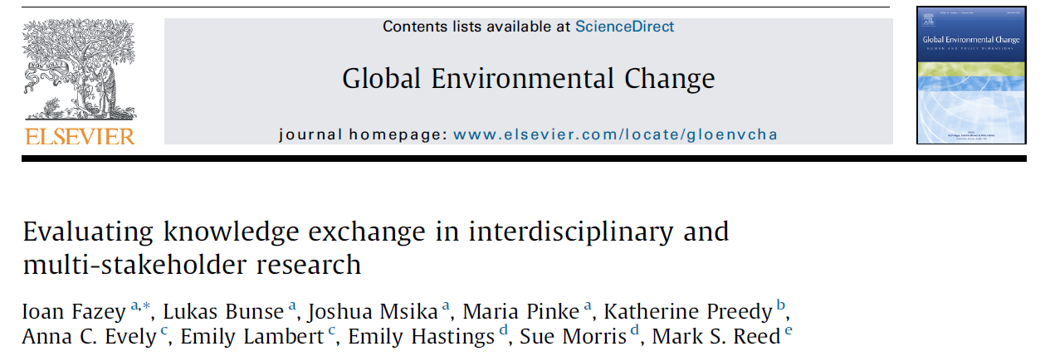
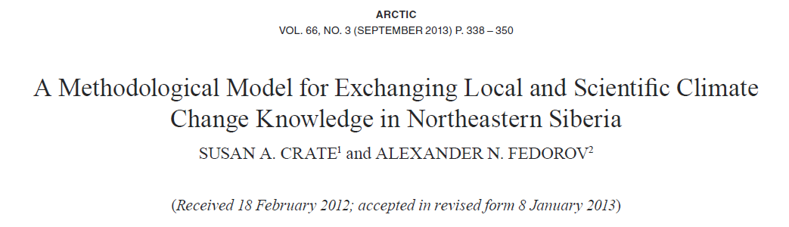
Read this for the introduction
Read this for the discussion
“Perhaps academics can find a more expedient way than peer-reviewed articles and other modes of communicating our research to build upon our findings, bring about more robust understandings, and bolster adaptive capacities for those most affected. “

Slide 15
Discussion

Slide 16
Later slides are some thoughts and excerpts from papers that weren’t used (yet)

Slide 17
Knowledge exchange
local knowledge is culture-specific and place-dependent,
  an empirical knowledge system, based on time-tested methods and expertise
Scientific knowledge is generalizable (?)
Many researchers are making their projects culturally appropriate with participatory and ethnographic methods that involve “users,” or local communities, incorporating societal values, priorities, and needs into long-lasting adaptive strategies that perpetuate learning among users. Scientific data provide an explanation of global phenomena to the local people and can potentially bolster climate change adaptation and, more broadly, the reconfiguration of the roles of science, policy, and lay knowledge

Slide 18
Not just learning how to incorporate local knowledge as “data”
what we perceive as natural is also cultural and social” (Escobar, 1999:2)
despite much recent research on how global change is affecting local environments and cultures, the reality of integrating local and scientific knowledge systems remains problematic because of both the colonial legacy of Western research activities in many world regions (Smith, 1999) and the lack of meaningful ways to integrate the knowledge systems so they convey meaning for local and scientific knowledge holders alike.

Slide 19
Motivation
What motivates scientists to do science
  Innate pleasure in figuring things out
  Because their discoveries matter to others
  …
What motivates agencies to fund science
  Fulfills agency mandates
What motivates society to support science
  Fulfills their curiosity
  Provides useful knowledge

Slide 20
Framing
Change (in the Arctic) is causing problems
Problems will be alleviated by action
  Action should be informed by knowledge to ensure feasibility and to optimize its effectiveness
  Research is a means to acquire the necessary knowledge
The pace of change is driving a need for quick action, so
  The “right” research must be identified and carried out
  Knowledge gained from this research must be acquired quickly
  That knowledge must be used in defining necessary actions

