Slide 1
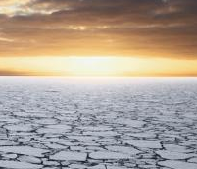
What is IARPC?
IARPC
Interagency Arctic Research Policy Committee
IARPC and US Arctic Research Commission (USARC) were established by Congress in the Arctic Research Policy Act (ARPA) in 1984
IARPC envisions a prosperous, sustainable, and healthy Arctic understood through innovative and collaborative research coordinated among Federal agencies and domestic and international partners.
Notes:
IARPC’s Principals drafted this vision statement in Spring of 2013

Slide 2
IARPC sits in the White House, EOP
Executive Office of the President (EOP)
11 major entities are f0und within EOP, including the National Security Staff (NSS), the Office of Management and Budget (OMB) and the Office of Science and Technology Policy (OSTP). EOP is overseen by the White House Chief of Staff.
Congress established OSTP with a broad mandate to advise the President on the effects of science and technology on domestic and international affairs. OSTP leads interagency efforts to develop and implement sound science and technology policies and budgets. It is directed by the President’s Science Advisor.
Office of Science and Technology Policy (OSTP)
NSTC is the principal means within the executive branch to coordinate science and technology policy across the Federal research and development enterprise. It is chaired by the President.
National Science and Technology Council (NSTC)
CENRS is one of four sub-committees of NSTC. Its purpose is to assist the NSTC to increase the overall productivity of Federal R&D efforts in the areas of environment, natural resources and sustainability. IARPC is one of twelve CENRS committees, including USGEO and USGCRP. CENRS is co-chaired by OSTP, NOAA, and EPA.
Committee on Environment and Natural Resources and Sustainability (CENRs)

Slide 3
Who’s Involved in IARPC?
Fourteen Federal entities, each with research responsibilities in the Arctic, comprise IARPC. They are represented on IARPC by their respective IARPC Principals :
Department of Agriculture
Department of Commerce
Department of Defense
Department of Energy
Department of Health and Human Services
Department of Homeland Security (U.S. Coast Guard)
Department of Interior
Department of State
Department of Transportation
Environmental Protection Agency
Marine Mammal Commission
National Aeronautics and Space Administration
National Science Foundation (chair)
Smithsonian Institution
IARPC also cooperates with the State of Alaska, indigenous organizations, academic institutions, non-governmental organizations, the Arctic Council, and international partners.

Slide 4
IARPC Implementation Structure
Committee on Environment and Natural Resources and Sustainability (CENRs)
IARPC Principals (1-2/yr)
Federal
IARPC Staff (1/mo)
IPMC (2-4/yr)
Fed & Non-Fed
IARPC Collaboration Team Co-Leads (1/mo * 12)
ACT
ADCT
MCT
HHCT
WFCT
TECT
SICT
GFCT
DBOCT
CBCT
AOSCT
ACCT

Slide 5
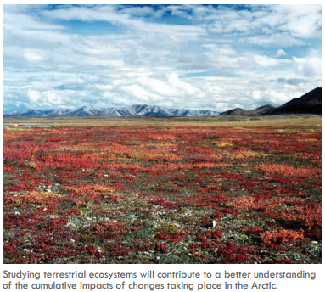
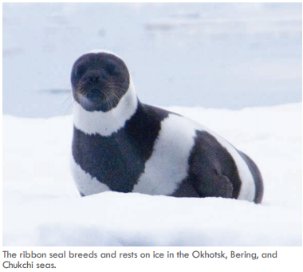
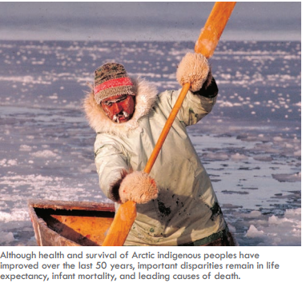
IARPC’s Current Key Activity, Implementing
IARPC Arctic Research Plan: FY2013 – 2017
Research Themes emphasize those activities that would benefit from an interagency approach –
Sea ice and marine ecosystem studies
Terrestrial ice and ecosystem studies
Atmospheric studies of surface heat,
energy, and mass balances
Observing systems
Regional climate models
Adaptation tools for sustaining
communities
Human health studies
Link to 5-Yr Plan Fact Sheet
Notes:
A key activities of IAPRC is drafting and implementing a 5-YR plan for Arctic Research. The most recent was published in spring of 2013. It emphasized seven broad research themes that would benefit from an interagency approach. Each topic addresses why this research theme is important, expected outcomes of this research, gaps in science and technology and attaches actionable collaborative milestones to each theme.

Slide 6
From Themes to Collaboration Teams
Teams meet monthly to communicate & make progress towards 145 milestones
Collaboration Teams | Chair(s), Agency
Sea Ice (SICT)** | Martin Jeffries and Scott Harper, DOD
Distributed Biological Observatory (DBOCT)** | Sue Moore, NOAA & Jackie Grebmeier, UMCES
Chukchi Beaufort (CBCT) | Guillermo Auad, BOEM & Danielle Dickson NPRB
Glaciers and Fjords (GFCT) | William Wiseman and Hedy Edmonds, NSF
Terrestrial Ecosystems (TECT) | John Payne, NSSI and Carl Markon, DOI
Wildfires (WCT) | Kent Slaughter, DOI
Atmosphere (ACT) | Ashley Williamson, DOE
Arctic Observing Systems (AOSCIT) | Erica Key, NSF
Arctic Data (ADCIT) | Marco Tedesco, NSF
Modeling (MCT) | Mike Kuperberg, Dorothy Koch & Renu Joseph, DOE
Human Health (HHCT) | Alan Parkinson, HHS/CDC
Communities (CCT) | Bill Fitzhugh, SI
** Jointly Implemented w\ National Ocean Council
Notes:
These milestone, more than 145 and growing, are being address by 14 Implementation Teams. These teams meet about once a month, led by a chair from a federal agency. Two teams are jointly convened by IAPRC and the NOC to closely coordinate implementation. Teams are comprised by both federal scientists and broader talent from outside the federal government, “outside partners”.

Slide 7
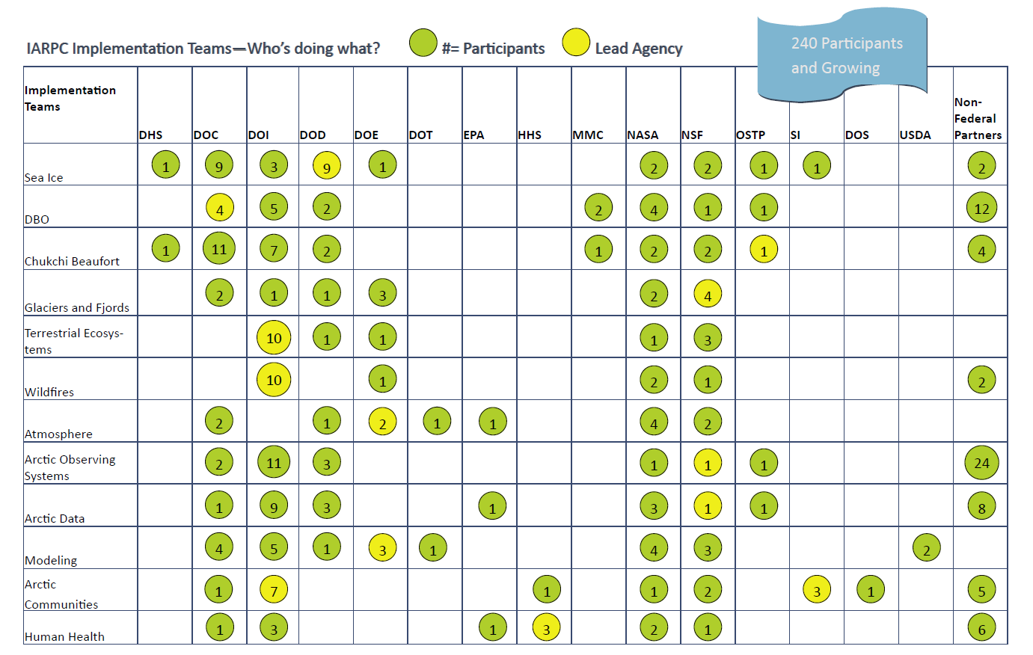
Who’s Participating in Implementation?
Participation from non-Federal partners is welcome and growing. Contact Implementation Team leads to find out how you can get involved.
Notes:
There is significant participation in these activities and it continues to grow. The green dots in this matrix show the number of participants by agency AND from outside the federal family. Yellow dots show the number of participants from the lead agency. Currently there are more than 200 participants in IARPC implementation. Participation from non-Federal partners is welcome. Individuals wishing to become involved should contact the appropriate implementation team lead from the previous slide.

Slide 8
What do Coordination Teams work on?
Monthly Communications Forums
Planning Progress Towards Milestones
Thematic Cross-Cutting Inventories of Research Assets and Investments
Improved Coordination of Research Calls
Improved Cooperation with non-Federal Partners
Gap Identification
Logistics Leveraging
Workshop Development
Data Sharing

Slide 9
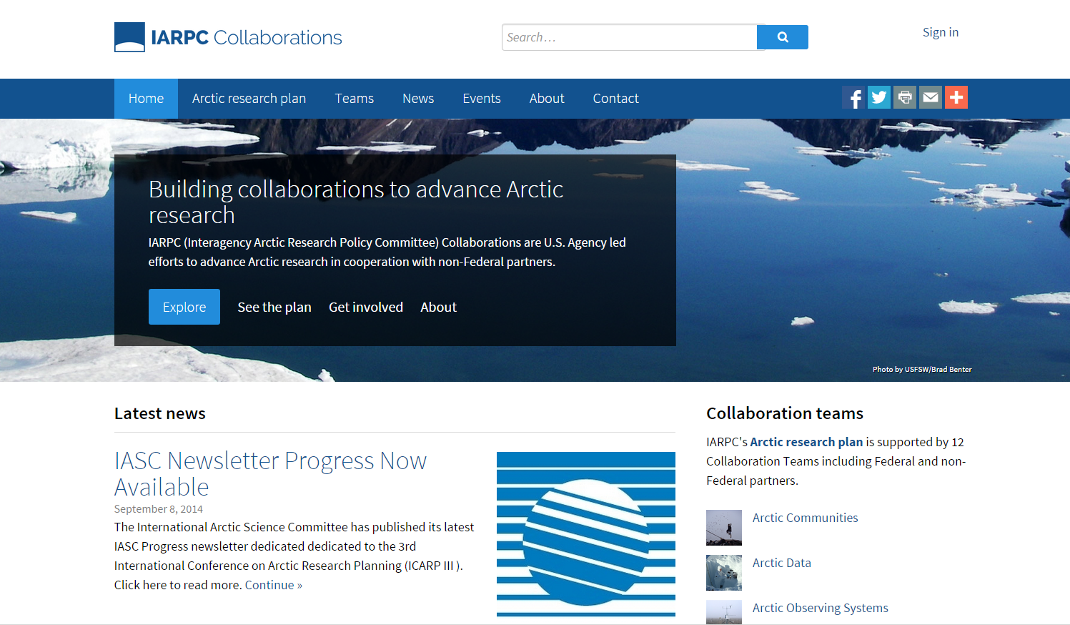
Our new website
http://beta.iarpccollaborations.org/members/index.html

