Slide 1

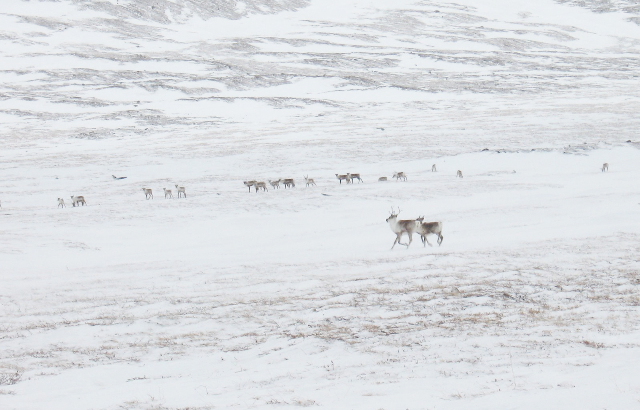




SEARCH Kick-Off Tactics Meeting
September 16-17, 2014
NCAR Foothills Lab Bldg 2
ACADIS - Activities and Potential Collaboration with SEARCH
Lynn Yarmey and the ACADIS Team

Slide 2
ACADIS Vision
ACADIS provides sustainable data management, data stewardship services and leadership for the NSF Arctic research community through open data sharing, adherence to best practices and standards, capitalizing on appropriate evolving technologies, community support, and community engagement.
ACADIS leverages other pertinent projects, capitalizing on appropriate emerging technologies and participating in emerging cyberinfrastructure initiatives.

Slide 3
The ACADIS Team
ACADIS is funded as a collaborative research award with four organizational partners
  National Center for Atmospheric Research (NCAR) Earth Observing Laboratory (EOL)
  National Center for Atmospheric Research (NCAR) Computational and Information Systems Laboratory (CISL)
  University Corporation for Atmospheric Research (UCAR) Unidata
  National Snow and Ice Data Center (NSIDC)

Slide 4
ACADIS Focus Areas: Activities and Services
Documentation
Metadata Subgroup
Cleanup
ACADIS
Gateway
Standards
Web Services
Arctic Data Explorer
Metadata
Archiving
Data Services
Inter-Operability
Rosetta
Feeds and Harvests
Data Citations
Science Support
Education and Outreach
Partnerships
Help desk
ReadMe Template
Special Requirements
DMP Template

Slide 5
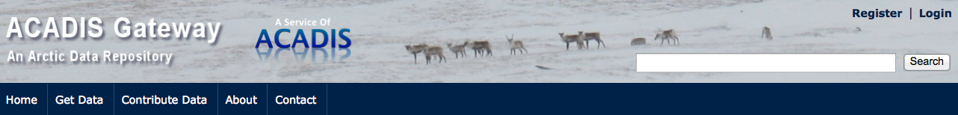
ACADIS Gateway
Sustainable Arctic research data manage-ment, archival, preservation and access
The ACADIS Gateway supports NSF PLR
ARC researchers with tools and services for
preserving, citing and sharing research data.
ACADIS
Gateway
Arctic Data Explorer
Data Services
Tools for self service data publication
Access to provider resources and documentation
Web services for workflow automation
Feeds for metadata access and sharing
Integrated access to Rosetta data translation tool
Search and browse of ACADIS Arctic data holdings
Support feedback guides product direction
OpenSource Apache License 2.0
Rosetta
Data Citations
aoncadis.org

Slide 6
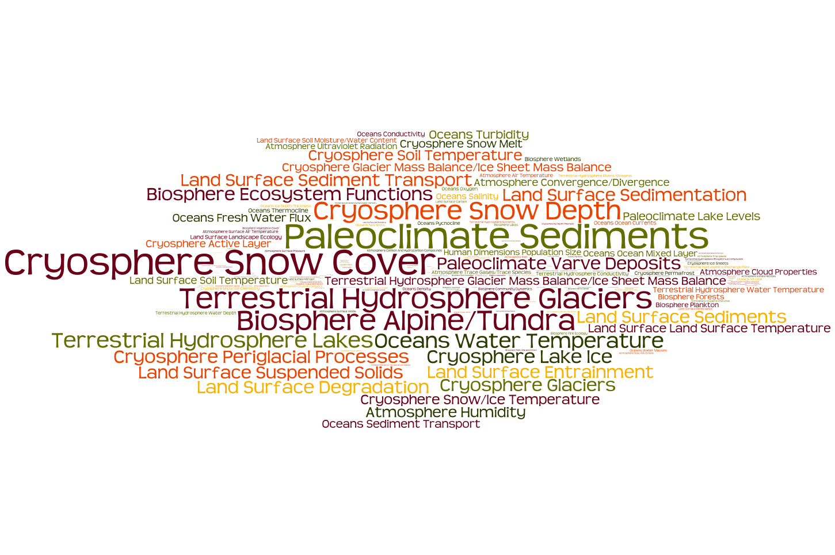
Data Holdings by GCMD Discipline, ACADIS Gateway

Slide 7
Metrics and Community Service
Projects by NSF directorate
  AON - 58
  ANS - 39
  ARCSS - 26
  ASSP - 1
  ANS/CI - 1
  ARCSS/AON - 2
  PCI - 1
  Other - 13
3000 - ACADIS Datasets
190 - Contributing PIs
140 - Projects
500 - Visitors Monthly
50 - Download Visitors Monthly

Slide 8
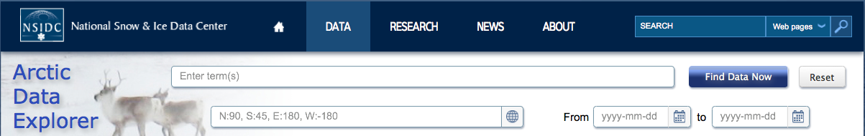
Arctic Data Explorer
Efficient discovery, access for Arctic data
The Arctic Data Explorer is a broad discovery tool for finding and accessing interdisciplinary Arctic data from diverse investigators, projects, agencies, and nations.
ACADIS
Gateway
Arctic Data Explorer
Data Services
User centered development
Usability study driven refinement
Supports emerging discovery standards
Built on metadata brokering technology
Leverages other Arctic data repositories
Contributing to/creating open source libraries
Rosetta
Data Citations
nsidc.org/acadis/search

Slide 9
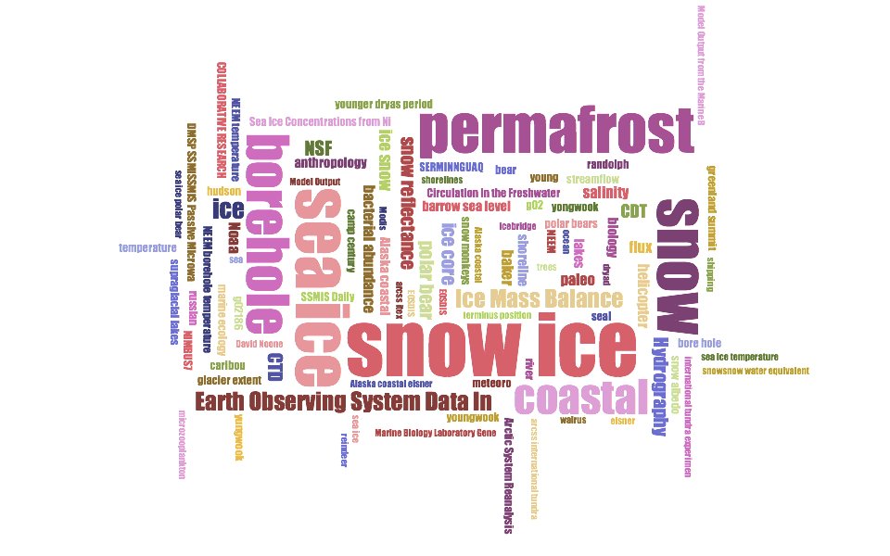
Data Searches by Topic, Arctic Data Explorer

Slide 10
Arctic Data Explorer
Data catalogs at the following organizations are in active daily harvest by the ACADIS Arctic Data Explorer
ACADIS Gateway
NCAR - Earth Observing Laboratory (EOL)
National Snow and Ice Data Center (NSIDC)
NCAR - Research Data Archive (RDA)
National Oceanographic Data Center (NODC)
Norwegian Meteorological Institute (NMI)
International Council for the Exploration of the Sea (ICES)
NASA Earth Observing System Clearing House (ECHO)

Slide 11
Rosetta Data Translator
Enabling science through data sharing
The Rosetta Data Translation tool, is a web-based service that provides an easy, wizard-based interface for data collectors to transform their ASCII output into Climate and Forecast (CF) compliant netCDF files.
ACADIS
Gateway
Arctic Data Explorer
Data Services
Web based guided interface
Data format conversion
  Upload a local Excel file
  Fill in metadata GUI
  Extract standard NetCDF or Excel
Rosetta
Data Citations
https://rosetta.unidata.ucar.edu/createAcadis

Slide 12
Community Engagement
Example engagement activities include:
National Meetings
American Meteorological Society (AMS)
American Geophysical Union (AGU)
Geological Society of America (GSA)
American Association for the Advancement of Science (AAAS)
Ocean Science Meeting (OSM)
American Association of Geographers (AAG)
Research Data Access and Preservation Summit (RDAP)
International Meetings
International Polar Data Forum
Targeted Events
EarthCube workshops
Cyberinfrastructure for Polar Science
Domain Science Events
Ocean sciences, snow remote sensing, Arctic ecology and geology, etc.

Slide 13
Request for Publications from Arctic Community
Letter was sent on Aug. 15th to NSF Arctic investigators (~500) asking for:
A full reference of each publication you have authored or co-authored that used ACADIS data
The URL(s) of the ACADIS data set(s) used in the publication(s)
You are optionally asked to include grant information supporting the publication
A link to the easy-to-use form was in the letter and is on the ACADIS Gateway http://tinyurl.com/acadisPubSubmit
ACADIS Publications List https://www.eol.ucar.edu/node/5279
        Publications: 213
        Books: 9
        Conference Proceedings: 3
        Theses & Dissertations: 8
        Special Issues: 3
        Reports: 2
          Total: 238

Slide 14
Potential Areas of Collaboration with SEARCH
Data portal
  open access to NSF Arctic data
Interdisciplinary data linked from other archives
  broad interoperability, international data exchange
Data reformatting
  Rosetta data format translation tool
EOL data management focused website for SEARCH
Best Practices
  data management, metadata, formatting, documentation, DOIs
Unify diverse metadata

Slide 15
Thank you!
Lynn Yarmey – lynn.yarmey@colorado.edu
and the ACADIS Team – support@aoncadis.org

Slide 16
Data Relevance Process
Panel Recommendation: Find out what it takes to make ACADIS science relevant
Challenges:
  How does relevance connect to use?
  Science relevance is very subjective
  Mechanisms are not fully in place to track use
  Relevance can change over time
  Relevance often lives at a parameter level rather than dataset level
Fundamentally, science relevance is a research question

Slide 17
Data Relevance Process
Multi-faceted approach
  How does relevance connect to use?
    Work with community to capture existing use through published papers
  Science relevance is very subjective
    Take a data-driven perspective using metrics
  Mechanisms are not fully in place to track use
    Use mechanisms we do have (existing DOIs, user communities
  Relevance can change over time
    Preservation Assessment tools looks at long-term use
  Relevance often lives at a parameter level rather than dataset level
    ______?
Outcomes
  Our best understanding of the Science Relevance of ACADIS given the state of the field.

Slide 18
ACADIS Data Advisory Committee
Members
  Dave Bailey (Chair), University Consortium for Atmospheric Research, Boulder, Colorado
  Carin Ashjian, Department of Biology, Woods Hole Oceanographic Institution, Woods Hole, Massachusetts
  Larry Hamilton, Sociology Department, University of New Hampshire, Durham, New Hampshire
  Andrew (Drew) Slater, National Snow and Ice Data Center, University of Colorado, Boulder
  Mary-Louise Timmermans, Department of Geology and Geophysics, Yale University, New Haven, Connecticut
  Craig Tweedie, Department of Biological Science, University of Texas at El Paso

Slide 19
ACADIS System Integrated in the Community
Preserve
Data
Chronopolis
Creates Standard
Format Files
Publishes
Files
Rosetta
Self Published
Datasets
ACADIS
Gateway
Discovery
Data Users
Harvested
Metadata
Harvested
Metadata
Arctic Data Explorer
Data Providers
Data Support
Services
Harvested
Metadata
Assists
with
External Data
Services
Arctic Field
Project Archive
Special
Requirements
Datasets
Harvested
Metadata
External
Arctic Data
Repositories
Harvested
Metadata

