Slide 1
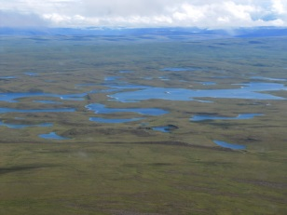
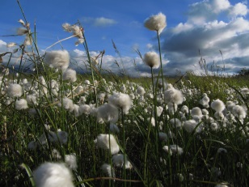
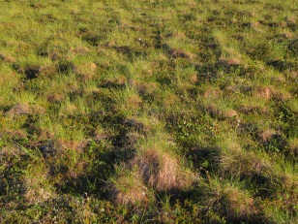
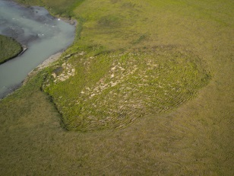
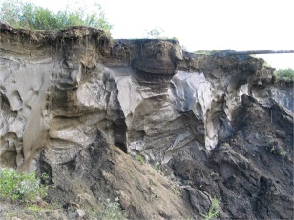





Permafrost Carbon Network
PIs: Ted Schuur, A. David McGuire
Steering Committe: Josep Canadell, Jennifer Harden, Peter Kuhry, Vladimir Romanovsky, Merritt Turetsky; Postdoctoral Researcher: Christina Schädel
Search Terms Web of Science
Permafrost and Carbon in Full Text
2000–present: 92%
2005–present: 80%
2010–present: 47%
www.biology.ufl.edu/permafrostcarbon

Slide 2
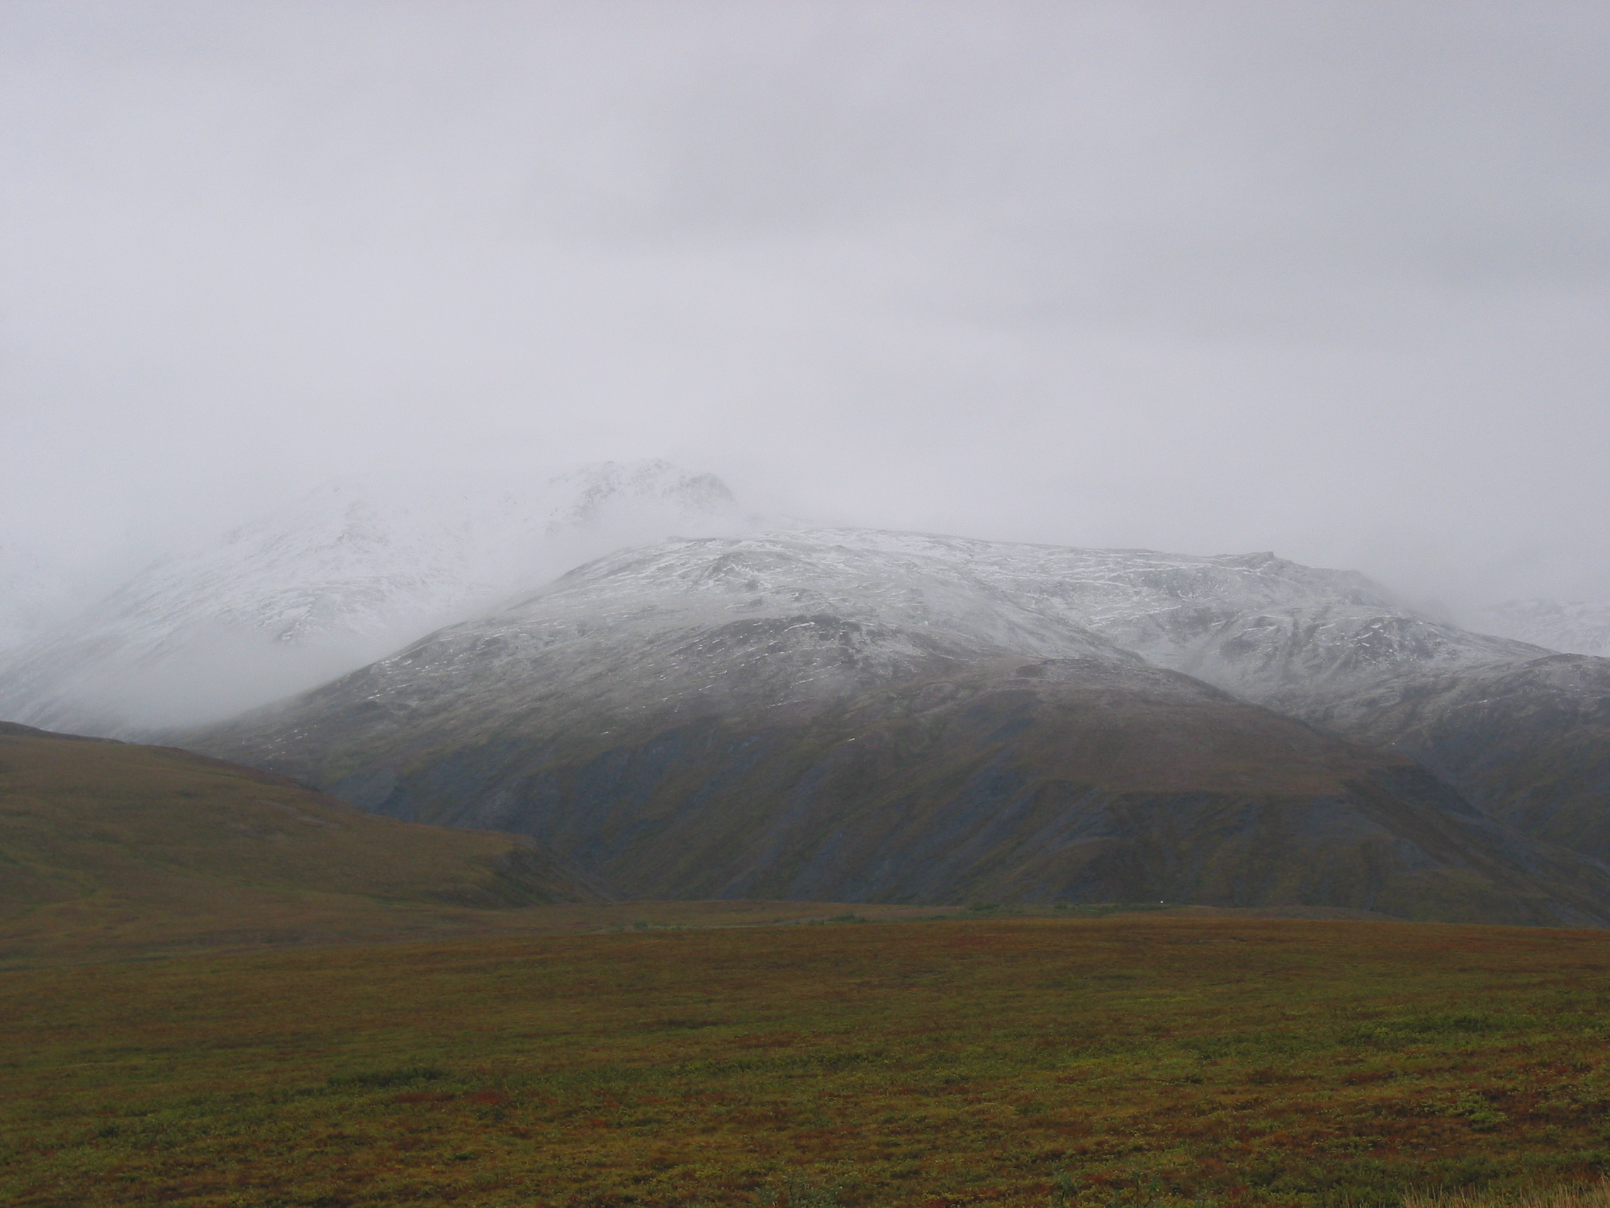
Permafrost Carbon Feedback to Climate
What is the magnitude, timing, and form of the permafrost carbon release to the atmosphere in a warmer world?
Notes:
My research has focused on trying to shed some clarity on the issue of permafrost vulnerability to climate change.
Yes the carbon is there frozen, but its potential impact on climate is encapsulated by this overarching question.

Slide 3
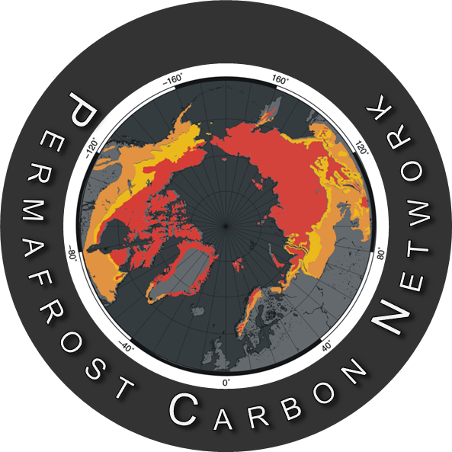
Permafrost Carbon Network
OBJECTIVE: Produce new knowledge through research synthesis that can be used to quantify the role of permafrost C in driving climate change in the 21st century and beyond.
ACTIVITIES:
1) Organize a sequence of meetings and working groups designed to synthesize existing permafrost C research
2) Formation of a consortium of interconnected researchers to disseminate synthesis results
3) Permafrost carbon website
4) Enhance young researcher networks

Slide 4
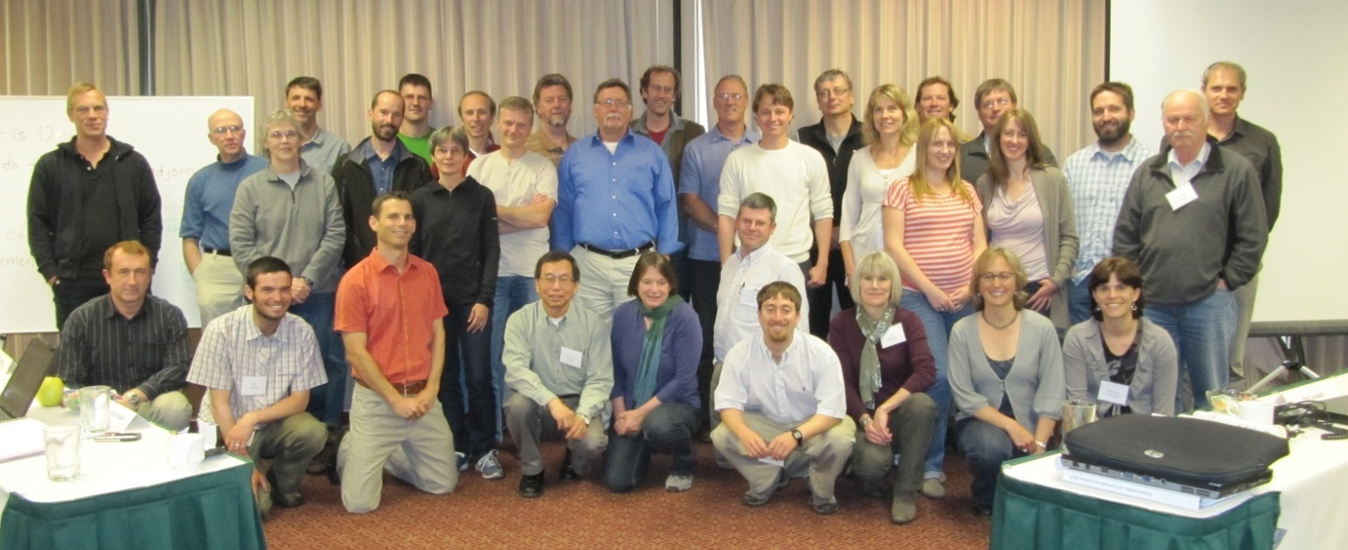
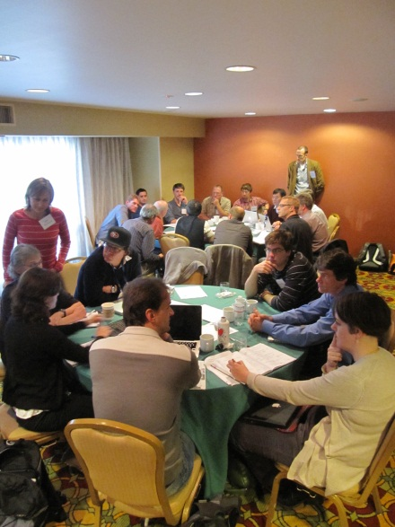
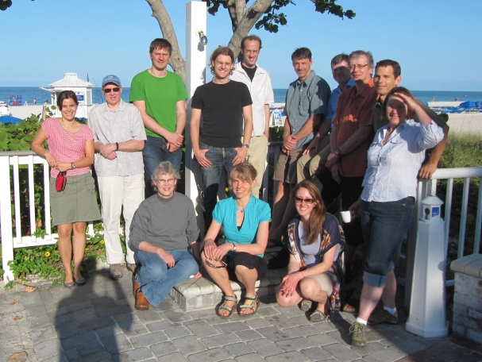
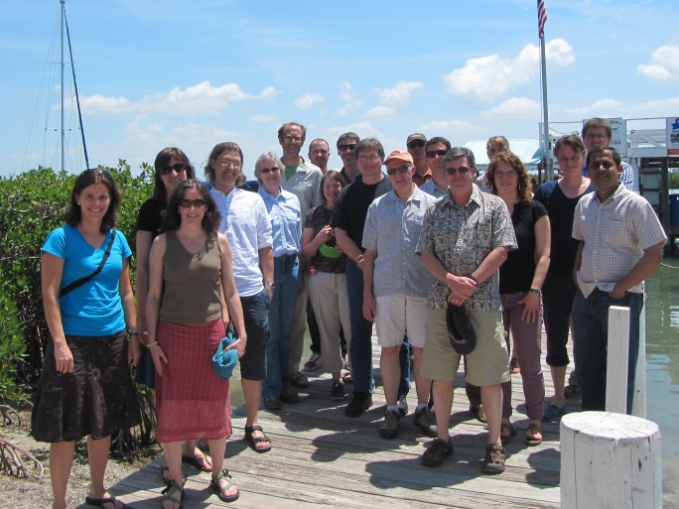
Permafrost Carbon Network Members
Current number of:
Members: 200+
Institutions: 88
Countries: 17
Working Groups
Carbon Quantity: 30 members
Carbon Quality: 35 members
An/Aerobic: 29 members
Thermokarst: 38 members
Modeling Integration: 70 members

Slide 5
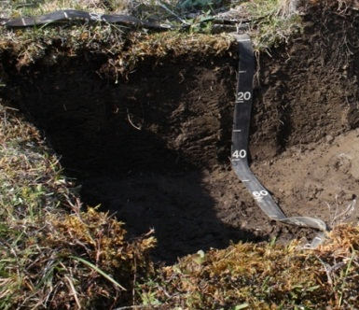
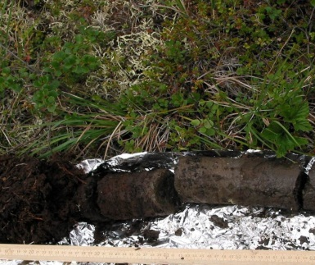
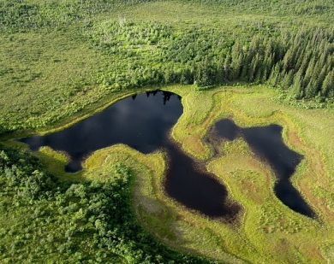
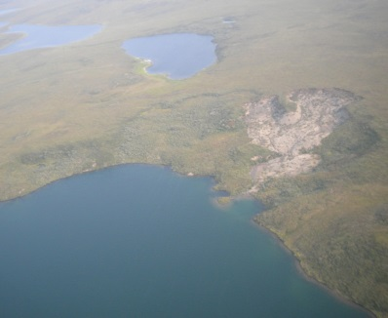
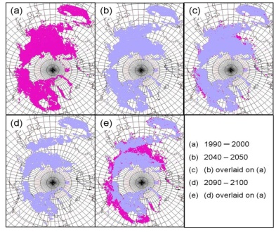
Working Group Synthesis Activities
Data syntheses in formats for biospheric or climate models:
1) Permafrost Carbon Quantity
Leads: Gustaf Hugelius, C. Tarnocai, J. Harden
Circumpolar SOC stocks and O-horizon depths;
Quantifying uncertainties in circumpolar permafrost SOC storage
2) Permafrost Carbon Quality
Leads: Christina Schädel, T. Schuur, S. Natali, C. Treat, J. Jastrow
Effect size of environmental controls on permafrost C decomposability;
Permafrost C release under saturated conditions
Assessing the lability of permafrost carbon using chemical and physical fractionation approaches
3) Anaerobic/Aerobic Issues
Leads: David Olefeldt, M. Turetsky
Synthesis of CO₂ and CH₄ fluxes from northern lakes and wetlands;
Controls on methane emission in permafrost environments
4) Thermokarst
Leads: Guido Grosse, B. Sannell
Metadata analysis of physical processes/rates;
Analysis of thermokarst inventories;
Distribution of thermokarst features in the Arctic
5) Modeling Integration
Leads: Dave McGuire P. Canadell, D. Lawrence, Charles Koven, D. Hayes
Evaluation of thermal and carbon dynamics of permafrost-carbon models;
State-of-the-art assessment of the vulnerability of permafrost carbon and its effects on the climate system

Slide 6
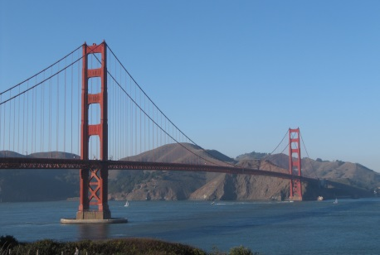
Permafrost Carbon Network Activities
Presentations/Networking:
2011
American Geophysical Union, San Francisco, CA
2012
European Geosciences Union, Vienna, Austria
Carbon Cycle Science Steering Group Meeting,
Washington DC
Center for Permafrost Steering Group Meeting,
Copenhagen, Denmark
Tenth International Conference on Permafrost
Salekhard, Russia
Ecological Society of America, Portland, OR
US-UK Arctic Workshop, Cambridge, UK
American Geophysical Union, San Francisco, CA
2013:
Bonanza Creek LTER Annual Meeting, Fairbanks, AK
North American Carbon Program, Albuquerque, NM
European Geosciences Union, Vienna, Austria
DOE Terrestrial Ecosystem Sciences, Washington, DC
Climate Science & Policy, Washington, DC
Cryosphere in a Changing Climate, Tromsø, Norway
2014
More
Workshops:
2011
Synthesis Workshop, Seattle, WA
Annual Meeting, San Francisco, CA
2012
Working Group Lead Meeting, St Pete Beach, FL
Annual Meeting, San Francisco, CA
2013
Working Group Lead Meeting, Captiva Island, FL
Annual Meeting, San Francisco, CA
2014
Working Group Lead Meeting, May 12-15, Stockholm, Sweden (co-sponsored by CAPP)
Activities: Team leads produce summary paper of synthesis results, future research recommendations, as well as project report
Annual Meeting, San Francisco, CA, Dec. 14, 2014
http://www.biology.ufl.edu/permafrostcarbon/upcoming%20meetings.html

Slide 7
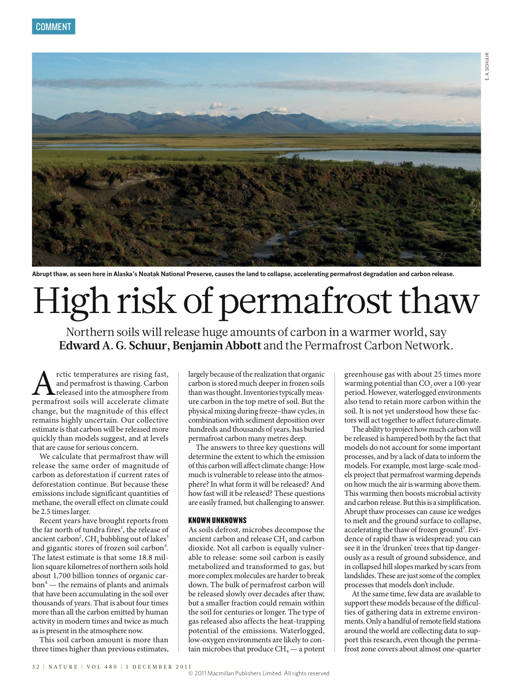
Permafrost Carbon Feedback: Expert Assessment
High Warming Scenario (2100): 162-288 Pg C (in CO₂ equivalent)
Low Warming Scenario (2100): 54-105 Pg C (in CO₂ equivalent)
2.3% CH₄ = half of emissions in CO₂ equivalent
Schuur et al. 2011 Nature
Schuur et al. 2013 Climatic Change

Slide 8
Recent Synthesis Products (2013-2014)
A pan-Arctic synthesis of potential CH₄ and CO₂ production under saturated conditions Treat, C. et al.. Global Change Biology, (in revision).
Improved estimates show large circumpolar stocks of permafrost carbon while quantifying substantial uncertainty ranges and identifying remaining data gaps Hugelius, G. et al.. Biogeosciences Discuss. 11, 4771-4822, (2014).
Circumpolar assessment of permafrost C quality and its vulnerability over time using long-term incubation data. Schädel C et al. (2014). Global Change Biology, doi: 10.1111/gcb.12417
The Deep Permafrost Carbon Pool of the Yedoma Region in Siberia and Alaska. Strauss et al. (2013) Geophysical Research Letters, 2013GL058088, doi: 10.1002/2013gl058088
Short Communication: Research Coordination Network on the Vulnerability of Permafrost Carbon (2013). Schädel, C et al. . Frozen Ground 37:7
Empirical estimates to reduce modeling uncertainties of soil organic carbon in permafrost regions: a review of recent progress and remaining challenges. Mishra U et al. (2013) Environmental Research Letters, 8, 3. 035020, doi: 10.1088/1748-9326/8/3/035020
Distribution of late Pleistocene ice-rich syngenetic permafrost of the Yedoma Suite in east and central Siberia, Russia. Grosse G et al. (2013) U.S. Geological Survey Open File report, 2013-1078, 37 pp.
many more publications: http://www.biology.ufl.edu/permafrostcarbon/publications.html

Slide 9
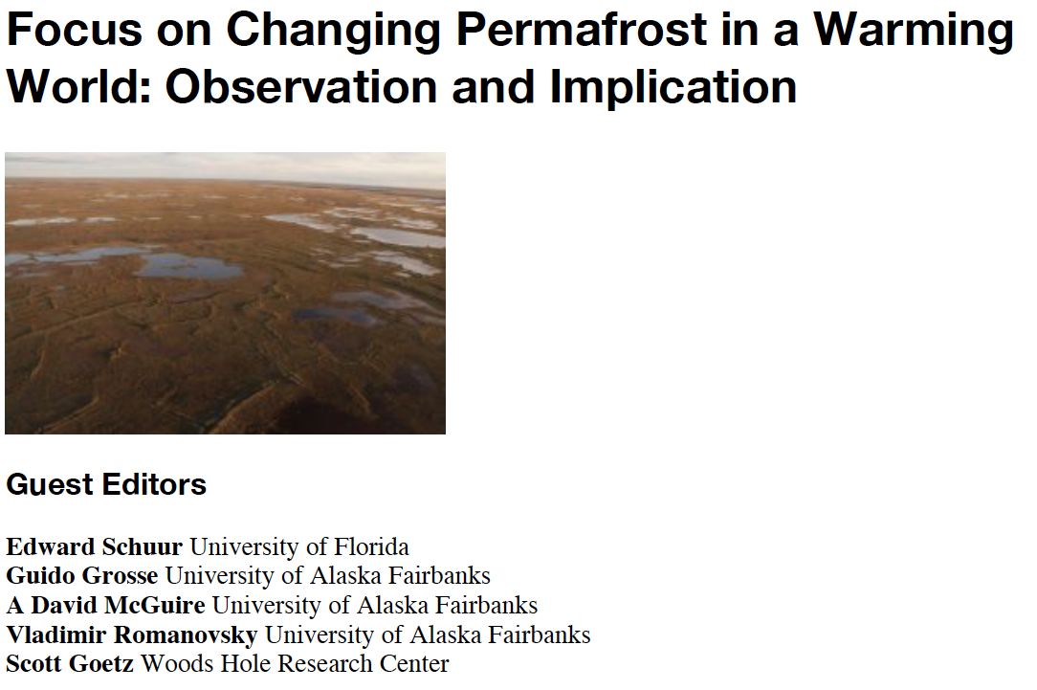
Permafrost Special Issue
Environmental Research Letters
(Open Access)
Papers published: 25+

Slide 10
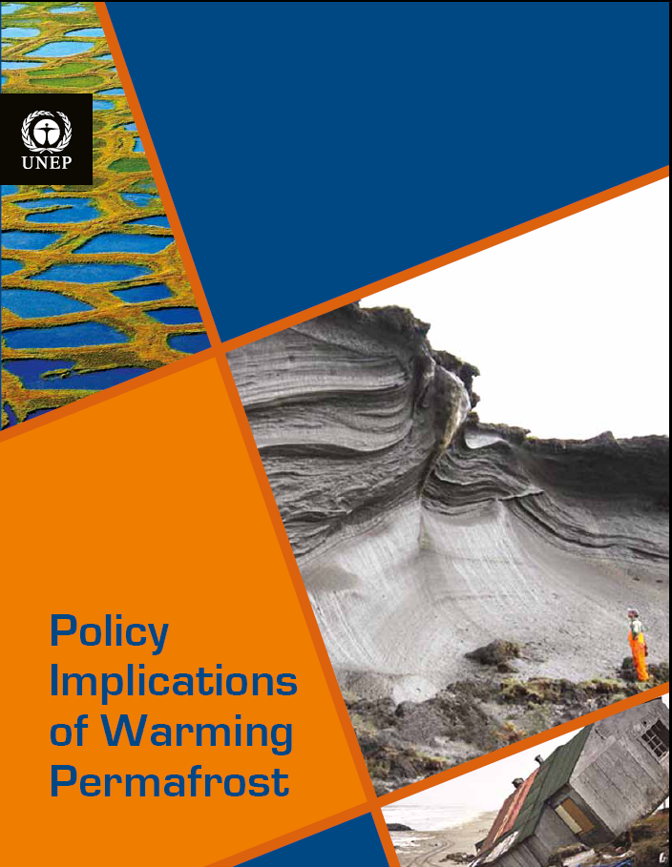
UNEP
Recommendations
•Special assessment on permafrost emissions
•National permafrost monitoring networks
•National adaptation plans
Schaefer et al. 2013 ERL

Slide 11
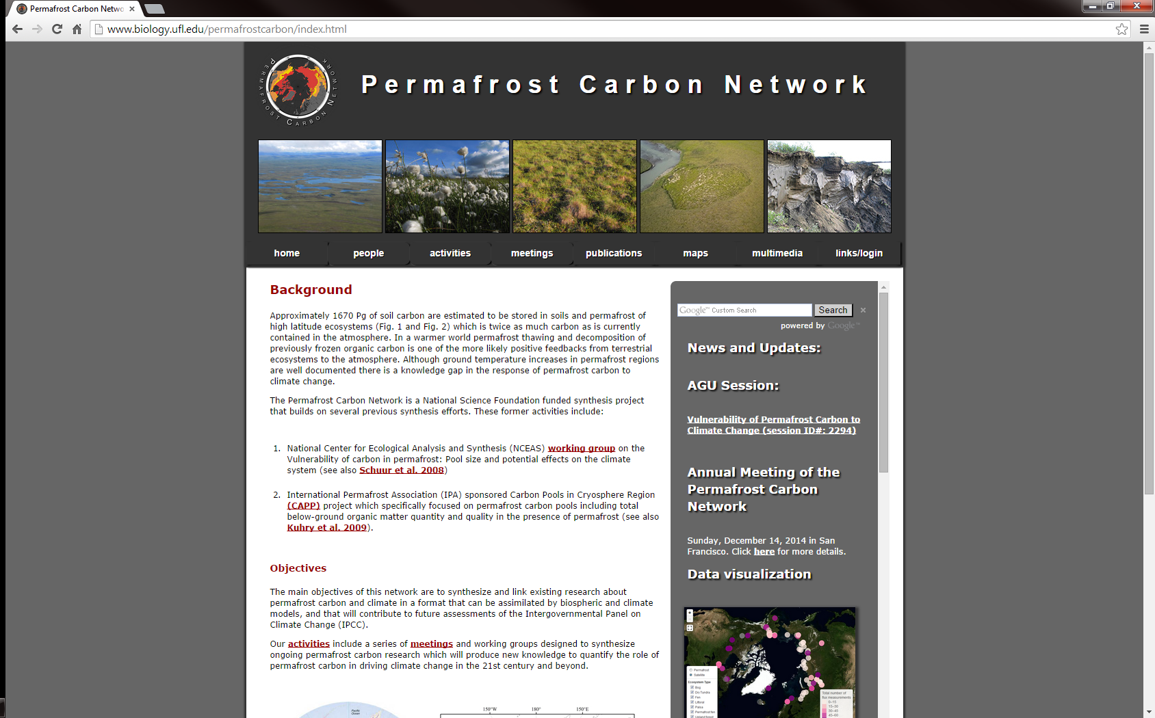
Permafrost Carbon Website
http://www.biology.ufl.edu/permafrostcarbon/
Including
Job ads

Slide 12
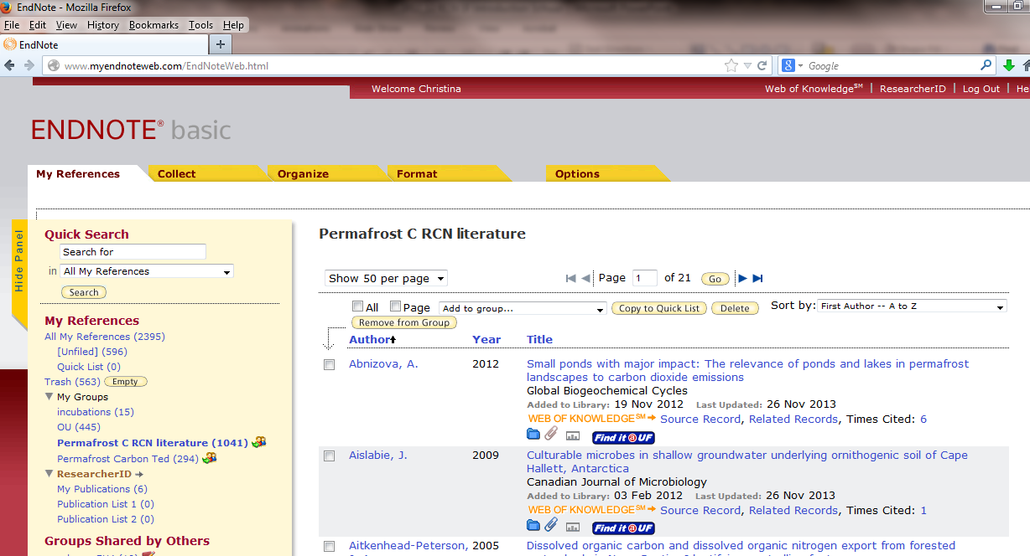
EndNote Web library: Permafrost Carbon Network literature contains 1040+ citations, with the search terms: ‘permafrost’ and ‘carbon’
At least 140+ new publications in 2013
Literature will be updated

Slide 13
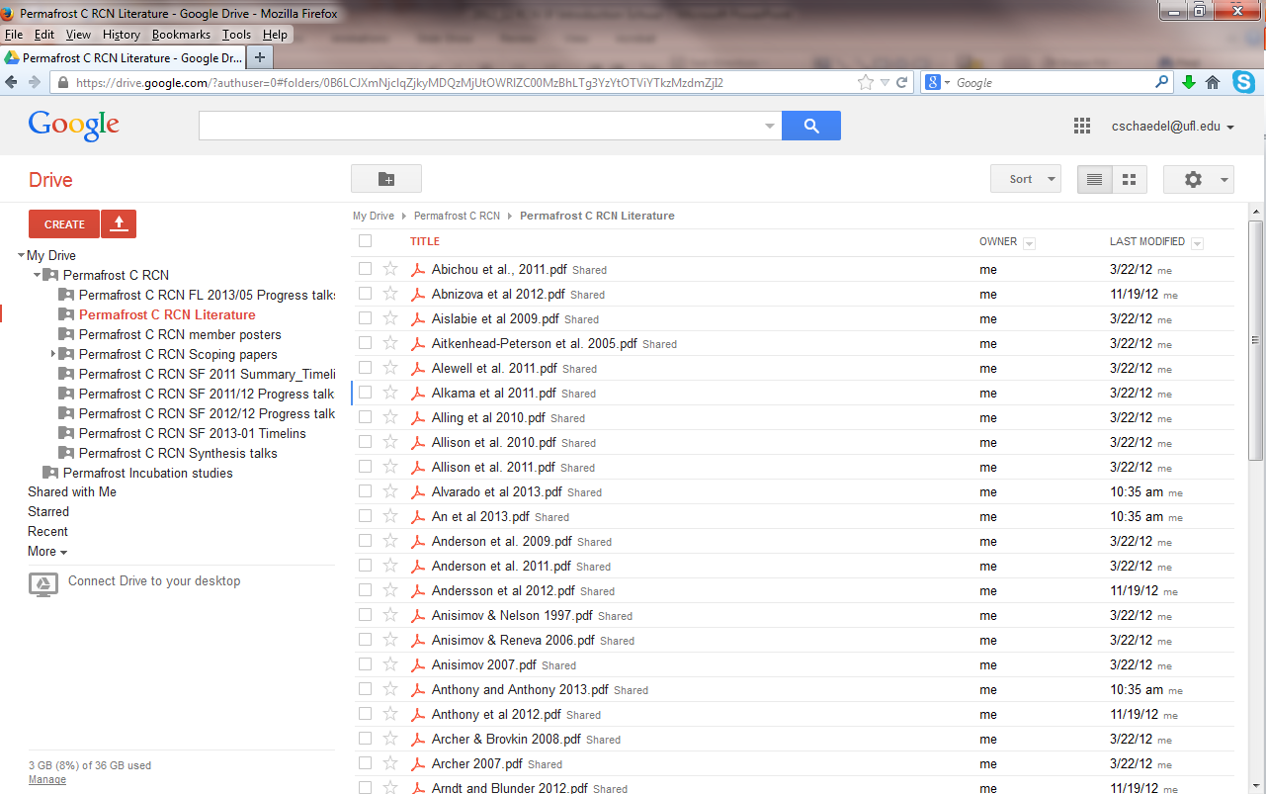
Google docs folder: Permafrost Carbon Network Literature contains most of the pdf’s from these citations

Slide 14
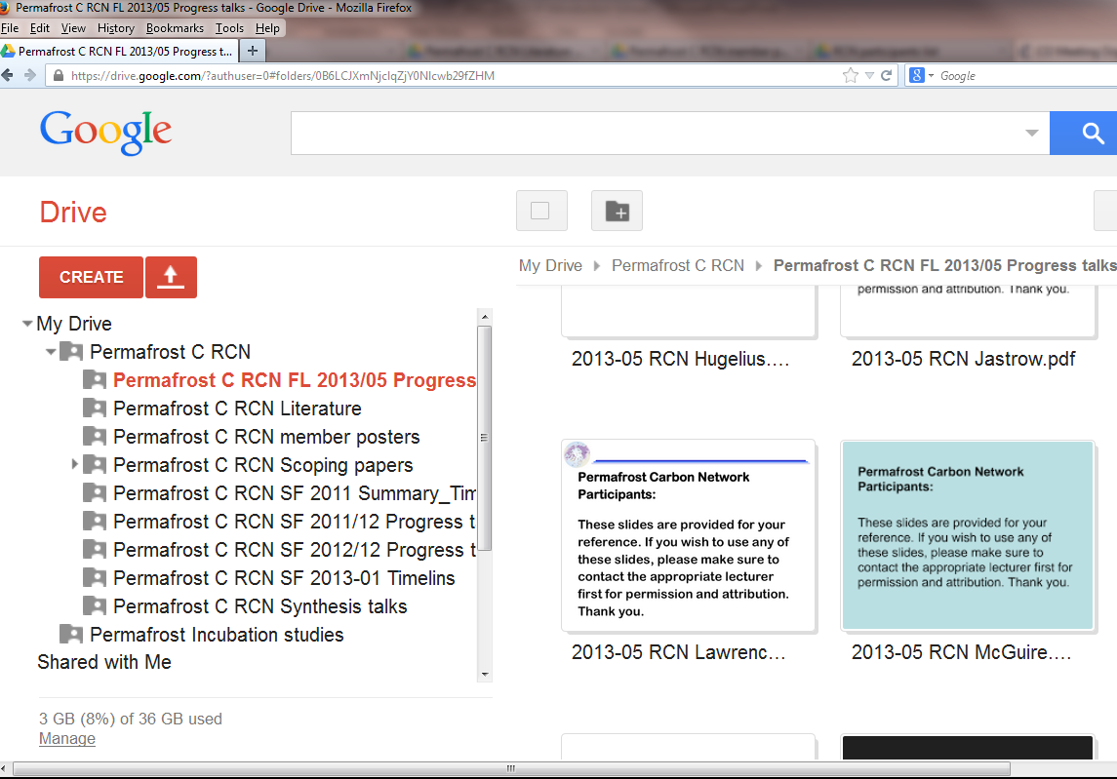
Permafrost Carbon Network(ing)
Shared Google Documents
Scoping Documents
Synthesis Ideas & Timelines
Databases – TBD
Use the Permafrost Carbon Network
Permafrost Carbon Google Groups
permafrostcarbon@googlegroups.com
permafrostcarbon_cquantity@googlegroups.com
permafrostcarbon_cquality@googlegroups.com
permafrostcarbon_anaerobic@googlegroups.com
permafrostcarbon_thermokarst@googlegroups.com
permafrostcarbon_modeling@googlegroups.com

Slide 15
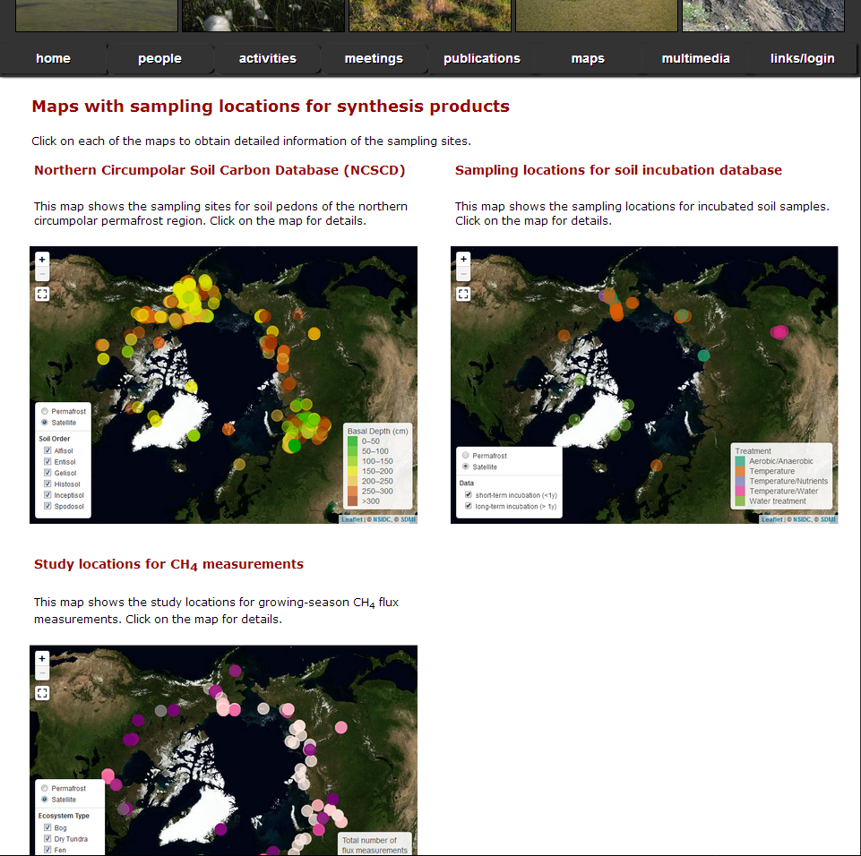

Slide 16
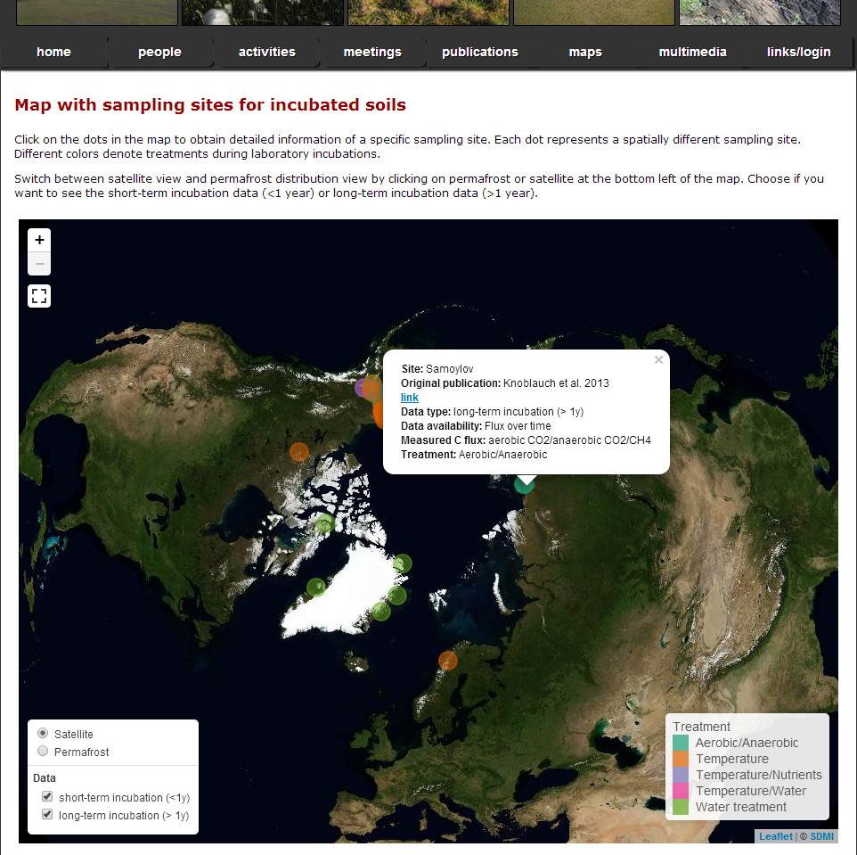

Slide 17


Permafrost Carbon Network
Annual Community
Meeting at AGU
Sunday, December 14th 2014
9 am – 5 pm
Workshop Format
AM
Working Group Updates:
C Quantity; C Quality; Thermokarst; Aerobic/Anaerobic; Modeling Integration:
PM
Breakout discussion groups: Focus on cross-linking products.
input and new ideas from new members welcome
AGU Organized Sessions: Vulnerability of Permafrost Carbon
70+ invited and contributed abstracts

Slide 18
Upcoming Permafrost Synthesis & Outreach
Permafrost Research Priorities: Community survey activity.
Coordinated by CliC, IPA. Deadline September 20, 2014
Lead: H. Lantuit, AWI
Adaptation Action for a Changing Arctic (AACA): Regional assessments focused on adaptation to a changing Arctic. Coordinated by Arctic Council/AMAP. Writers workshop September 20-21, 2014
BCB Lead: L. Hinzman
Snow, Water, Ice, and Permafrost in the Arctic (SWIPA): Update permafrost (and other) sections. Coordinated by Arctic Council/AMAP
Permafrost Lead: V. Romanovsky

Slide 19
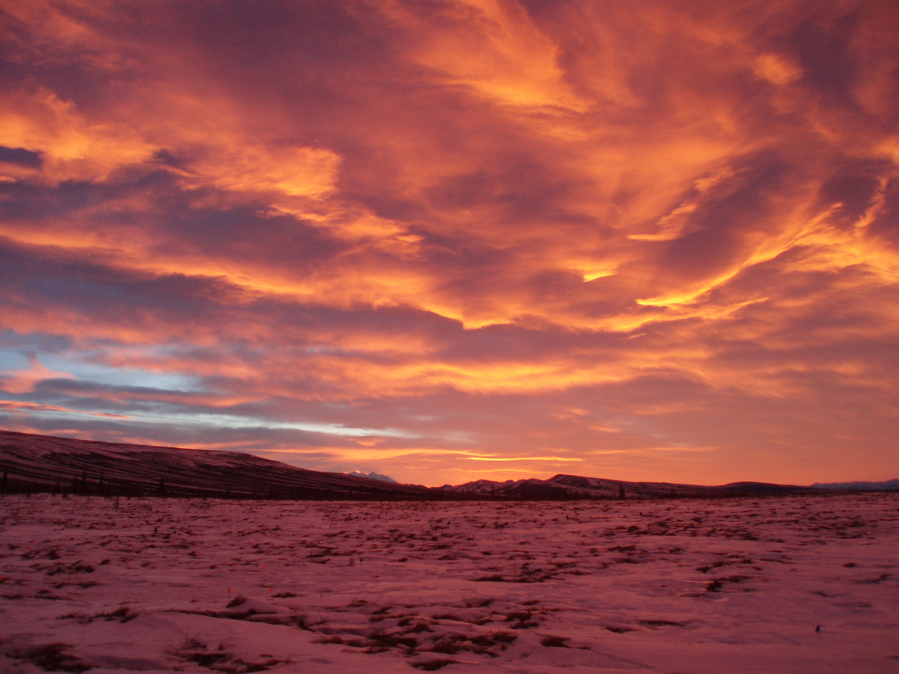
Summary
New Knowledge: Future (and ongoing) data generation will be maximized by Permafrost Carbon Network synthesis effort
Participants: Network is open for active participation. Distributed format designed to connect multiple national and international nodes
Funding: Framework is established, additional funding necessary to support participants at synthesis workshops and for future research activities. Additional workshop support has already been provided by: WCRP CliC, DOE, USGS, IASC
Notes:
Thank you; I am happy to take any questions.

