Slide 1
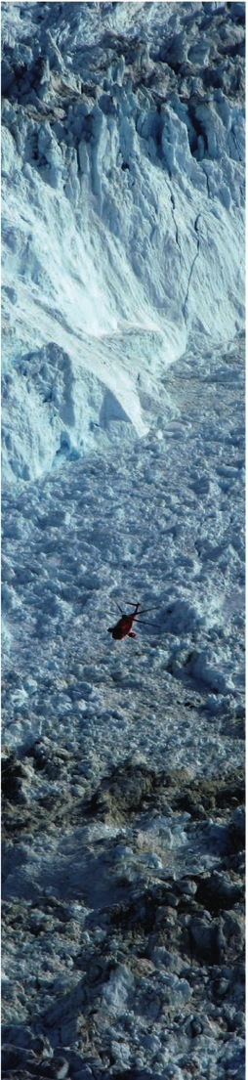
Understanding and Predicting Land-ice Loss in the Arctic and its impacts
Fiamma Straneo (WHOI), Ted Scambos (NSIDC)
Greenland Ice Sheet
(6.5 m SLR)
Arctic Ice Caps/Glaciers
(0.35 m SLR)
Greenland loss rate: 211 Gt/yr
Arctic Ice caps loss rate: 64 Gt/yr
Alaskan glacier loss rate: 65 Gt/yr

Slide 2
Increasing Greenland Ice Sheet Mass Loss
Gravity-based (GRACE) results for Greenland since 2003
(Tedesco et al. 2013; Harig and Simons, 2012; Velicogna and Wahr, 2006)
Notes:
Mass loss quadrupled from 1992-2001 to 2002-2011 → 7.5 mm of slr over 20 years
Presently Greenland accounts for ¼ of global SLR
Cumulative freshwater anomaly since 1995 is ~ 1/3 GSA of 1970s (Bamber et al. 2012)

Slide 3
Goals – Land-ice Action Team
LAND ICE LOSS
Improved understanding of rates, processes, and prediction
COMMUNICATION TO STAKEHOLDERS & POLICY MAKERS
LAND ICE LOSS IMPACTS
Improved understanding of linkages and prediction

Slide 4
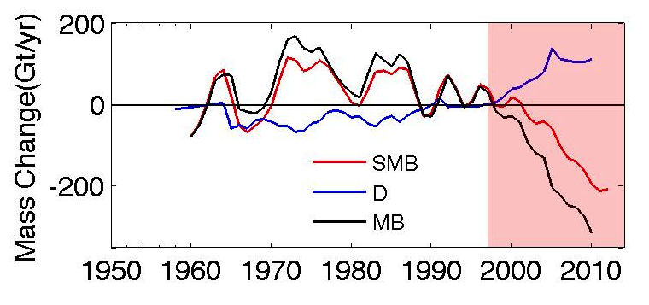
LAND ICE LOSS
Improved understanding and prediction
DYNAMIC ICE LOSS
SURFACE MASS BALANCE
Bamber et al. 2012; Van den Broeke et al. 2009; Straneo and Heimbach 2013
Notes:
Mass loss quadrupled from 1992-2001 to 2002-2011 → 7.5 mm of slr over 20 years
Presently Greenland accounts for ¼ of global SLR

Slide 5
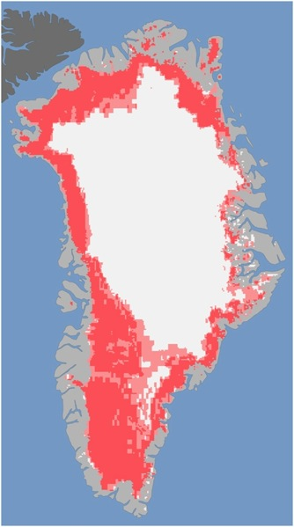
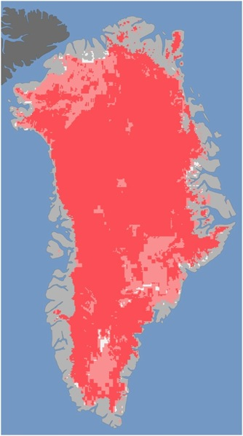
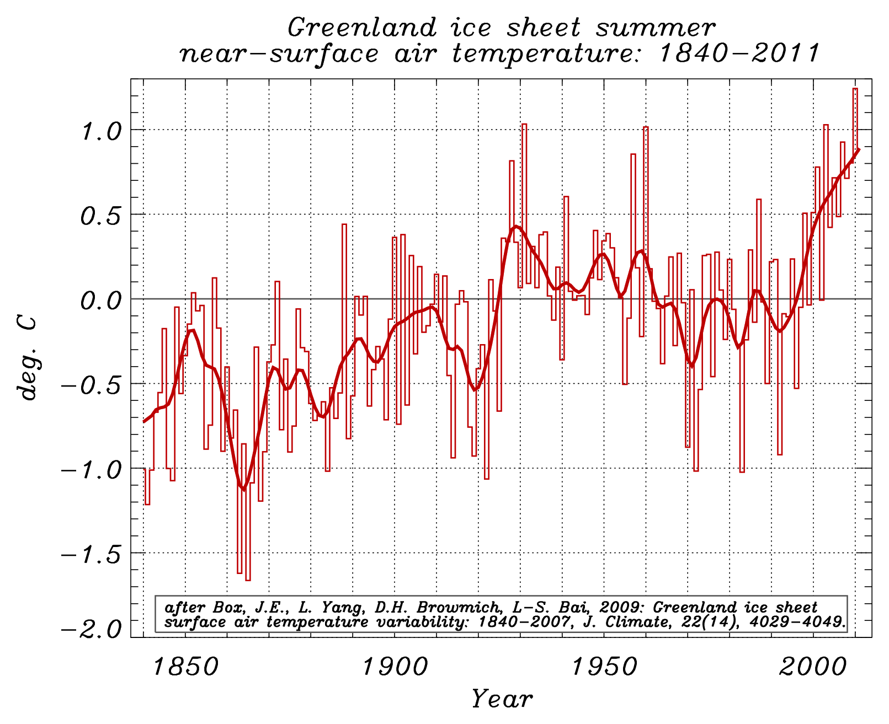
Land-Ice Loss due to net surface melt - SMB
July 8, 2012
July 12, 2012
Box et al. 2009 - extended
(Source http://www.nasa.gov/topics/earth/features/greenland-melt.html)

Slide 6
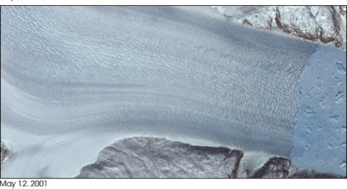
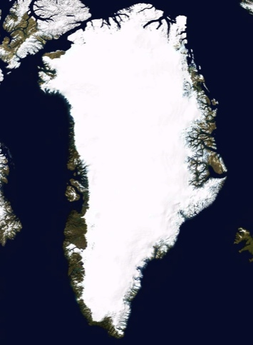
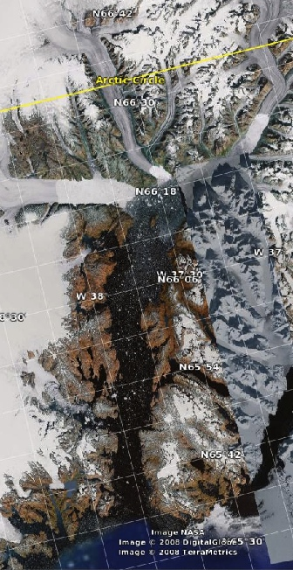
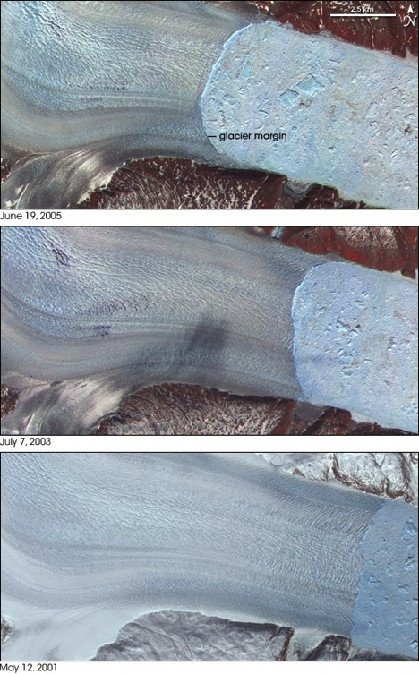
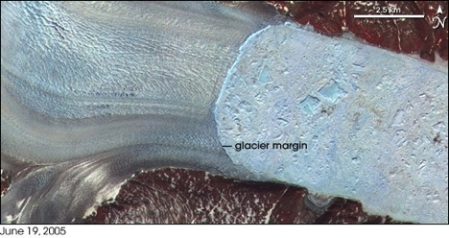
Dynamic Mass Loss due to Marine Terminating Glacier Retreat
2001
Glacier
Helheim Glacier
Ocean
2003
2006
Sermilik Fjord
Rignot et al. 2008
Thinned 700 feet
Doubled its speed
Retreated 4.5 miles
Stearns and Hamilton 2007; Howat et al., 2007; van den Broeke et al. 2009

Slide 7

DYNAMIC ICE LOSS
GRISO Working Group
Synthesis – State of Knowledge
White Paper – Straneo et al 2012
BAMS Arcticle – Straneo et al. 2013
International Workshop, June 2013
Multidisciplinary, early career, discussion of how to move forward
Workshop Report
Recommendations on how to move forward
(Heimbach et al. 2014)

Slide 8
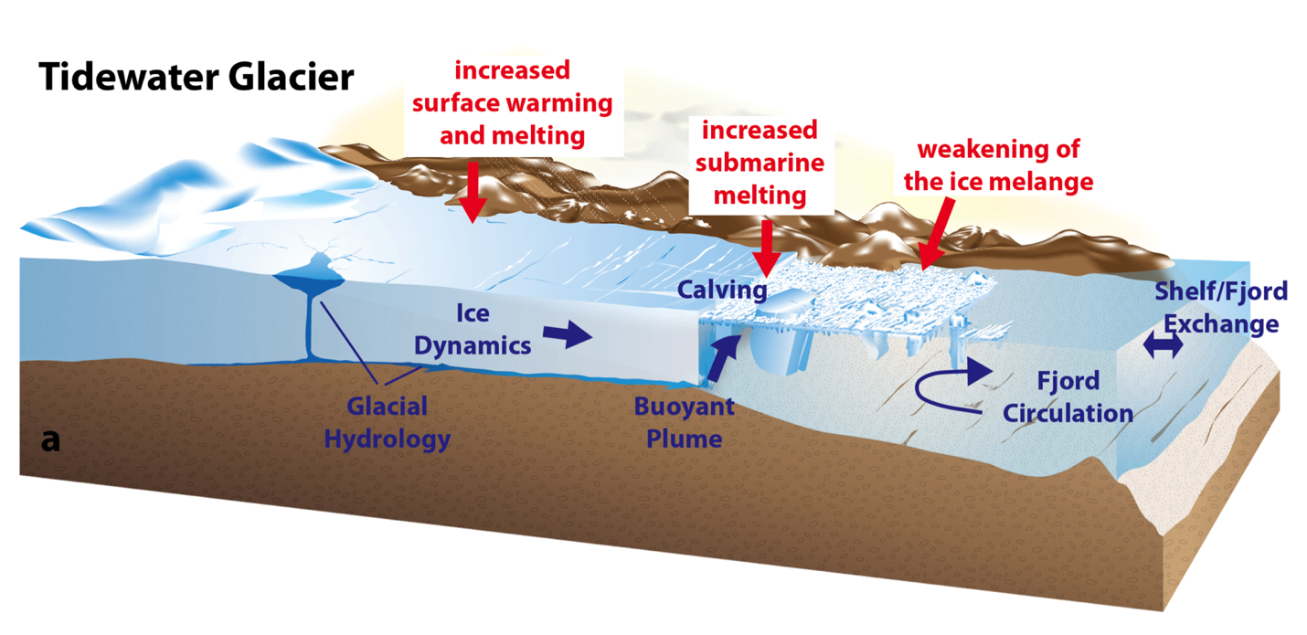
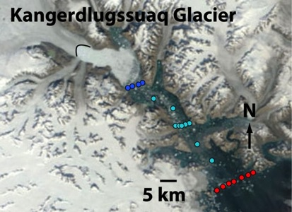
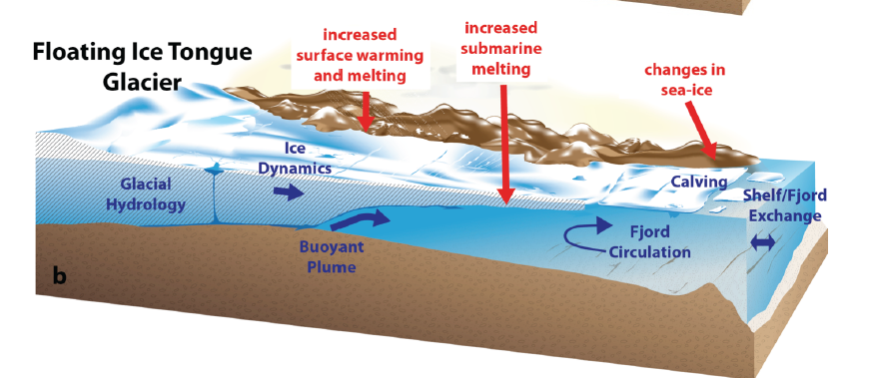
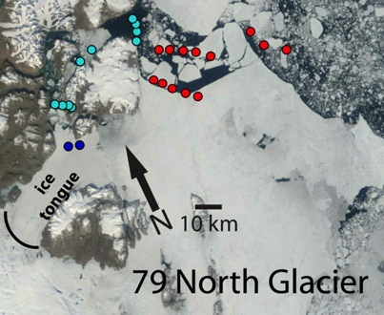

Slide 9
DYNAMIC ICE LOSS
GRISO Recommendations
Megasite Experiments
(a few targeted sites, study of interaction of components)
GrIOOS
Greenland Ice Ocean Atmosphere Observing Network
Targeted Process Studies
(e.g. submarine melting, calving, subglacial hydrology)
Greenland Database
(including bottom topography)

Slide 10
LAND ICE LOSS IMPACTS
Sea Level Rise
Regional and global communities
Ocean freshening
Regional, global circulation, ecosystems, sea-ice formation
Increasing Icebergs
Shipping, Military, Oil Drilling
Increasing Runoff
Local Communities and infrastructure

Slide 11
Sea Level Rise
Gravity

Slide 12
Sea Level Rise Prediction
WCRP Grand Challenge
Focus of CLIVAR International, CLIC
Ice Sheet Modeling:
Large number of ice sheet and ice sheet/ocean modeling working groups (e.g. MISMIP, ISMASS, WAGOM, ESM-ISMIP)

Slide 13
SEARCH: Understanding of Arctic Land-Ice Change and its impact
Development of observational nodes (GrIOOS, Megasite)
Site Choice
Measurement goals and technology development
Integration with existing networks (DMI, GEUS AWS, GNET, GCNET, Ocean Observing Systems)
Coordination of an international efforts

Slide 14
SEARCH: Understanding of Arctic Land-Ice Change and its impact
Development of observational nodes (GrIOOS, Megasite)
2. Database for Arctic Land Ice change
Data coordination, archive, distribution across all ocean ice Arctic instrument sites
Integration with international partners

Slide 15
CLIVAR
CLIC
IARPC
GRISO
International
SEARCH
Land-Ice
Working Groups
Workshops

